Slide 1
Important people who contrubute to democracy in my country
Vojin Dimitrijevic

Slide 2
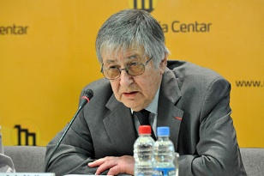
Vojin Dimitrijevic

Slide 3
Who was Vojin Dimitrijevic?
a law professor, public intellectual, and a prominent Serbian human rights activist and international law expert.
Professor Dimitrijević was for many years the director of the Belgrade Centre for Human Rights, a member of the Institut de droit international, received honorary doctorates in law from McGill University and the University of Kent, and was a chevalier of the French Legion of Honour.

Slide 4
From 2000 he was a member of the Venice Commission on Democracy through Law of the Council of Europe, while from 2001 he was a member of the Permanent Court of Arbitration in The Hague. He was a commissioner of the International Commission of Jurists from 2003, and from 2006 a member of its executive committee. He was also a member and a vice-chairman of the UN Human Rights Committee (1983–1994), and served as an ad hoc judge on the International Court of Justice (2001-2003).

Slide 5
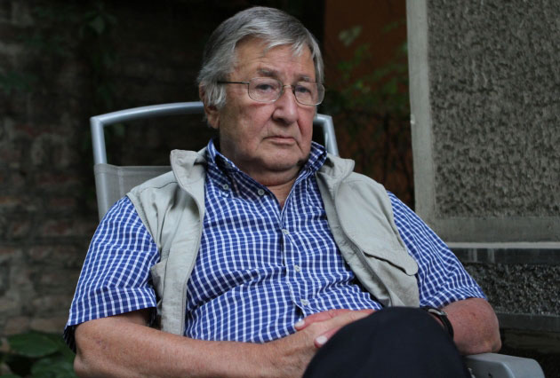

Slide 6
They told about him...
https://pescanik.net/vojin-dimitrijevic-sloboda-i-nezaborav/
https://www.blic.rs/vesti/drustvo/preminuo-vojin-dimitrijevic/gpzlsv9

