Slide 1
“Aurel LazĂr” – one of the most energetic supporters of the Romanian national cause
Student: Anasteh Natalia
Teacher: Urs Marcela
High School: “Traian Vuia” Oradea, Romania
Class: X-C

Slide 2
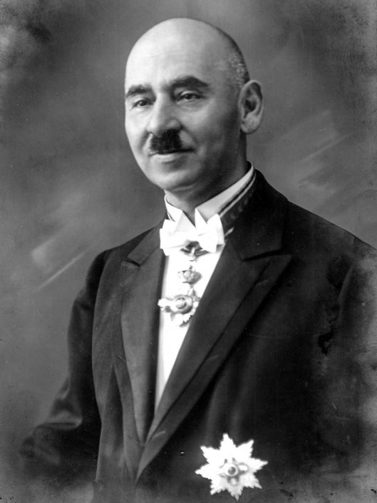
-Life-

Slide 3
Romanian nationality
Born August 5, 1872, Oradea
Deceased November 18, 1930, Oradea, Bihor County
Tomb in Oradea, Bihor County
Occupation: lawyer, politician
Orthodox religion
Married to Valeria Fejer
Parents: Theodore and Iulia (Iuliana)
Child: Liviu

Slide 4
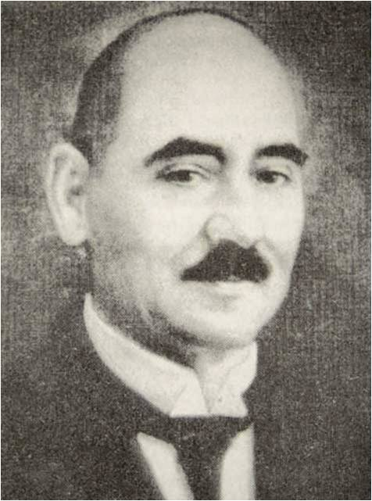
-Studies-

Slide 5
The gymnasium and lyceum studies finished at the Premonstratens High School in Oradea in 1890, and then enrolled at the Royal Academy of Law in Oradea. For three years she studied at this institution, benefiting from a scholarship from the Elena Foundation, Birta and Ghiba and another scholarship from the Gojdu Foundation.
In January 1896 he obtained his PhD in law from the University of Budapest, and on June 30, 1897, he enrolled in the lawyer's entrance exam. He has opened a private office in Oradea, for which his associate, lawyer Vasile Bledea has long dealt with.

Slide 6
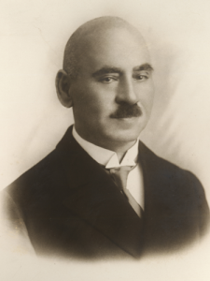
-First World War-

Slide 7
The outbreak of World War I meant for Aurel Lazar, as for all Transylvanian Romanian leaders, a permanent harassment on the part of the authorities. He was mobilized and deconcentrated repeatedly and persecuted for refusing to sign loyalty commitments to the Austro-Hungarian monarchy. As a member of the Synod of Arad, he drafted the protest against the establishment of the "cultural area", which seriously affected the autonomy of the Romanian School and Church. At the end of the war, Lazar seized the favorable moment and directly involved in the efforts to achieve the Great Union.

Slide 8
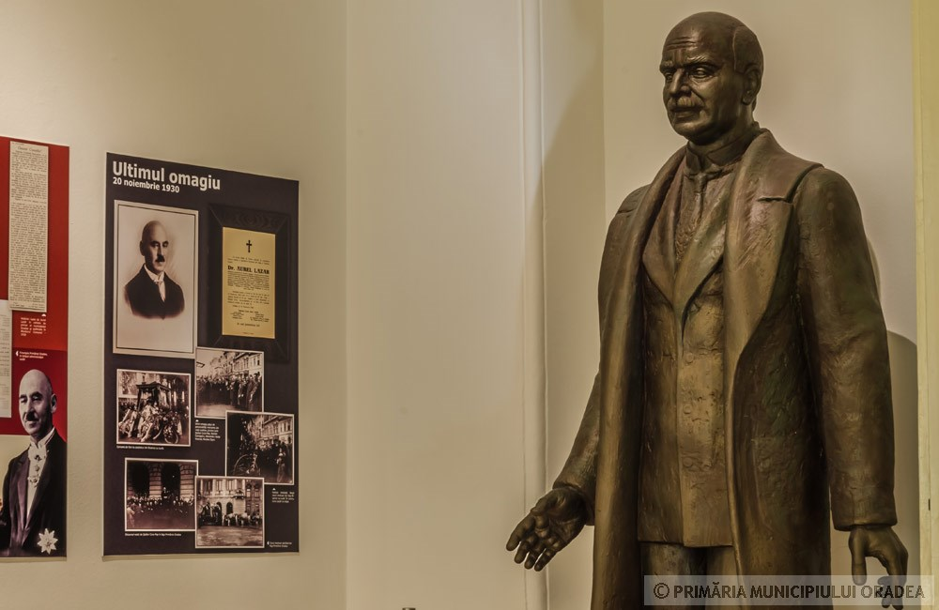
-Artisan of the Union-

Slide 9
He was one of the six PNR delegates who, together with six other delegates from the Social Democrats, formed on 29 October the Central Romanian National Council, set up in Budapest and then moved to Arad. On November 3, he establishes the Romanian National Council in Oradea and Bihor, which leads to the Great Union.

Slide 10
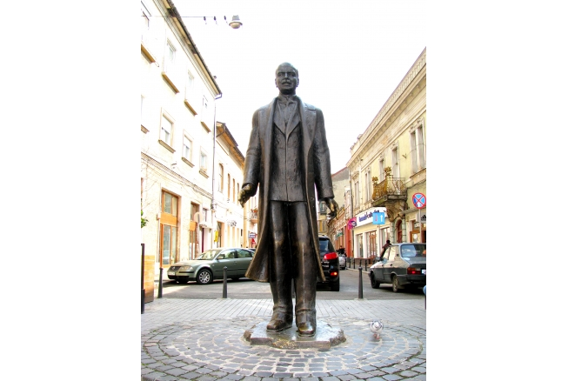
-The death-

Slide 11
He died in Oradea on November 18, 1930, at the age of 58.

