Slide 1
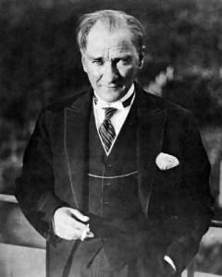
ATATURK AND DEMOCRACY

Slide 2
The greatest war is the war against ignorance

Slide 3
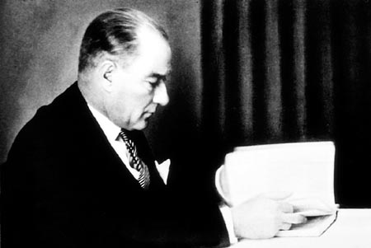

Slide 4
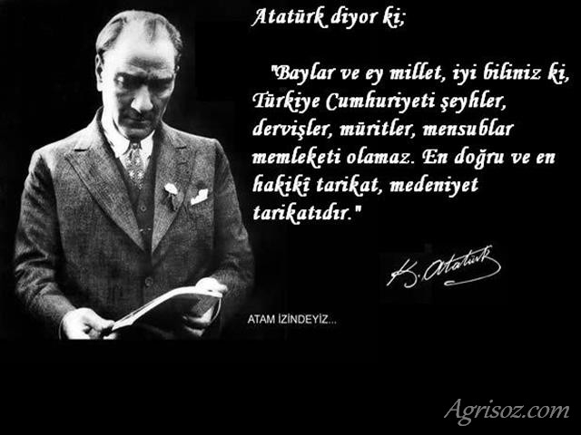
Do not be afraid of telling the truth

Slide 5
We are a nation born spiritually democrat

