Slide 1
The History Of Democracy in my Country
Student: Șandor Cătălina
Technical college “ Traian vuia” Oradea, Romania

Slide 2
The First Constitution of Romania
The 1866 Constitution of Romania was the fundamental law that capped a period of nation-building in the Danubian Principalities, which had united in 1859.
Drafted in a short time and using as its model the 1831 Constitution of Belgium, then considered Europe's most liberal, it was substantially modified by Prince (later King) Carol and adopted by the Constituent Assembly. The newly installed Prince then promulgated it on 13 July 1866.
This was done without input from the major powers, including the Ottoman Empire, which still had formal sovereignty over Romania.

Slide 3
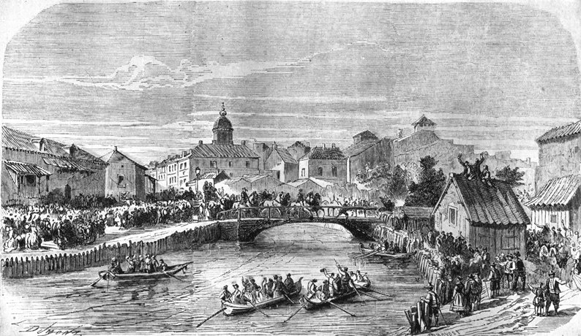
The arrival of Carol I in Bucharest(10th of May 1866)

Slide 4
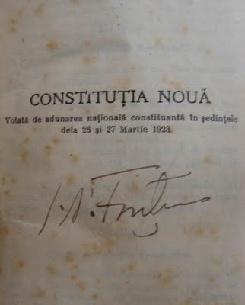
The Second Constitution of Romania, 1923
The 1923 Constitution of Romania, also called the Constitution of Union, was intended to align the organisation of the state on the basis of universal male suffrage and the new realities that arose after the Great Union of 1918.

Slide 5
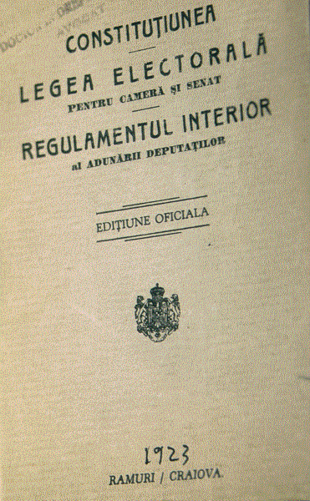
Regarding state organisation, legislative power was entrusted to Parliament (Senate and Assembly of Deputies) and the King; executive power to the King, who delegated it to the Council of Ministers; and judicial power to the central and local judicial organs. The right to vote was expanded beyond the 1866 regulations: it was universal for all males, equal, direct, compulsory and secret, based on majority representation.

Slide 6
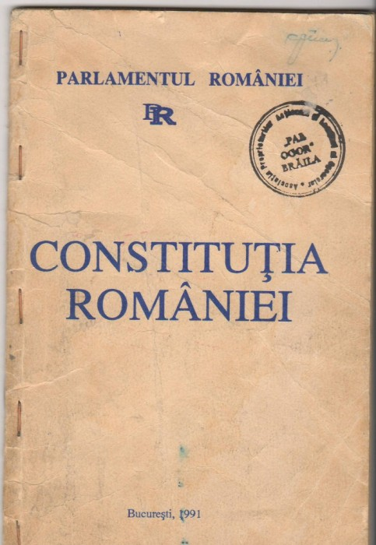
The current Constitution of Romania

Slide 7
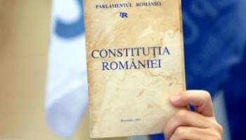
The current Constitution is the fundamental governing document of Romania that establishes the structure of its government, the rights and obligations of citizens, and its mode of passing laws.

Slide 8
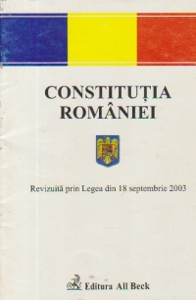
It was adopted on 21 November 1991 and approved on 8 December 1991 in a national referendum and promulgated on the same day. The constitution was amended once by a referendum on 18 October 2003. The new text took effect on 29 October 2003.

Slide 9
A proposed second revision
The issue of constitutional reform was raised repeatedly in the early 2010s, especially after a major political crisis in the second half of 2012. The ruling coalition at the time, the Social Liberal Union, claimed that insufficient constitutional constraints led then-incumbent President Traian Basescu to abuse his presidential powers, thus justifying new amendments.
Băsescu's successor, Klaus Iohannis, expressed support for a second revision of the Constitution.

Slide 10
Thanks for watching!

