Slide 1
Nicolaie Titulescu – a prominent Romanian
4 March 1882 – 17 March 1941
Student: Cătălan Carla
”Traian Vuia” Technical College, Oradea, Romania

Slide 2
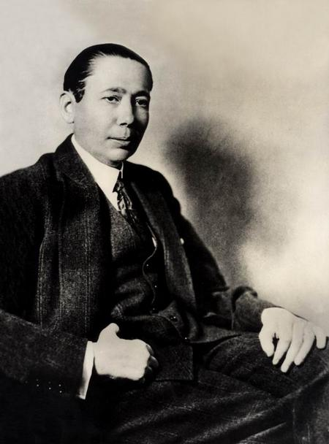
Nicolae Titulescu (Romanian pronunciation: [nikoˈla.e tituˈlesku]; was a Romanian diplomat, at various times government minister, finance and foreign minister, and for two terms President of the General Assembly of the League of Nations (1930–32).

Slide 3
Early years
Nicolae Titulescu was born in Craiova, the son of a solicitor. He grew up at his father's estate in Titulești, a commune in Romania that was later named after him. Upon graduating with honours in 1900 from the Carol I High School in Craiova, Titulescu studied law in Paris, obtaining his doctorate with the thesis Essai sur une théorie des droits éventuels. In 1905, Titulescu returned to Romania as a professor of law at the University of Iași, and in 1907 he moved to Bucharest.

Slide 4
Political career
Beginning in 1921, Titulescu functioned as the permanent representative of Romania to the League of Nations in Geneva. He was chosen twice (in 1930 and 1931) to be the president of that organization.
Following the Romanian elections of 1912, he became a parliamentarian with the Conservative-Democrat Party led by Take Ionescu, and five years later he became a member of the government of Ion I. C. Brătianu as Minister of Finance.

Slide 5
Political career
In the summer of 1918, together with other prominent Romanians (Take Ionescu, Octavian Goga, Traian Vuia, Constantin Mille), Titulescu formed, in Paris, the National Romanian Committee, with the purpose of promoting in international public opinion the right of the Romanian people to national unity, the committee being officially recognised as the plenipotentiary de facto organ of the Romanian nation.

Slide 6
Political career
Beginning in 1921, Titulescu functioned as the permanent representative of Romania to the League of Nations in Geneva. He was chosen twice (in 1930 and 1931) to be the president of that organization. In this capacity, he fought for the preservation of stable borders through the maintenance of peace, for good relations between both large and small neighboring states, for the respect of the sovereignty and equality of all nations in the international community, for collective security, and the prevention of aggression.

Slide 7
Thanks for atenttion!

