Slide 1
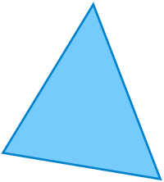
Triangle Quiz
Answers from Ukrainian team

Slide 2
Question 1
If a triangle has three unequal sides it is a ______ triangle. Answer is: scalene triangle
A triangle which has three equal angles is a ______ triangle.
Answer is: equiangular
Question 2

Slide 3
Question 3
A triangle with (at least) two equal sides is a ______ triangle.
Answer is: isosceles
Question 4
Two triangles that are equal are called ______ triangles
Answer is: congruent

Slide 4
A triangle with all three sides of equal length is a ______ triangle.
Answer is: equilateral
Question 5
Question 6
A triangle with an angle of 90° is a ______ triangle.
Answer is: right

Slide 5
A triangle in which all three angles are less than 90° is a ______ triangle.
Answer is: acute
Question 7
Question 8
A triangle in which one of the angles is greater than 90° is a ______ triangle.
Answer is: obtuse

Slide 6
Question 9
What is the Hypotenuse of a right triangle?
Answer is: the side opposite the right
Question 10
The Pythagorean Theorem states …
Answer is: a²+b²=c²

Slide 7
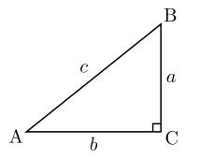
Question 11
Use the Pythagorean Theorem to solve the following:
a = 5
b = 12
c = ?

Slide 8
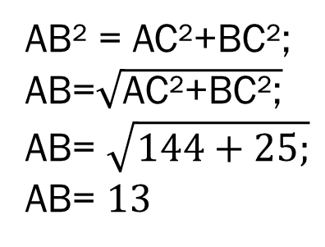
AB² = AC²+BC²; AB=$\sqrt{\text{AC}\text{²+}\text{BC}\text{²;}}$ AB= $\sqrt{144+25;}$ AB= $13$

Slide 9
Thank you for the tasks that you’d prepared☺

