Slide 1
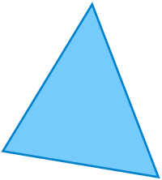
Triangle Quiz
Please complete
the following quiz

Slide 2
Question 1
If a triangle has three unequal sides it is a ______ triangle.
A) Scalene
B) Obtuse
C) Isosceles
Question 2
A triangle which has three equal angles is a ______ triangle.
A) Acute
B) Equilateral
C) Equiangular

Slide 3
Question 3
A triangle with (at least) two equal sides is a ______ triangle.
A) Scalene
B) Isosceles
C) Congruent
Question 4
Two triangles that are equal are called ______ triangles
A) Acute
B) Obtuse
C) Congruent

Slide 4
A triangle with all three sides of equal length is a ______ triangle.
A) Equilateral
B) Right
C) Equiangular
Question 5
Question 6
A triangle with an angle of 90° is a ______ triangle.
A) Acute
B) Right
C) Congruent

Slide 5
A triangle in which all three angles are less than 90° is a ______ triangle.
A) Right
B) Acute
C) Scalene
Question 7
Question 8
A triangle in which one of the angles is greater than 90° is a ______ triangle.
A) Obtuse
B) Isosceles
C) Acute

Slide 6
Question 9
What is the Hypotenuse of a right triangle?
A) The smallest angle.
B) The side opposite the right
angle.
C) The right angle.
Question 10
The Pythagorean Theorem states …
A) πr²
B) (a+b)²/2=c
C) a²+b²=c²

Slide 7
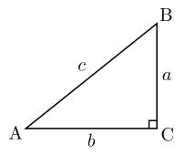
Question 11
Use the Pythagorean Theorem to solve the following:
a = 5
b = 12
c = ?

