Slide 1
Welcome to Poland
Let’s introduce ourself
Witamy w Polsce - poznajmy się

Slide 2
We in Poland My w Polsce
Polish flag
Polish emblem

Slide 3
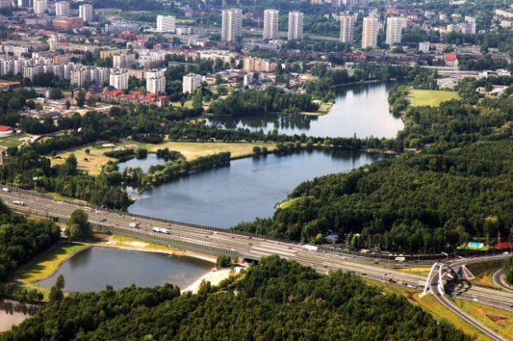
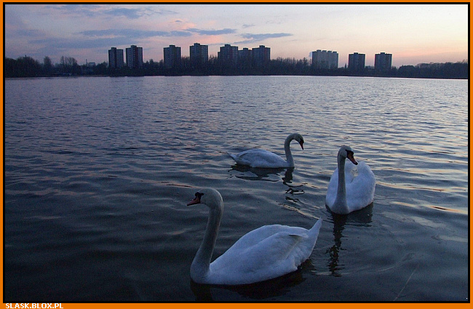
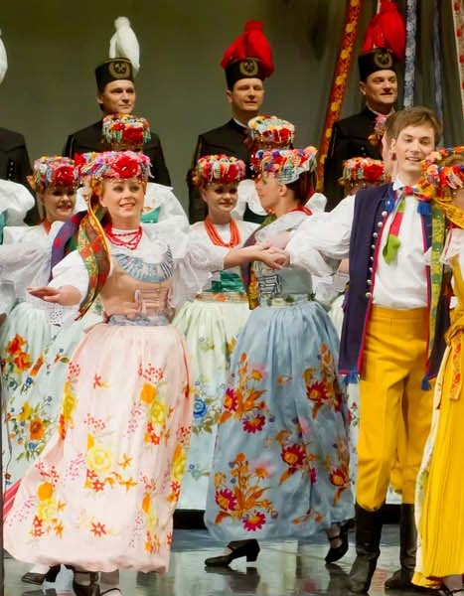
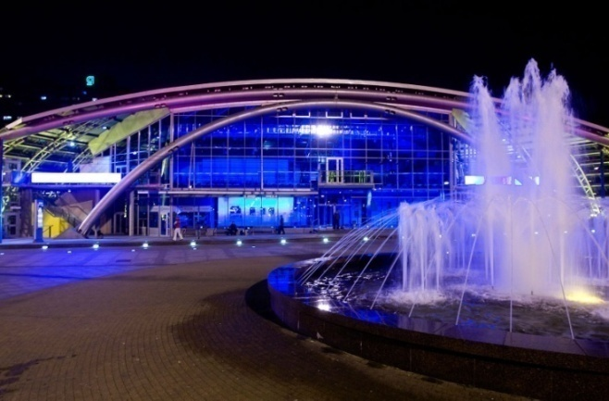
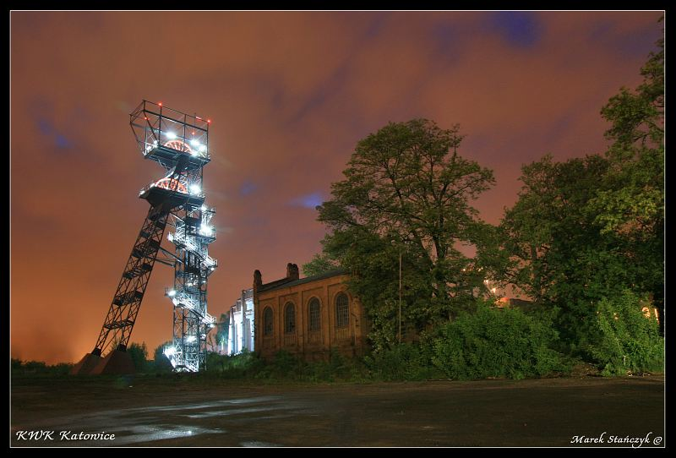
Katowice – this is our city Katowice – nasze miasto

Slide 4
Our kindergarten Nasze przedszkole
our emblem
our classrooms

Slide 5
There are three groups in our kindregarten:
Ladybirds – 6 year old children
– 4 and 5 year old children
Bees – 3 and 4 year old children

Slide 6
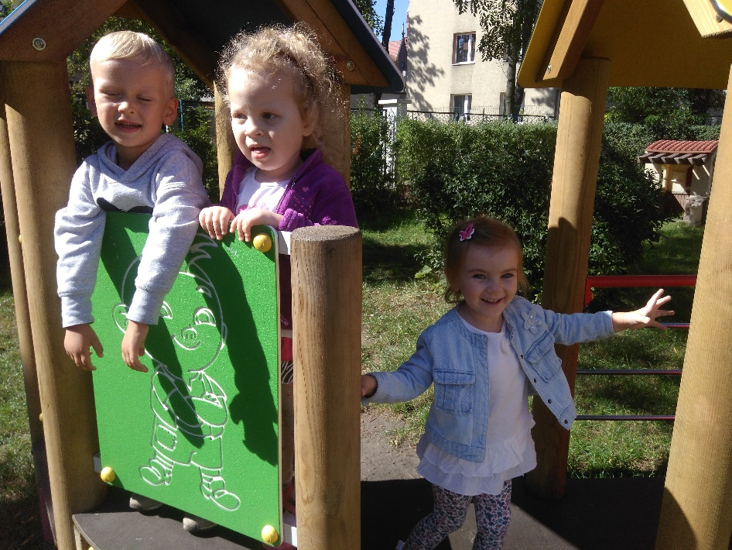
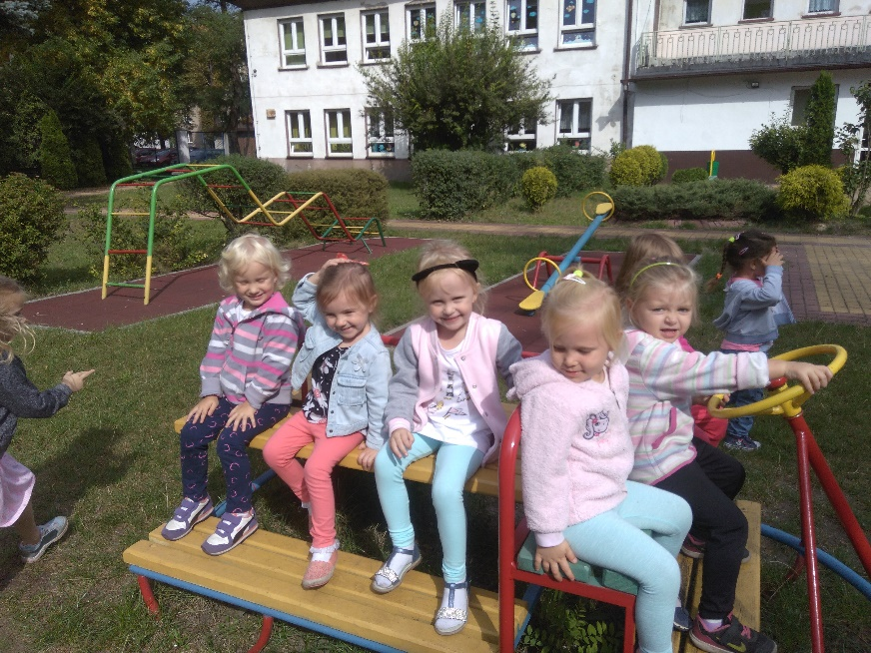
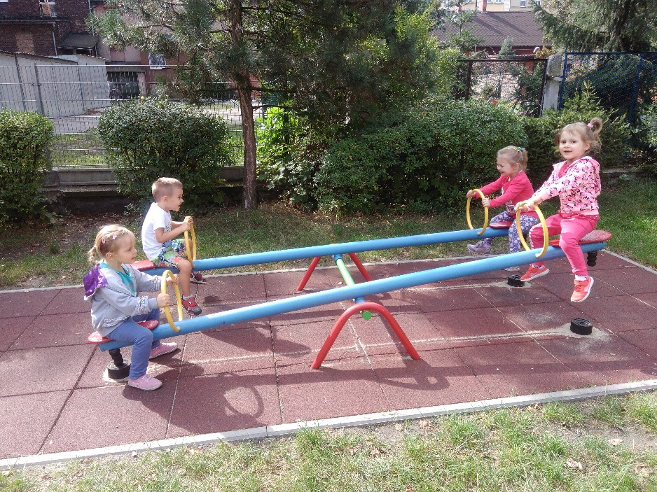
This is our group
Bees
W ogrodzie
In the play- park

Slide 7
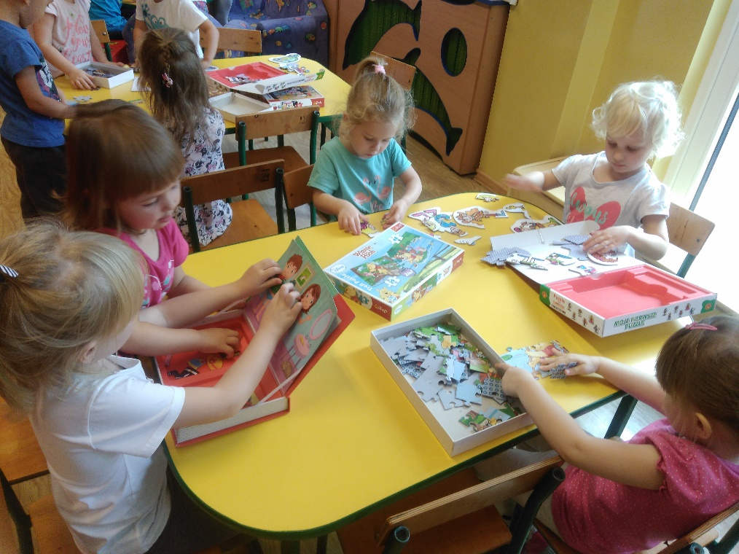
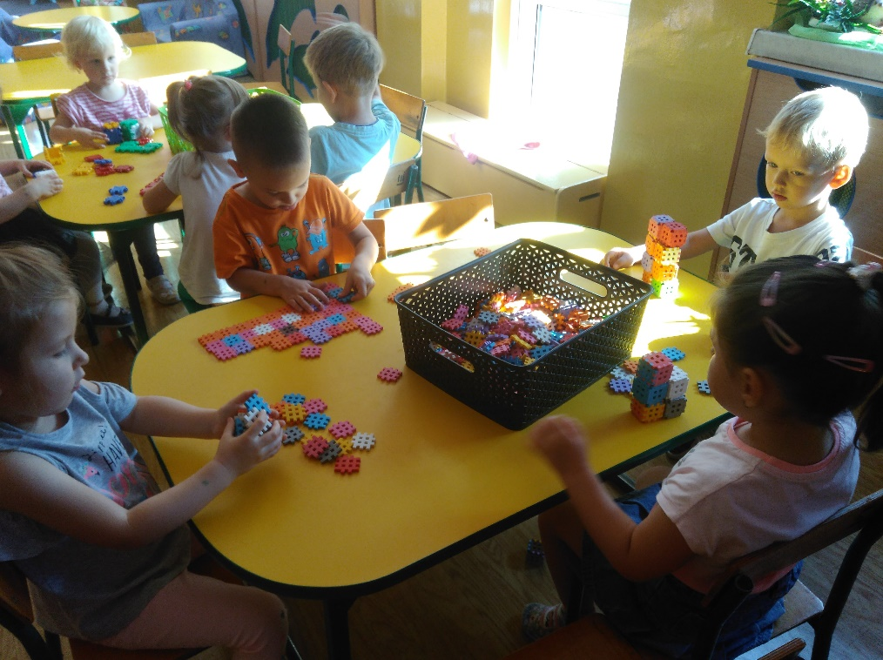
In the classroom W sali

Slide 8
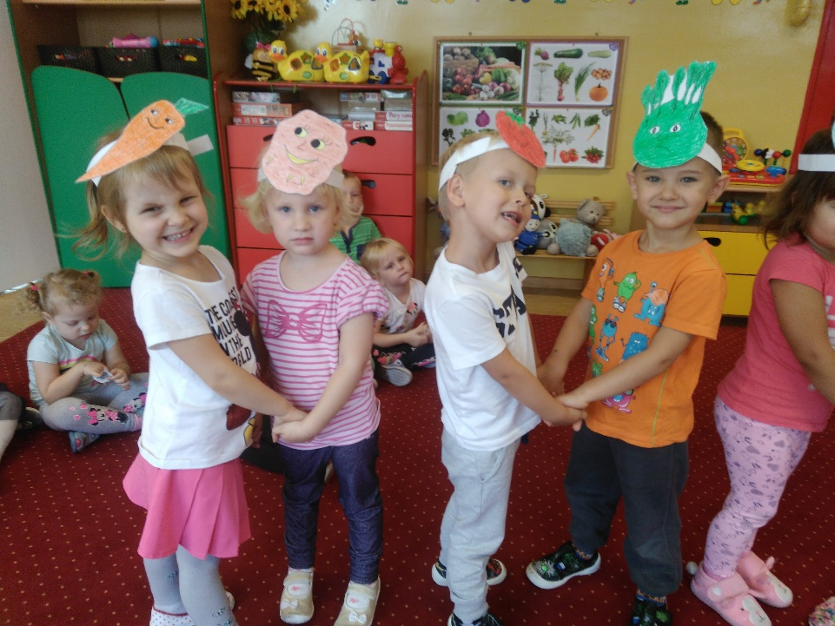
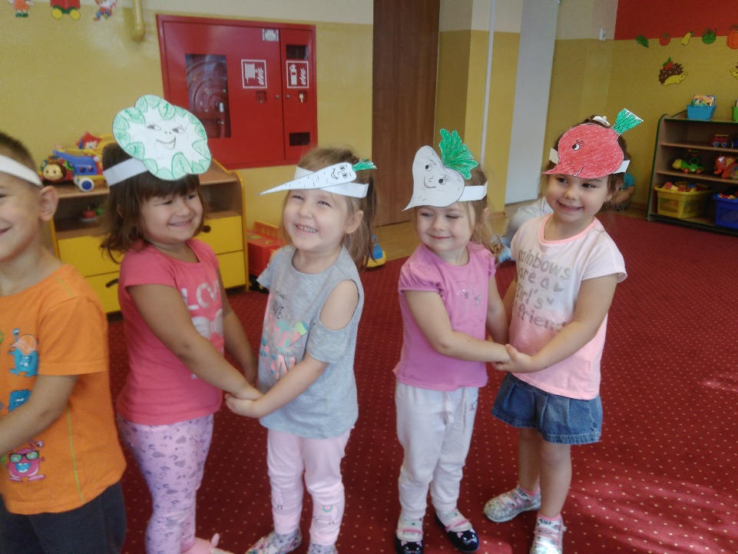

Slide 9
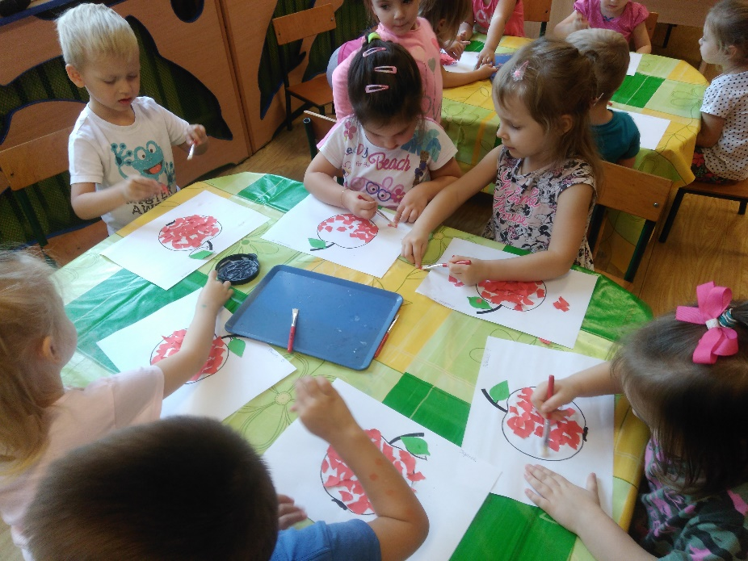
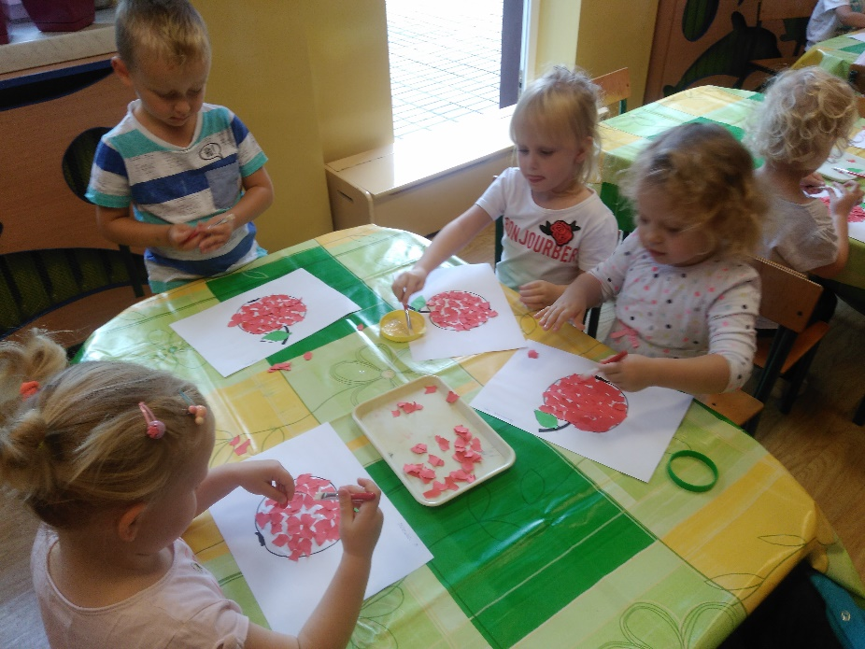

Slide 10
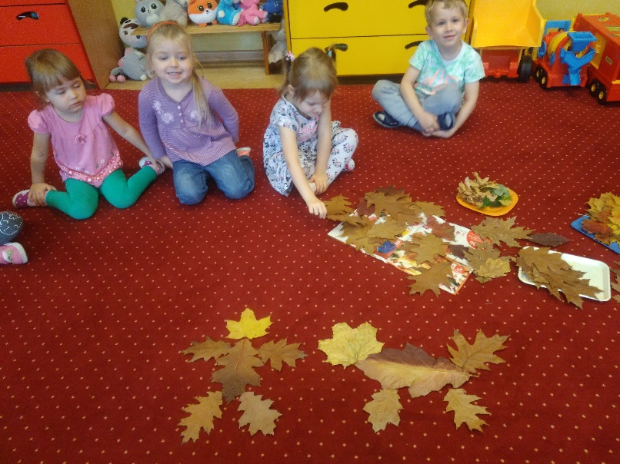
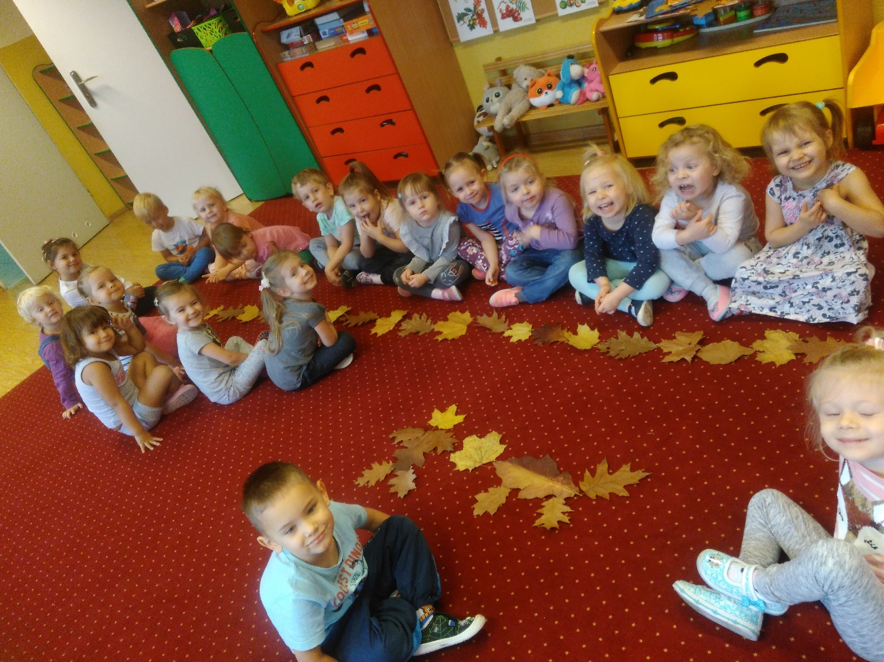

Slide 11
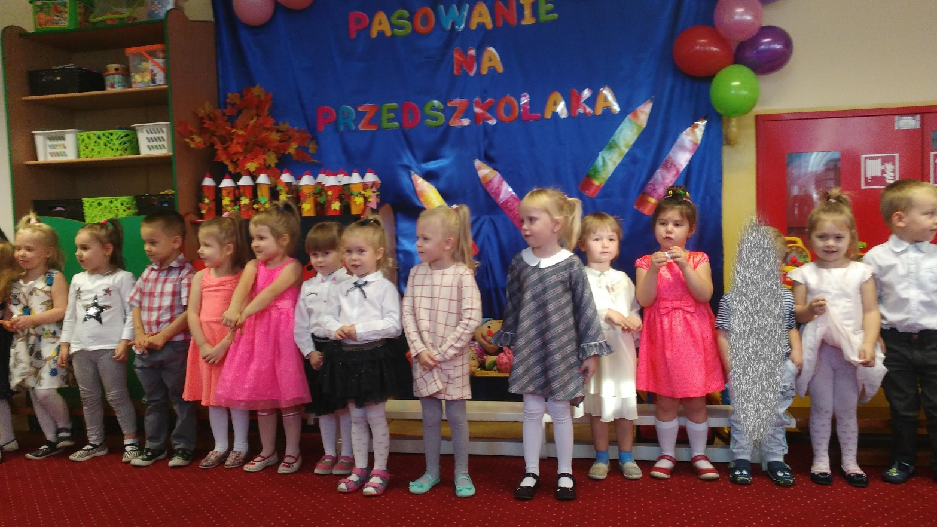
Welcoming party of our preschoolers
Pasowanie na przedszkolaka

Slide 12
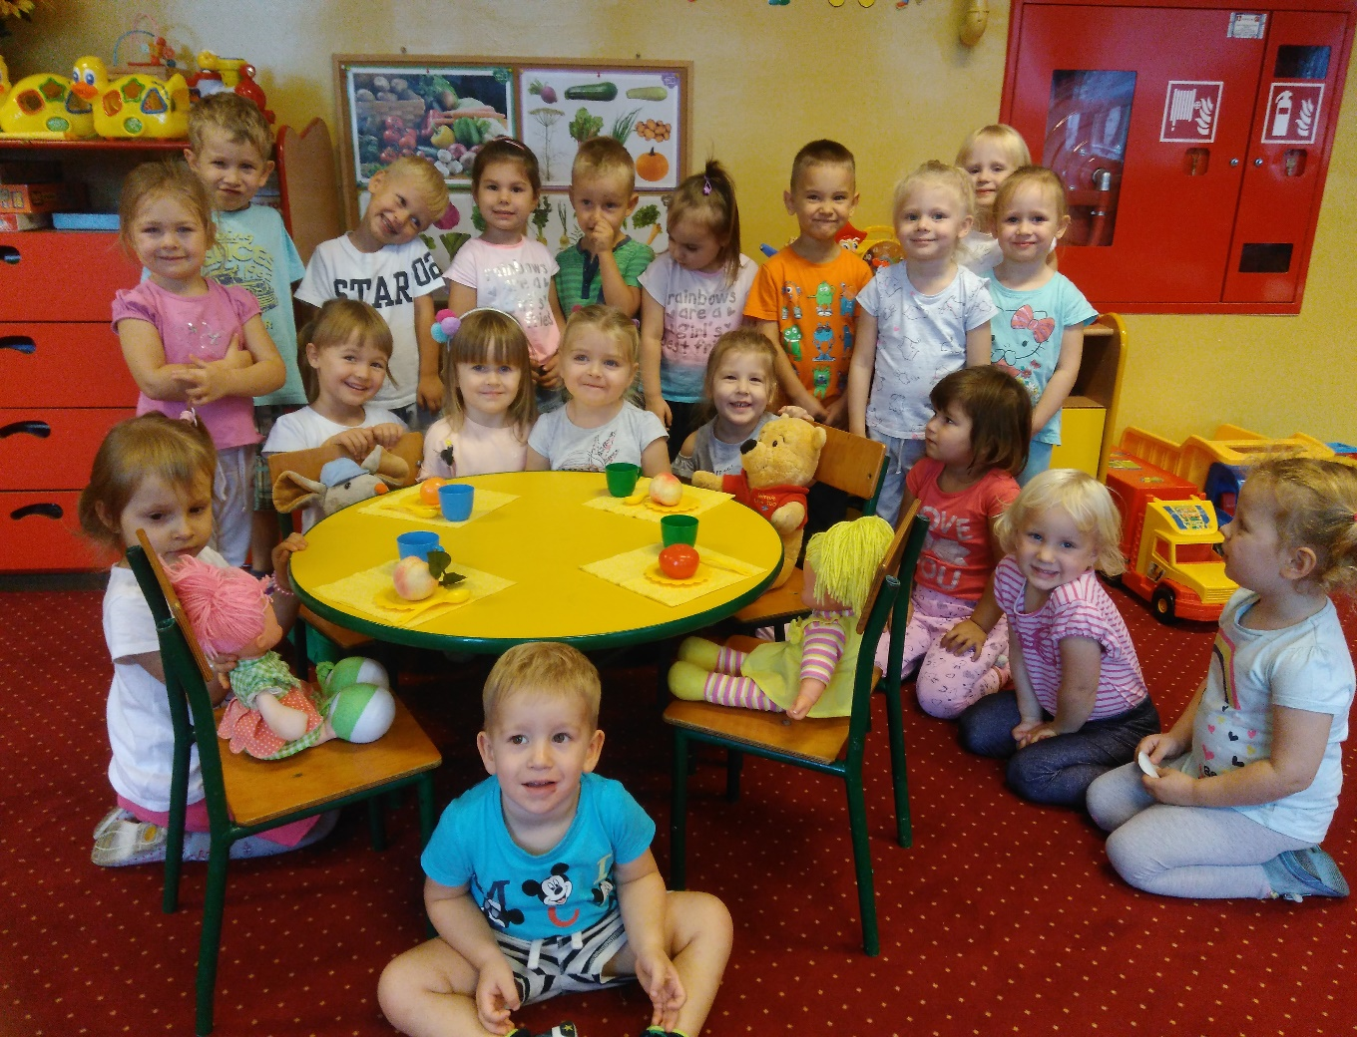
Greetings from poland
Pozdrowienia z Polski

