Slide 1
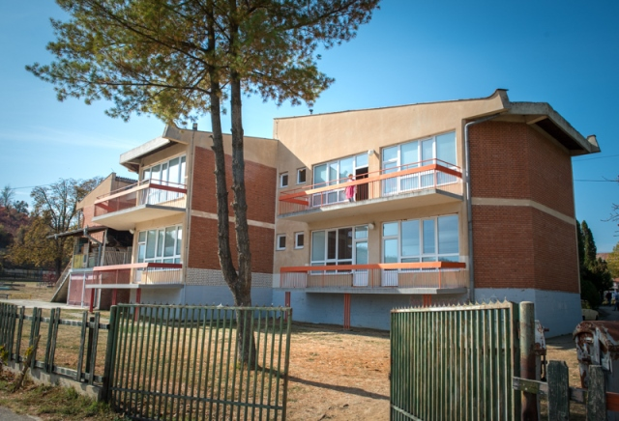
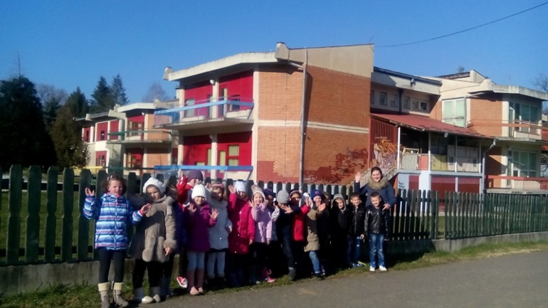
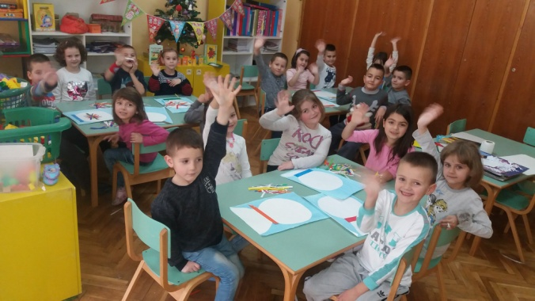
PU Naša radost Aleksandrovac, Serbia

Slide 2
We are from Serbia, Rasina area, from city Zupa Aleksandrovac

Slide 3
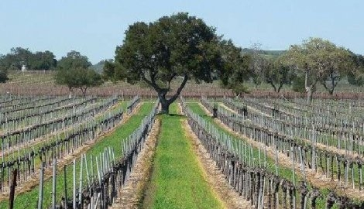
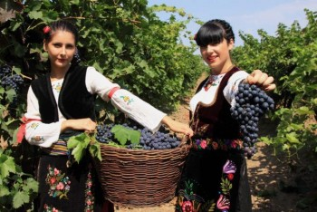
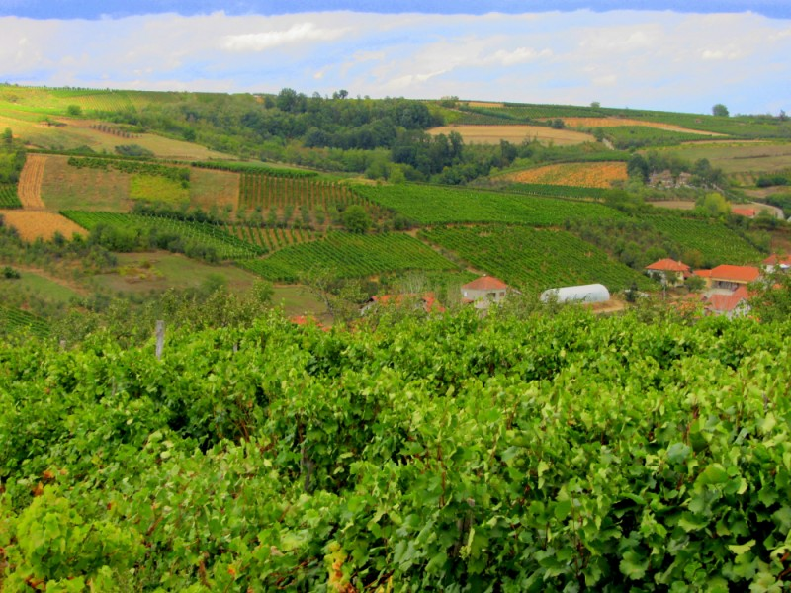
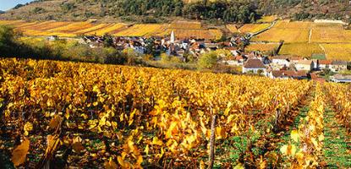
Our place, Zupa, is famous for its beautiful vineyards. Some of the best wines from Serbia are from here

Slide 4
Pre-school education in our city has a long tradition, since from beginning 20st

Slide 5
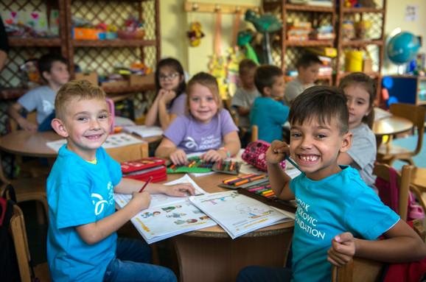
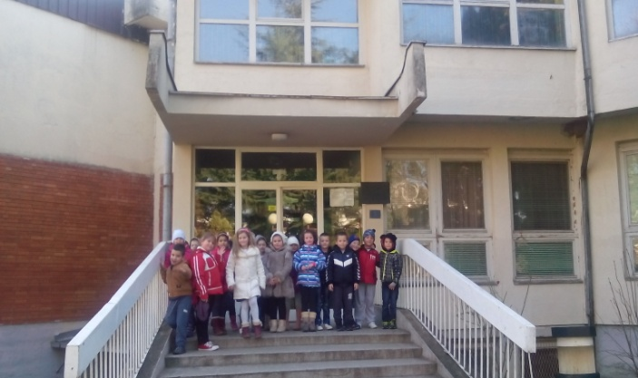
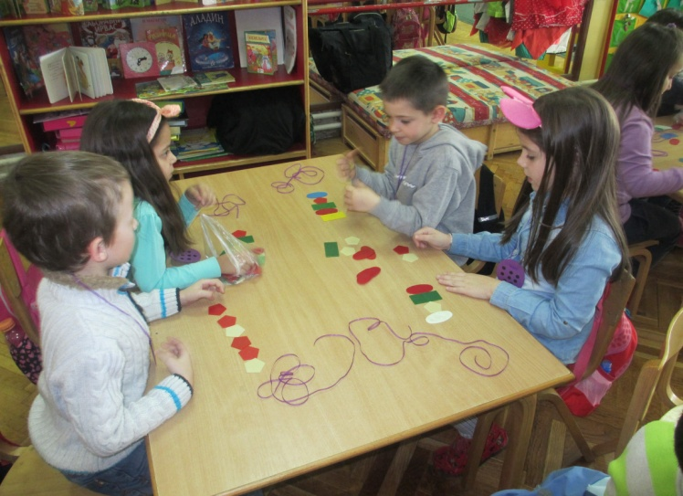
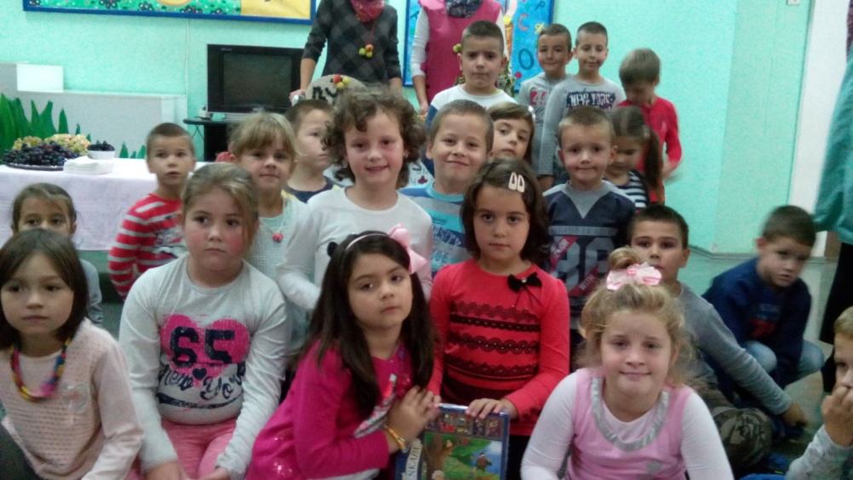
The name of our kindergarten, Nasa radost, means Our joy and this is the place of joy for all children from Zupa

Slide 6
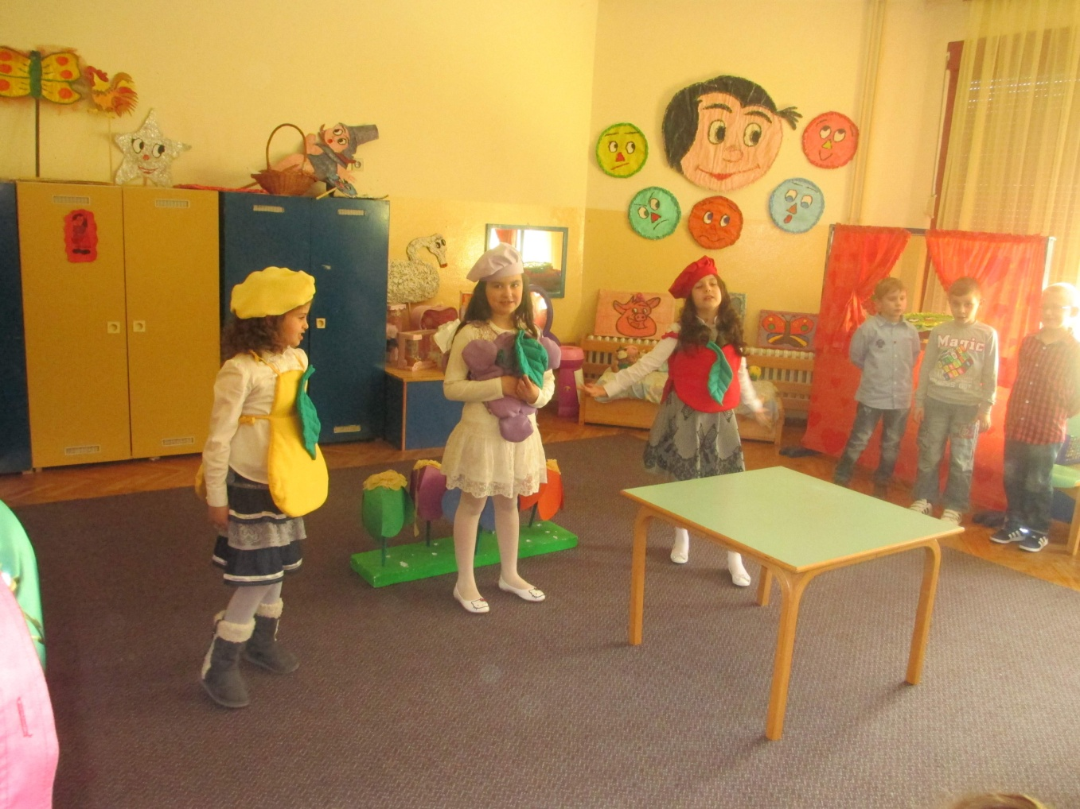
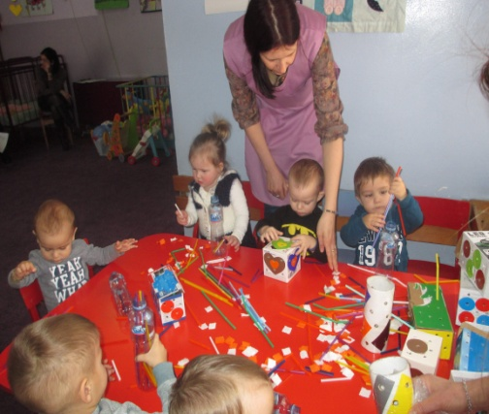
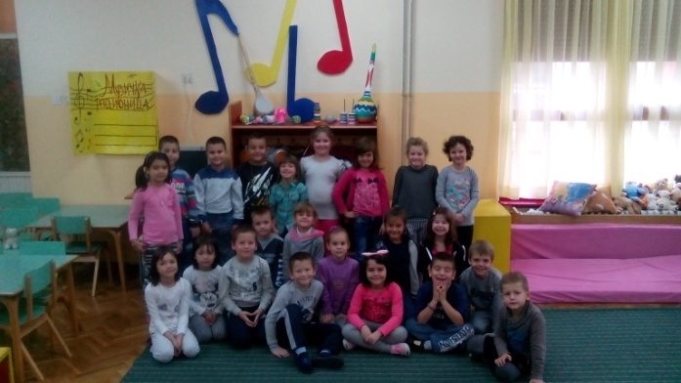
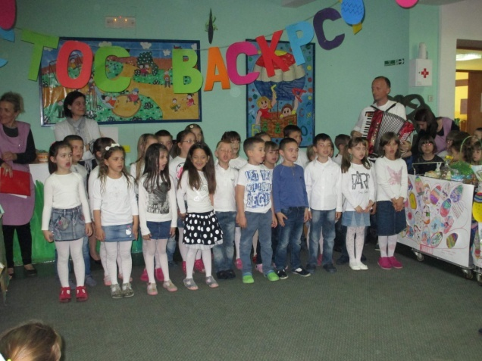
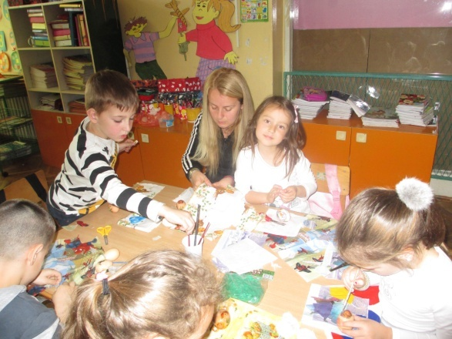
Today, our kindergarten have more than 600 children, 34 groups and 53 preshool teacher

Slide 7
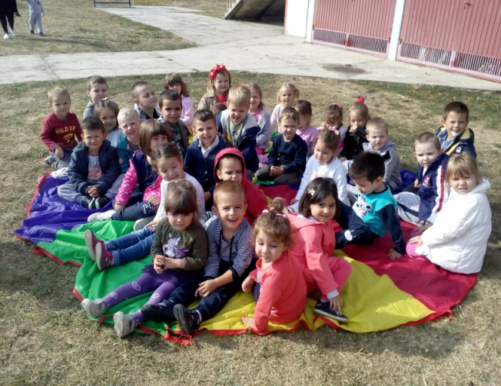
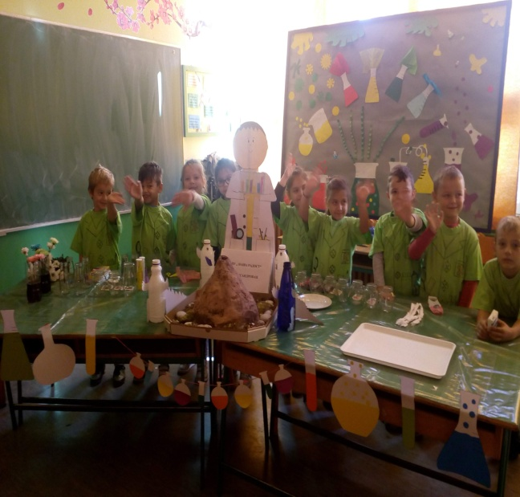
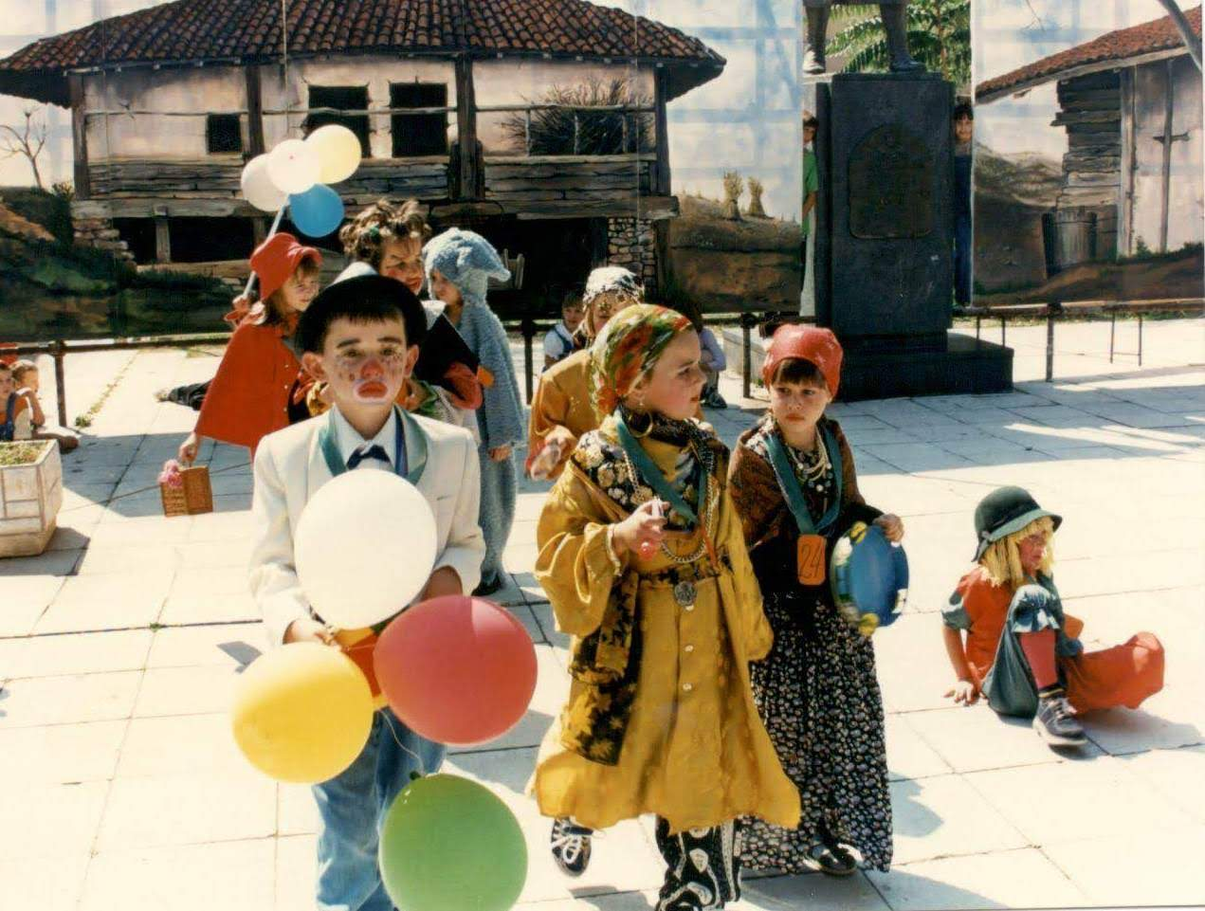
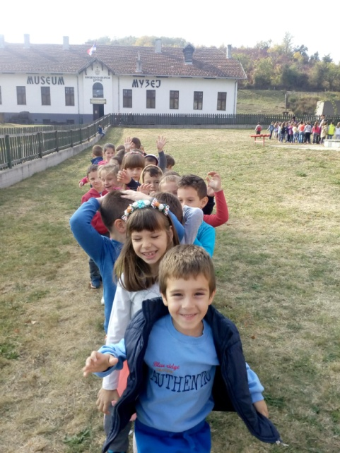

Slide 8
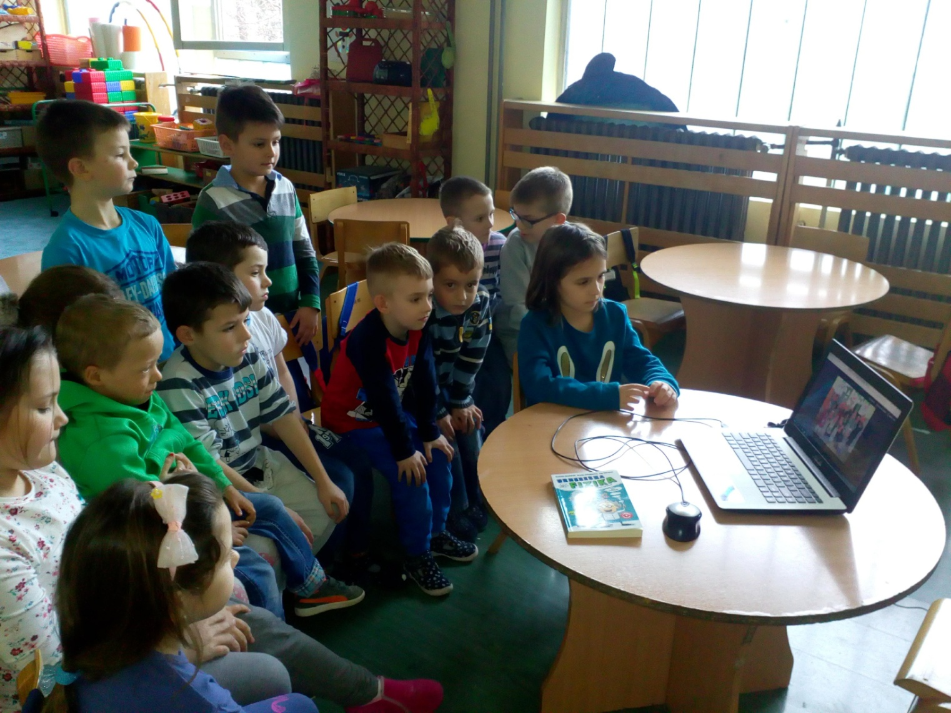
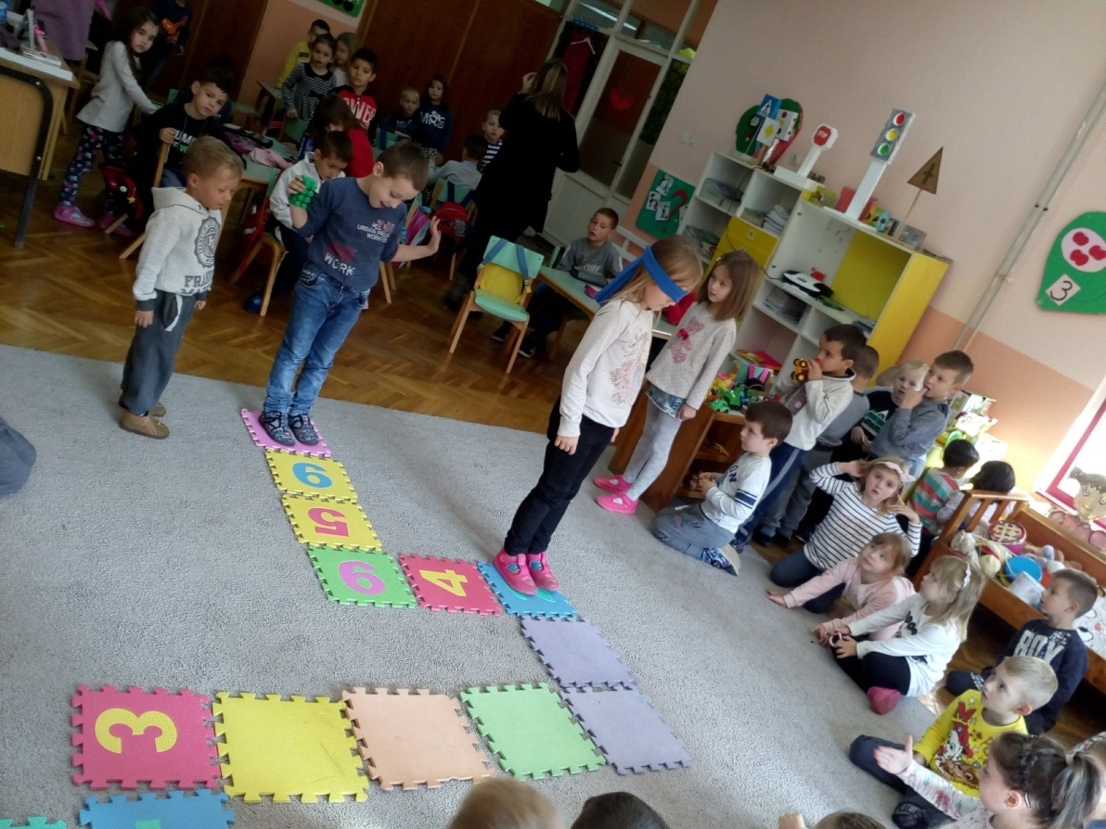

Slide 9
Our mission is that we create learning environments that encourage critical thinking, creativity, problem-solving, communication and collaboration, but also and global awareness, and social responsibility. We keep our Cultural heritage and learn about heritage other countries Etwinning helping us in that We look forward to new projects and new friends!

