Slide 1
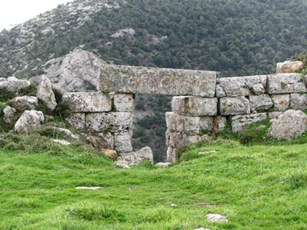
The Fortress of Fili

Slide 2
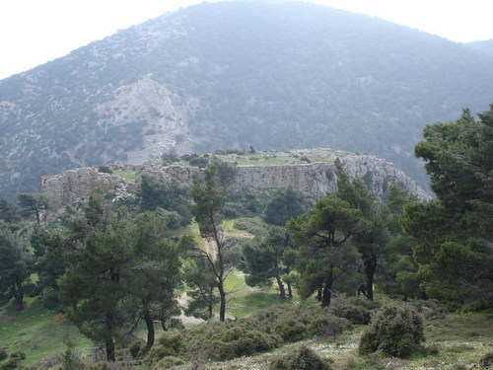
DEFINITION
A FORTRESS, LITERALLY, IS A BUILDING FOR THE STRATEGIC DEFENSE OF AN AREA.

Slide 3
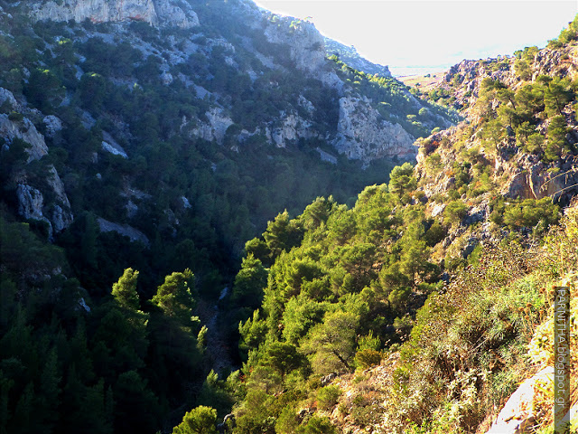
CASTLE LOCATION
The "Castle of Fili" is located at an altitude of 687 meters in West Parnitha, Attica.

Slide 4
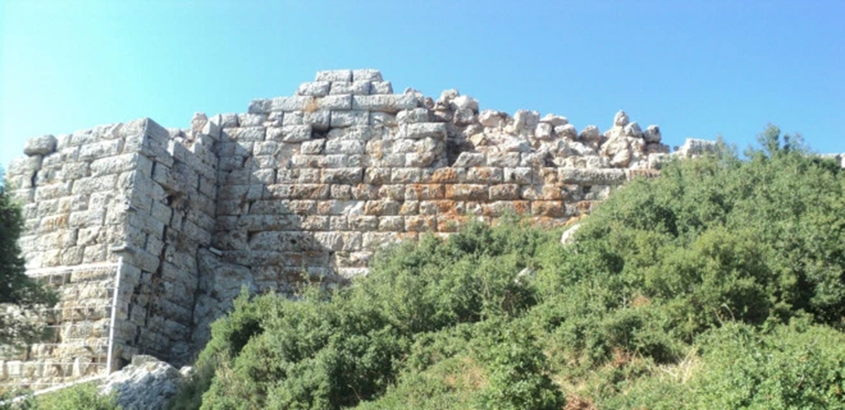
PURPOSE
It controlled the main streets and passages in Attica.
It served as a shelter for the population of the municipalities close to Athens in case of hostile invasion.

Slide 5
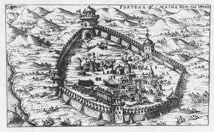
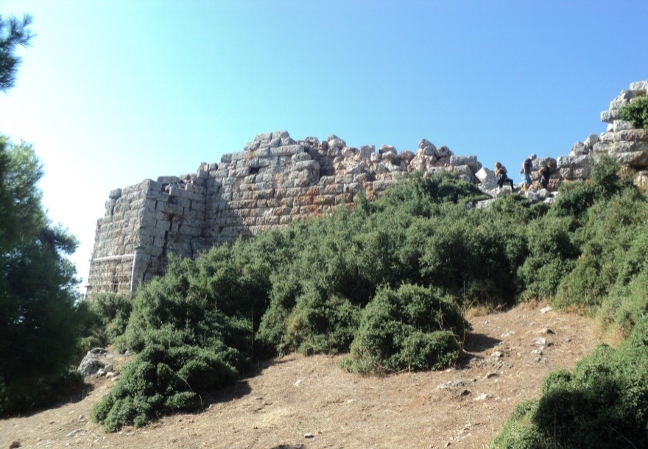
DESCRIPTION
This fort was on a steep rock. The thickness of the outer walls was 2.75m. It had two gates, six square towers and one round. It was supplied by four springs to the north, and had several water storage tanks in the event of siege.

Slide 6
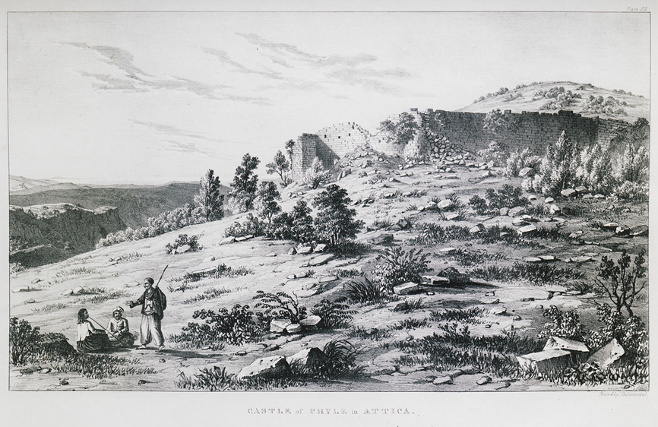
HISTORY
The Fortress of Fili was built in the 5th century BC. Its position was unique, as it controlled the road that bordered Attica with the neighbouring area of Boeotia. The newest fortress of Fili, 4th c. BC, was developed by the Athenians after their defeat in the Peloponnesian War.

Slide 7
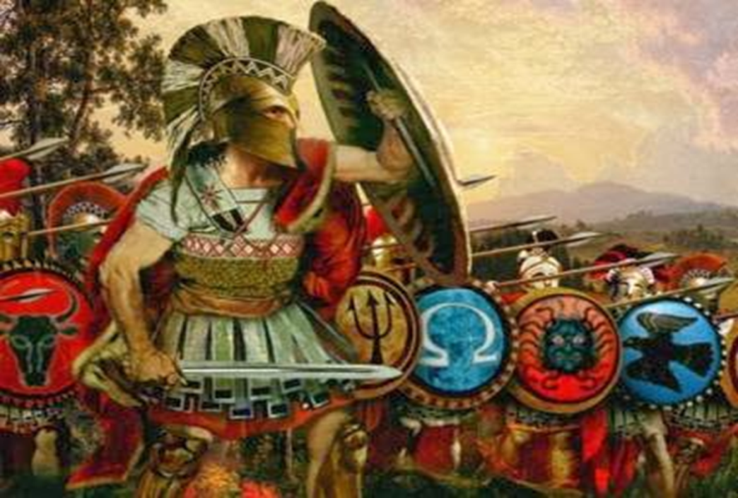
From this castle the resistance against Peisistratos began in the 6th century BC. and because of this, Thrasyvulos was arrested with 70 soldiers who overturned the regime of the Thirty Tyrants and democracy was restored.

Slide 8
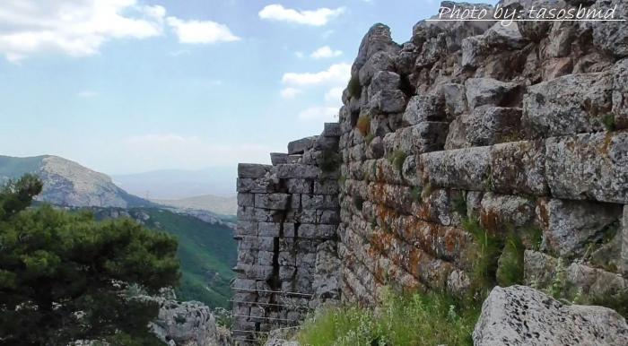
HISTORY EVOLUTION
The fortress was occupied in 304 BC by Demetrios Poliorketis and Kassandros,
After seven years, it was besieged by D. Poliorkitis, remaining in his possession until 283 BC. Since then, there have been no epigraphical or literary testimonies of its fate.

Slide 9
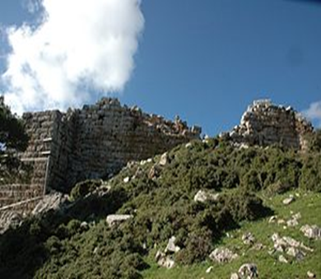
MODERN CULTURE
Τhe habitation of Fili continued in the years that followed the classical era. In addition, there are various fortifications in the hills around the area and during the Ottoman domination. This settlement of was renamed Chassia in 1915.

Slide 10
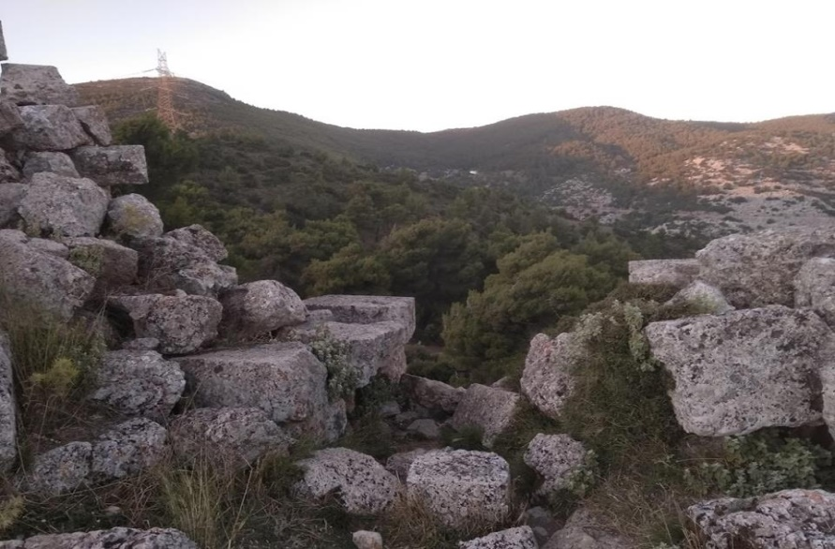
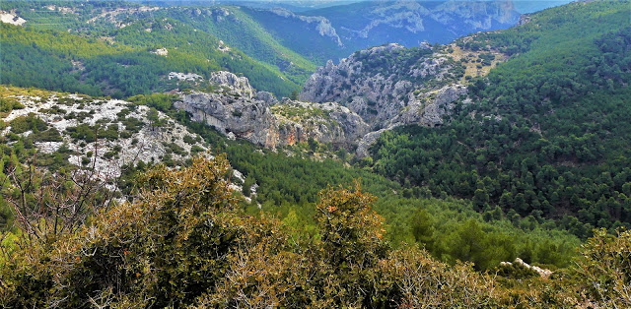
TODAY
1981: an earthquake triggered its total destruction.
Today, the fortress and the wider area are a pole of attraction for many Athenians who organize small excursions in the green surroundings.

Slide 11
THE END
Lazaridis Alexandros
Beltis Konstantinos
Nikolia Helena
Nikolias George

