Slide 1
SAFER INTERNET DAY
CYBERBULLING

Slide 2
DON’ T POST YOUR PRIVATE PHOTOS
INTERET HASN’T GOT FORGET

Slide 3
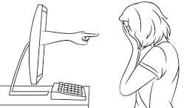
THE WOUND MADE BY A PHRASE THAT EVERYONE CAN SEE, DOES NOT HEAL.

Slide 4
