Slide 1
Beam me to 2017
von: Nico und Yasmin

Slide 2
Popular brands

Slide 3
Popular Internet sites

Slide 4
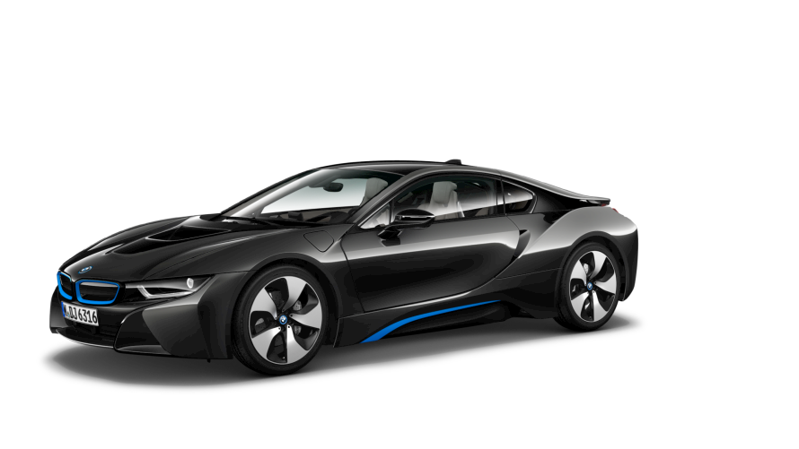
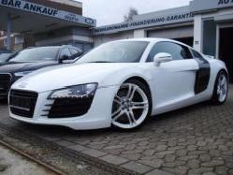
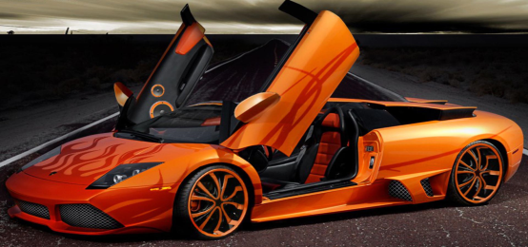
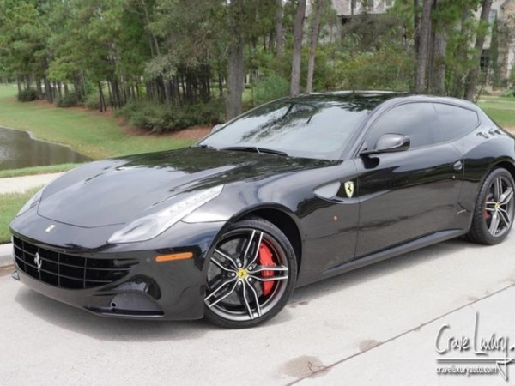
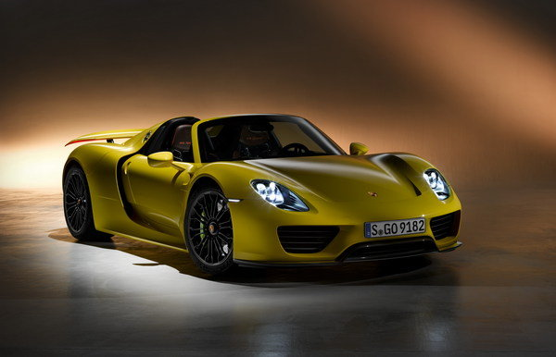
Popular car brands

Slide 5
Popular Handy brands

