Slide 1
Beam me to 2027
By: Armin & Abas

Slide 2
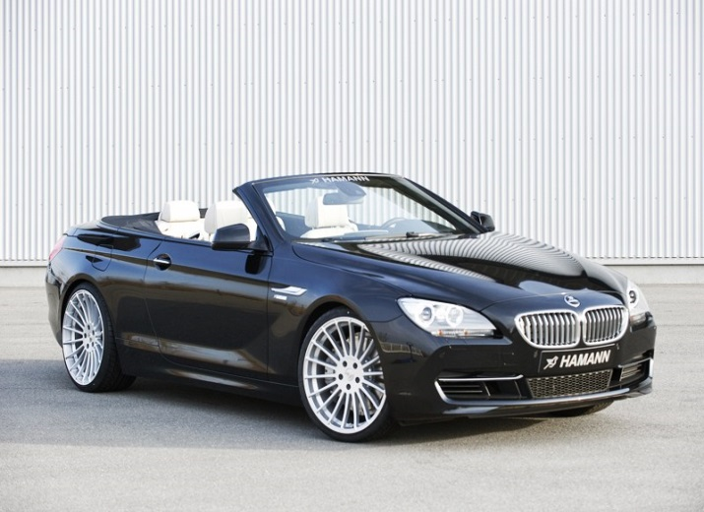
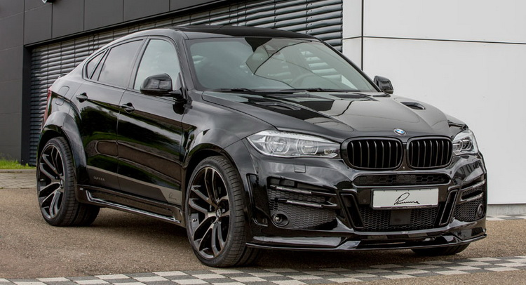
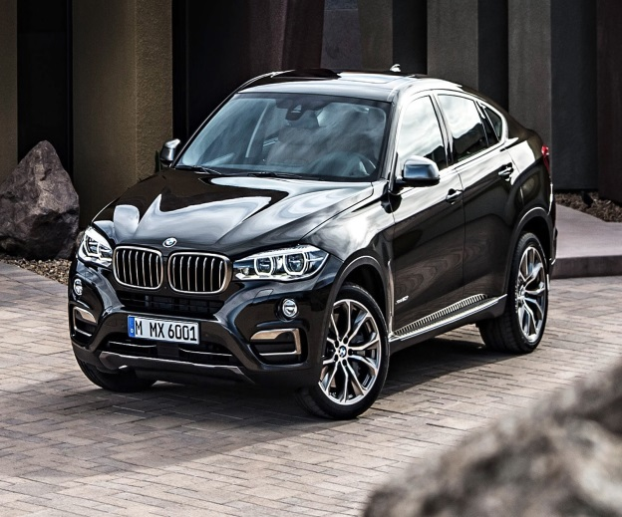
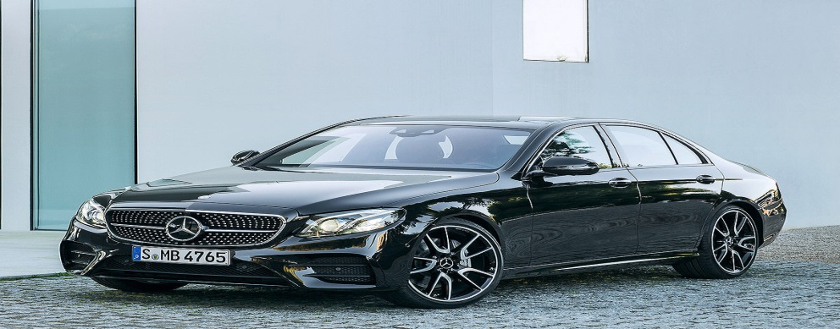
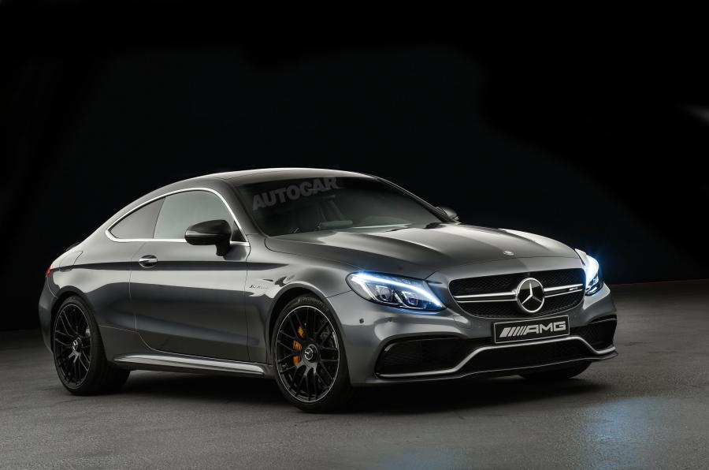
Cars today 2017
BMW 6er Cabrio BMW X6 BMW X6
Mercedes-AMG E63 S 4Matic + Mercedes-AMG C63 Coupe

Slide 3
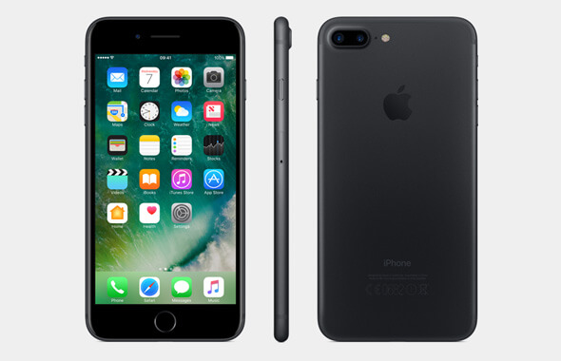
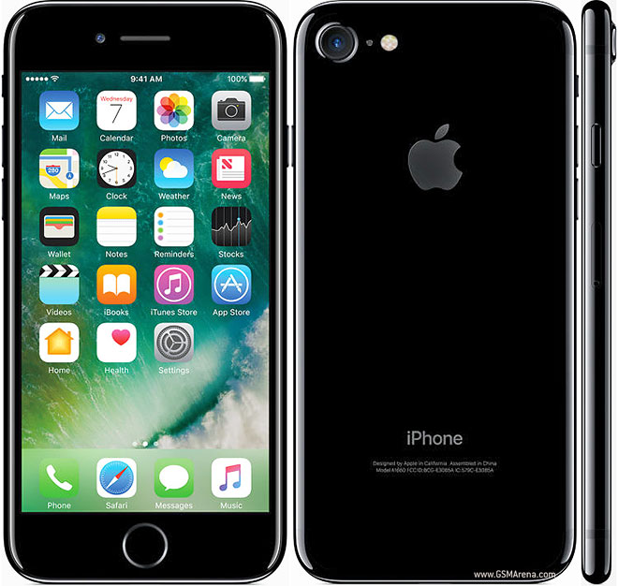
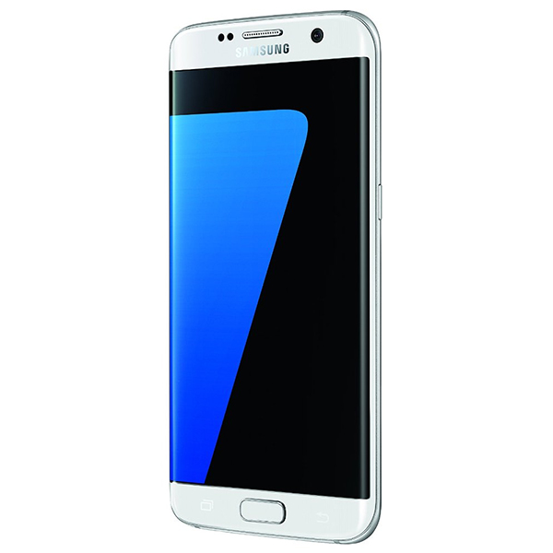
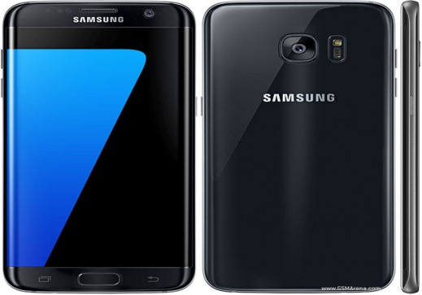
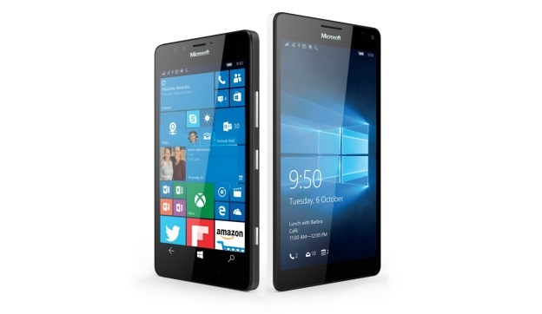
Smartphones today 2017
Iphone 7 Iphone 7
Samsung Galaxy S7 Edge Samsung Galaxy S7 Edge Nokia Lumia

Slide 4
Brands today 2017

