Slide 1
Beam me to 2027

Slide 2
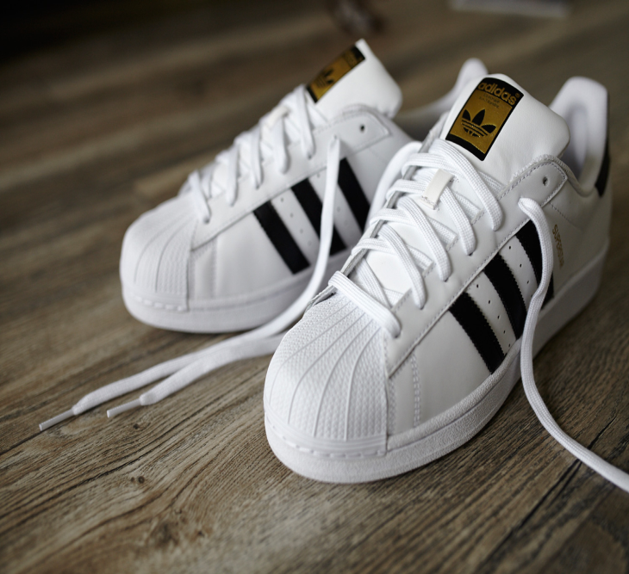
Fashion in 2017
This is a boyfriend jeans. It‘s very popular, because of the ripped parts of it and it is comfortable. Many girls and boys wear it and adults too.
Those shoes are called Adidas Superstar. Back in 2001 they was also popular. It fits to a streetstyle and also to classy outfits. Stars and famous people are wearing it in public.

