Slide 1
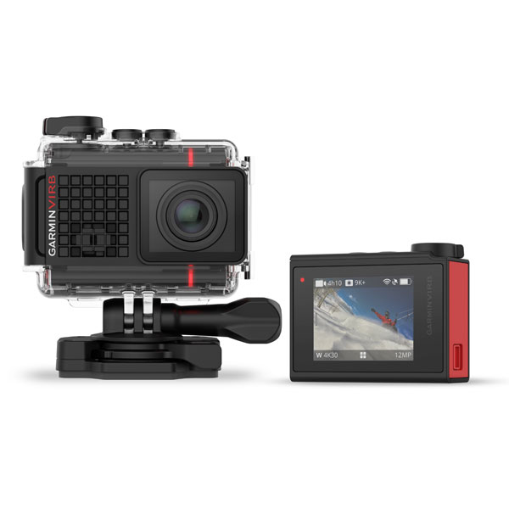
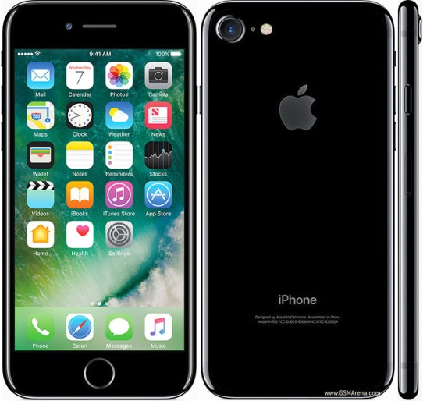
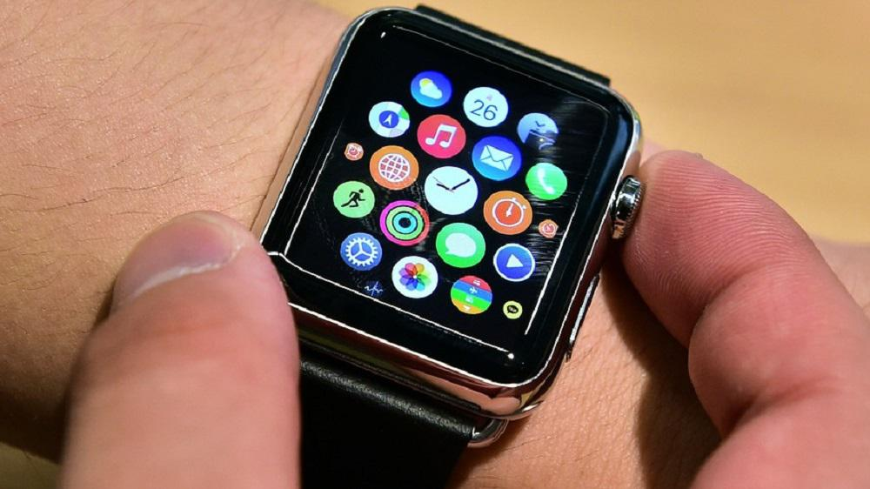
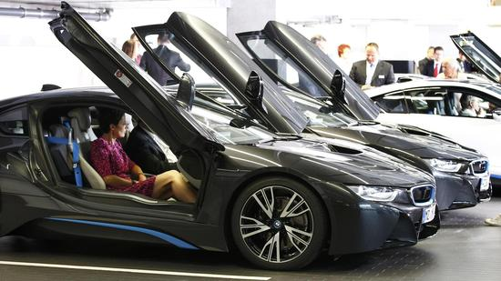
Beam me to 2027
The technology has changed the cars were created with electronic and the mobile phones are touch and thin. The cameras film well and are mordern and waterproof. The computer can man with dehm finger touch like a cell phone without cable it goes also only over Usb. The watches are like mobile phones with touchmann, man can even telephone with the clock.
.

