Slide 1
Beam me to 2027

Slide 2
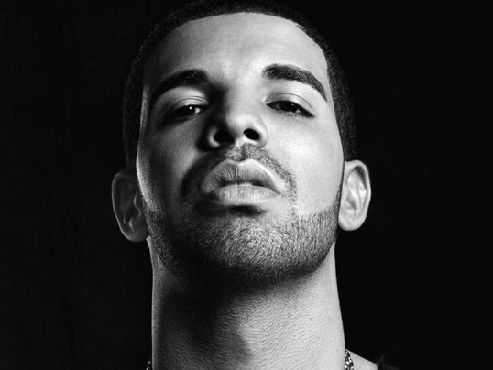
Drake
Aubrey Drake Graham (born October 24, 1986), known simply as Drake, is a Canadian rapper, singer, songwriter, record producer, and actor. Drake initially gained recognition as an actor on the teen drama television series Degrassi. The Next Generation in the early 2000s. Intent on pursuing a career as a rapper, he departed the series in 2007 following the release of his debut mixtape, Room for Improvement. He released two further independent projects, Comeback Season and So Far Gone, before signing to Lil Wayne's Young Money Entertainment in June 2009.

Slide 3
Fashion 2017

