Slide 1
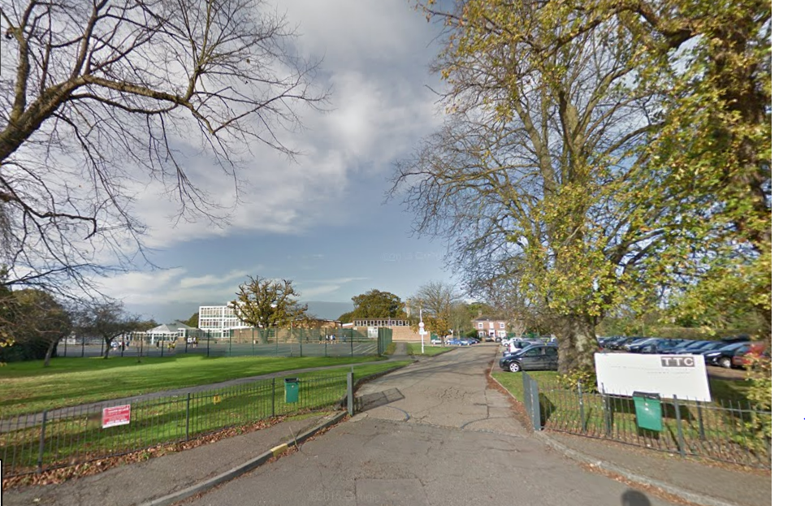
Beam Me To 2027
Our School
Tendring Technology College

Slide 2
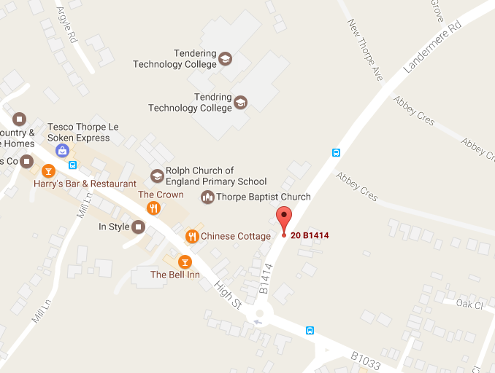
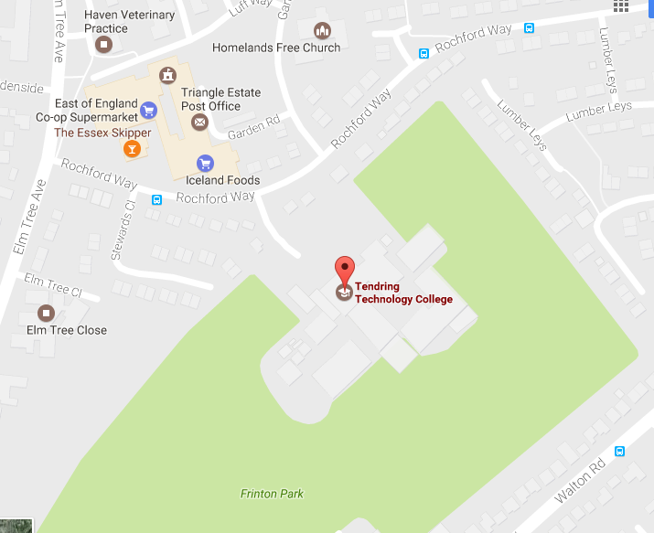
Where Are We?
Our school is located in Thorpe-Le Soken a small village located in Essex, in England. We are in the South East of England. We have two campuses, one in Thorpe, one in Frinton. Thorpe is for Year 7, Year 8 and Year 9 (11-14 years old) while Frinton we have Year 10, Year 11 and Sixth Form (14-18 years old).

