Slide 1
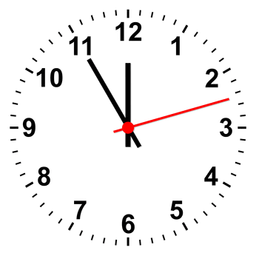
Memory box
Memory box from : Kamil-Can,Muhammet,Khodor,Philipp

Slide 2
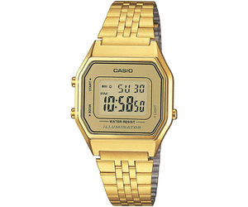
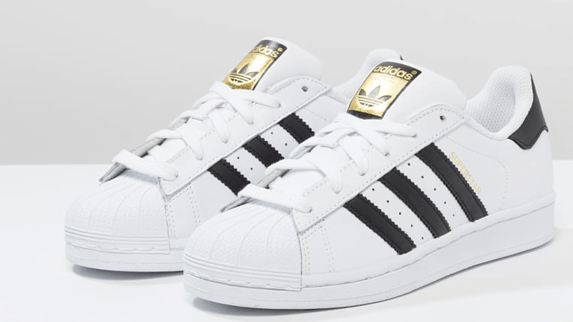
Many Teenager wear this clock
This shoes are a trend !

Slide 3
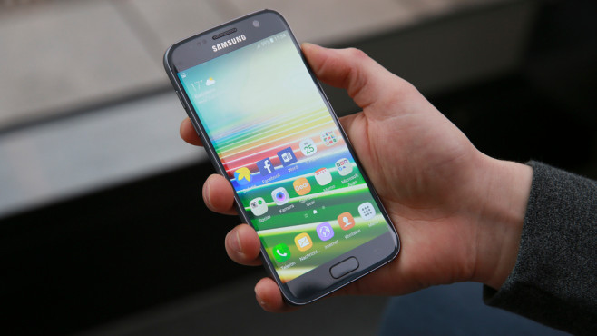
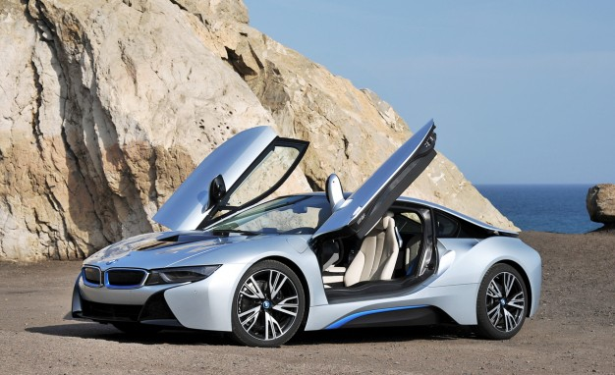
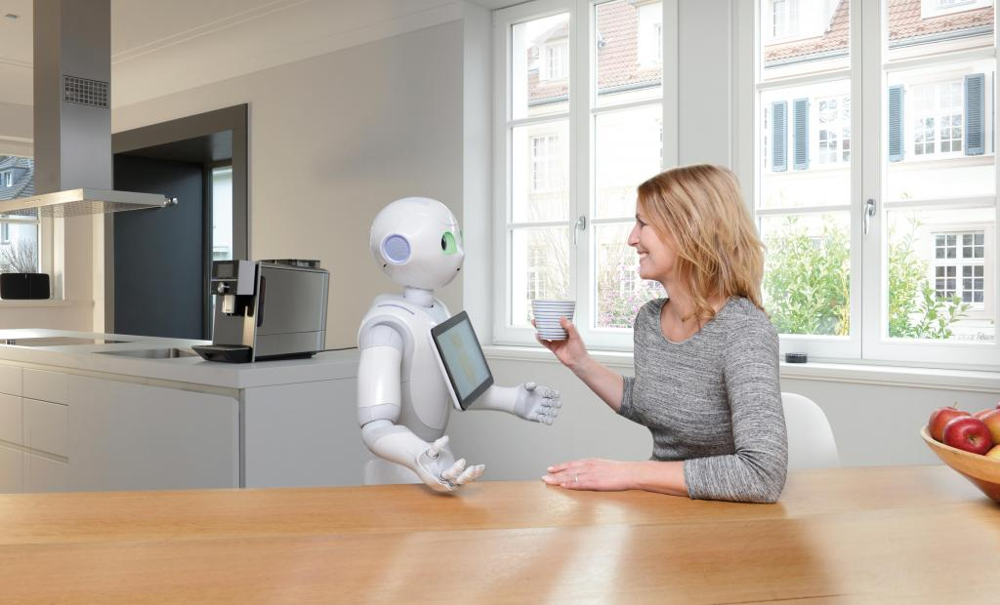
We have handys which are better than computersin 2000
We have elektro cars
We have already invented robots

