Slide 1
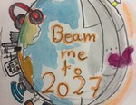
Project title: Europe 4.0 - Beam me to 2027
Aim: To share ideas about what will life be like in the future, collaborate and discuss common topics
eTwinning Quality Label Application

Slide 2
Project Plan:
Step one: We introduce each other. (PPT, Picturestories, ...)
Students enter ‘design project logo’ competition, voting is concluded on Tricider. Groups of pupils in each school pack a memory box : what is interesting for our partner students? What would be interesting for people who open this box in 2027? (Film, PPT, ... Forum)
Step two: Songs about the future (i.e. "In the year 2525",...) Brainstorming: our future in 2027? (Padlet) Discussion of ideas in the forum
Step three: Work in small mixed groups on one topic, for example: Session, architecture, language, society, environment, school, are, technology, music, travelling, economy, ... and prepare a presentation on your ideas (Films,PPT, Picture Story, Comic, ...)
Step four: The students present their ideas and outcomes as well as their products. There will be a follow-up discussion on the ideas. The students discuss whether there for you on the future it's up optimistic I'll pass on the stage one.. (Tricider, Forum) as well as a survey on the project.

Slide 3
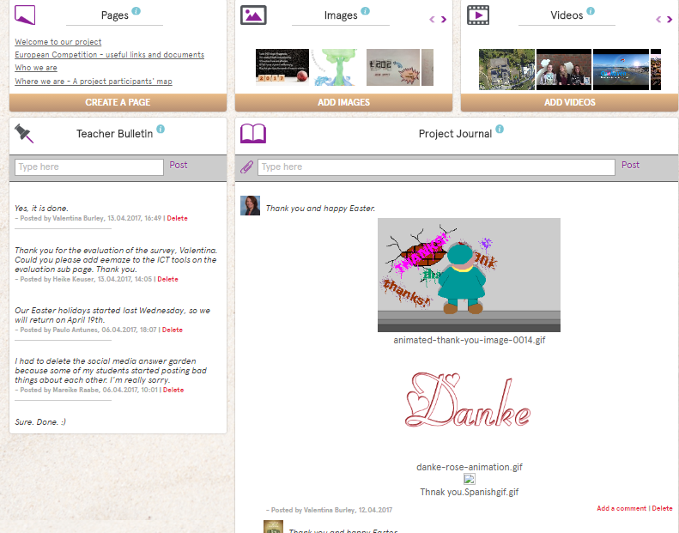
Communication
Teacher Bulleting was used to discuss future planning
Project Journal to post examples of work and messages to everyone involved.

Slide 4
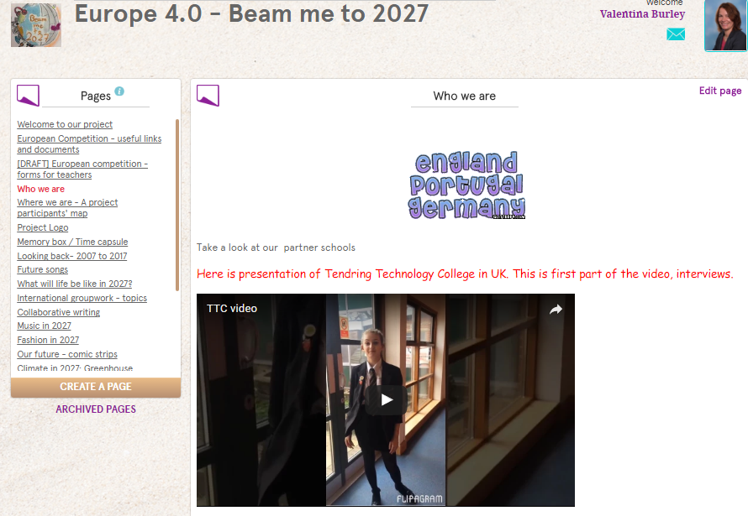
Step One:
Introducing group, school and the area

Slide 5
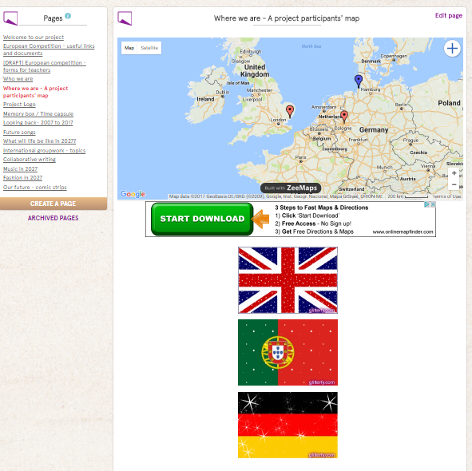
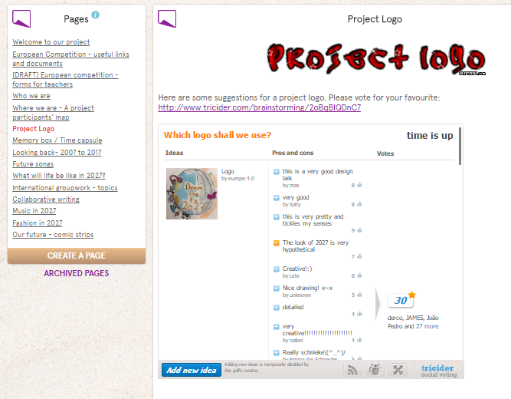
Step One:
Describing area on the map
Voting for project logo

Slide 6
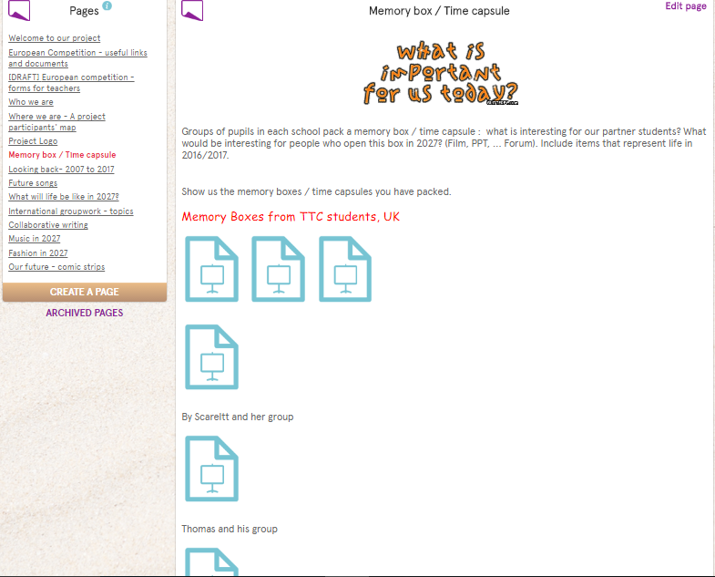
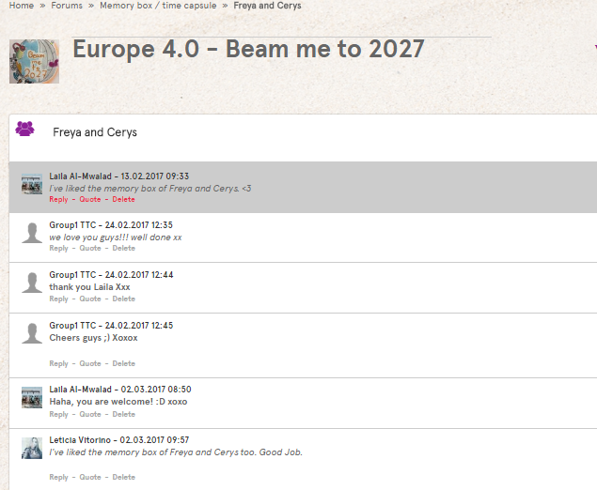
Step One:
Memory box – power pints
Comments and voting on Forum

Slide 7
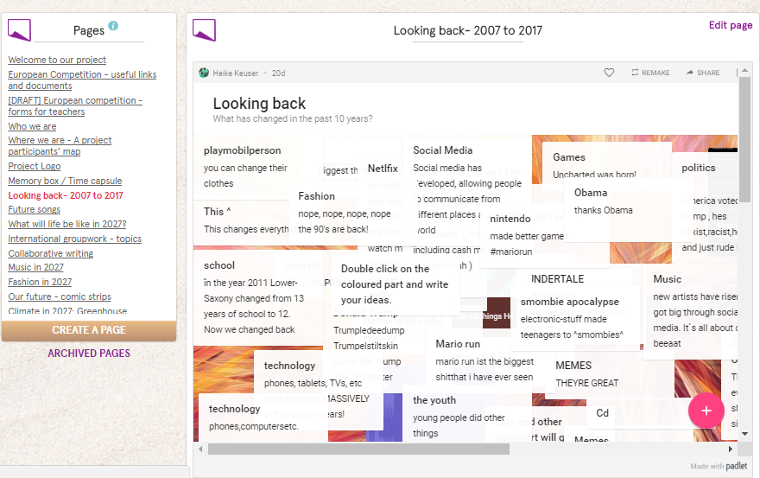
Step two:
What has changed in 10 years – using Padlet

Slide 8
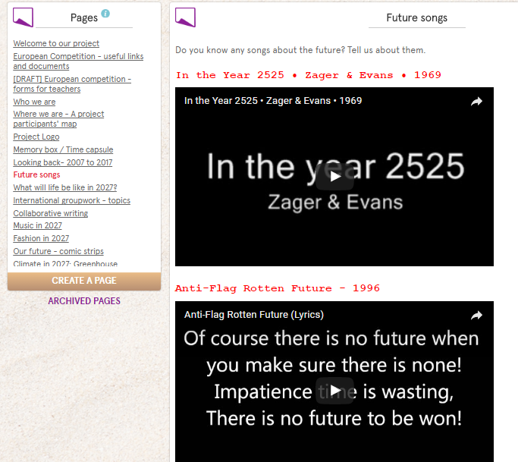
Step two:
Future songs – looking at the lyrics of ‘2525’ and other songs

Slide 9
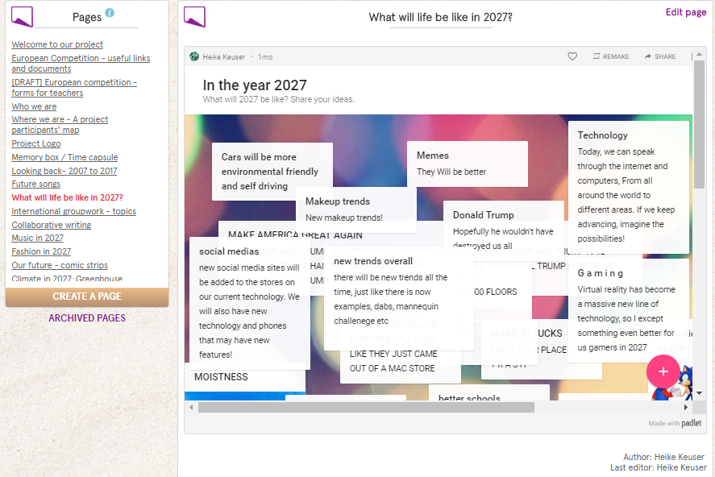
Step two:
What will it be like on 2027? Ideas and comments on Padelt

Slide 10
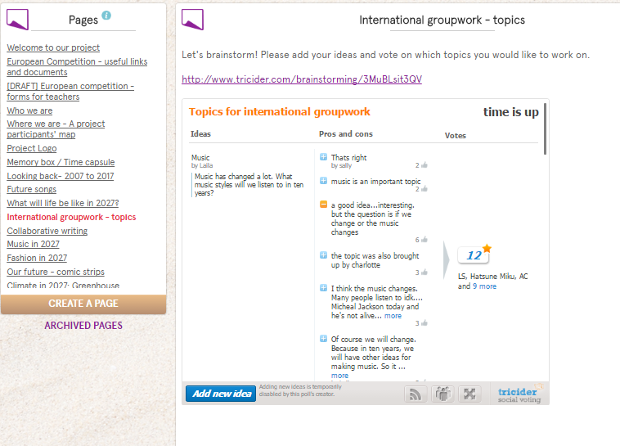
Step three:
Voting for international work: ideas and voting on Tricider
Music was the winner!

Slide 11
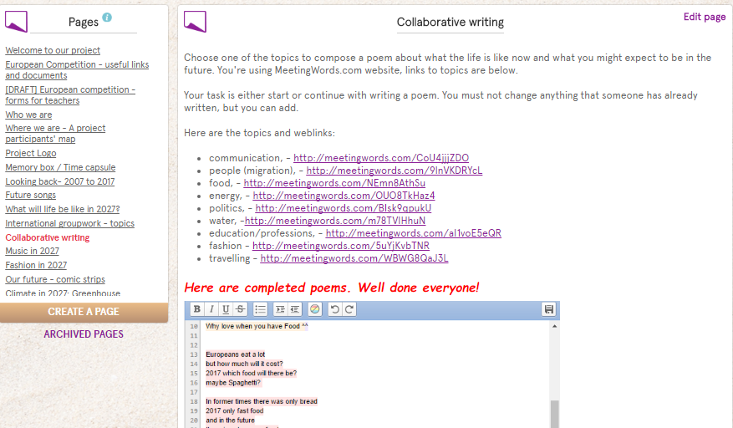
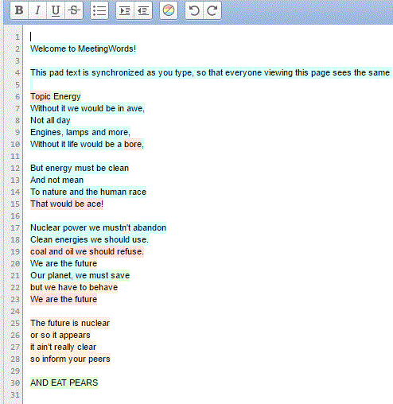
Step three:
Collaborative poems using Meetingwords, example of international collaboration

Slide 12
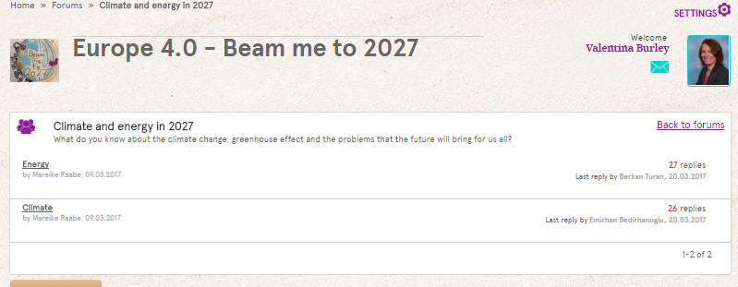
Step three:
Discussing topics: Climate and energy – using Forum

Slide 13
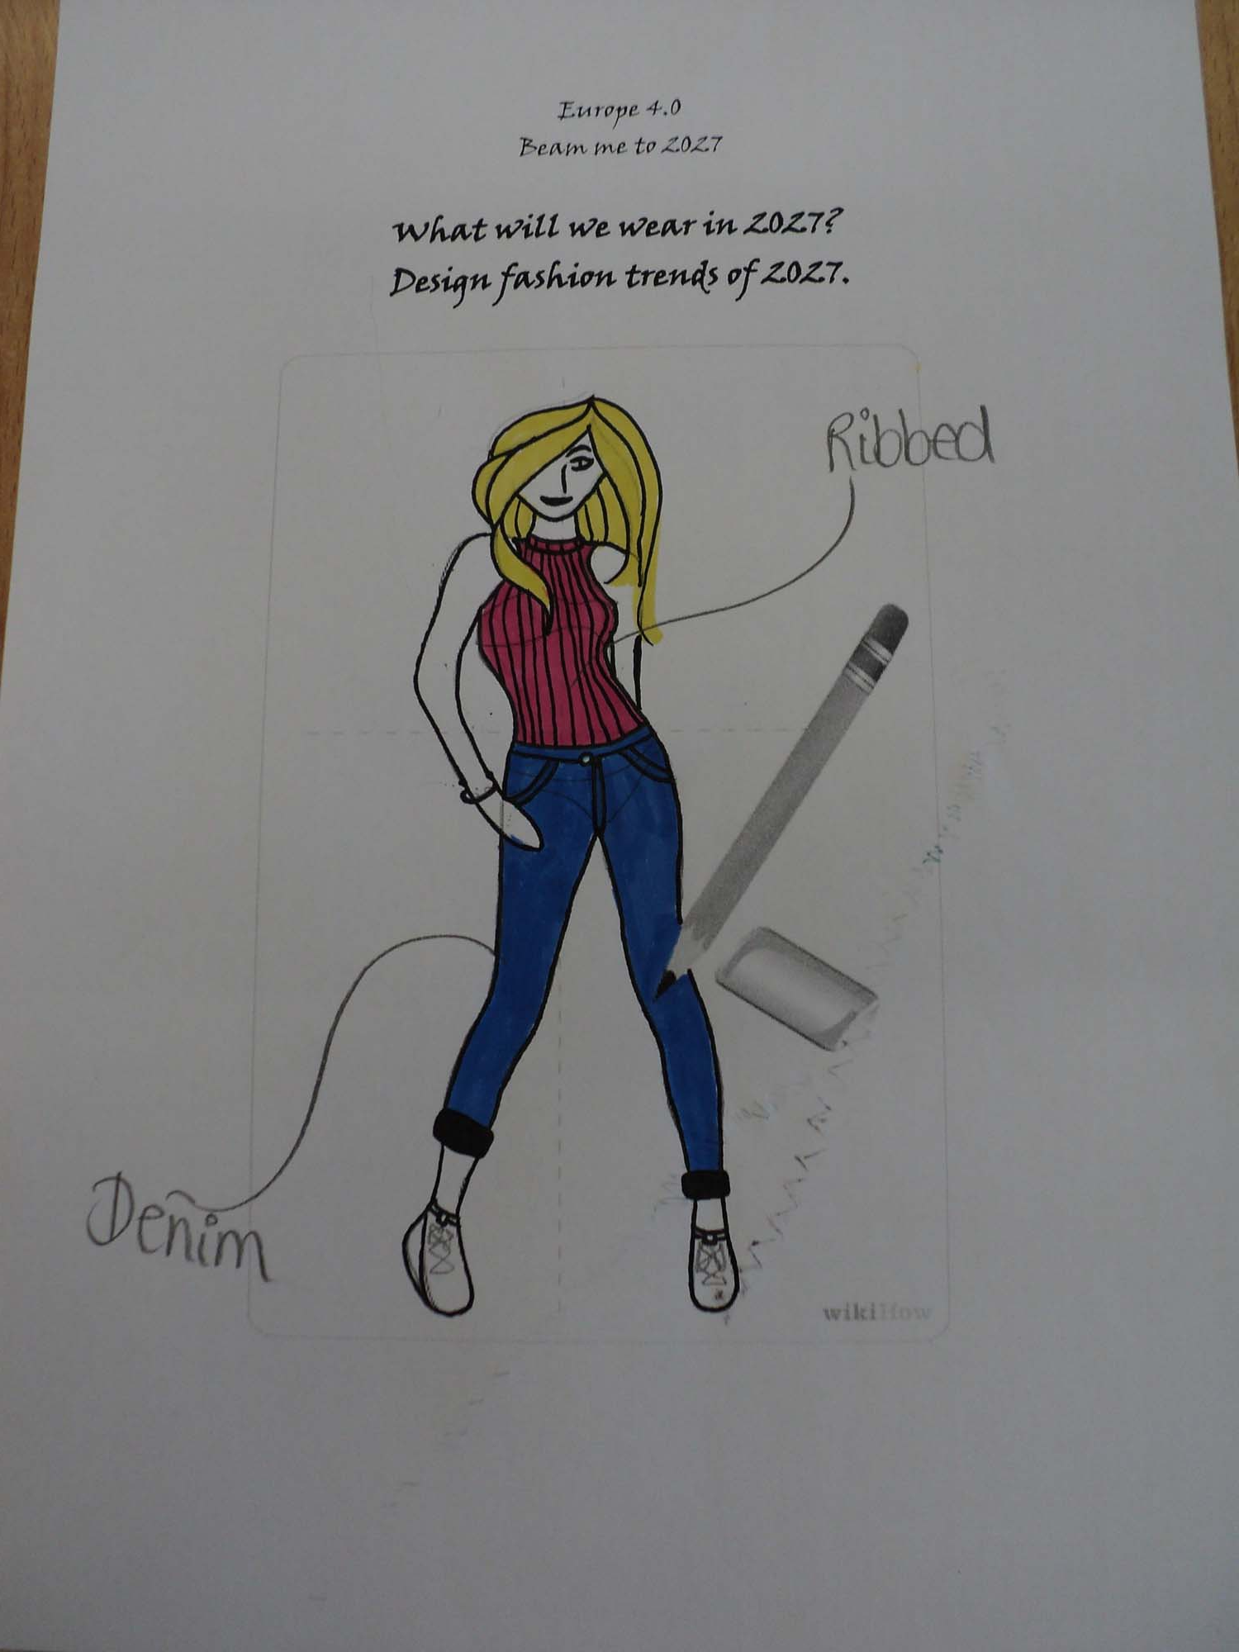
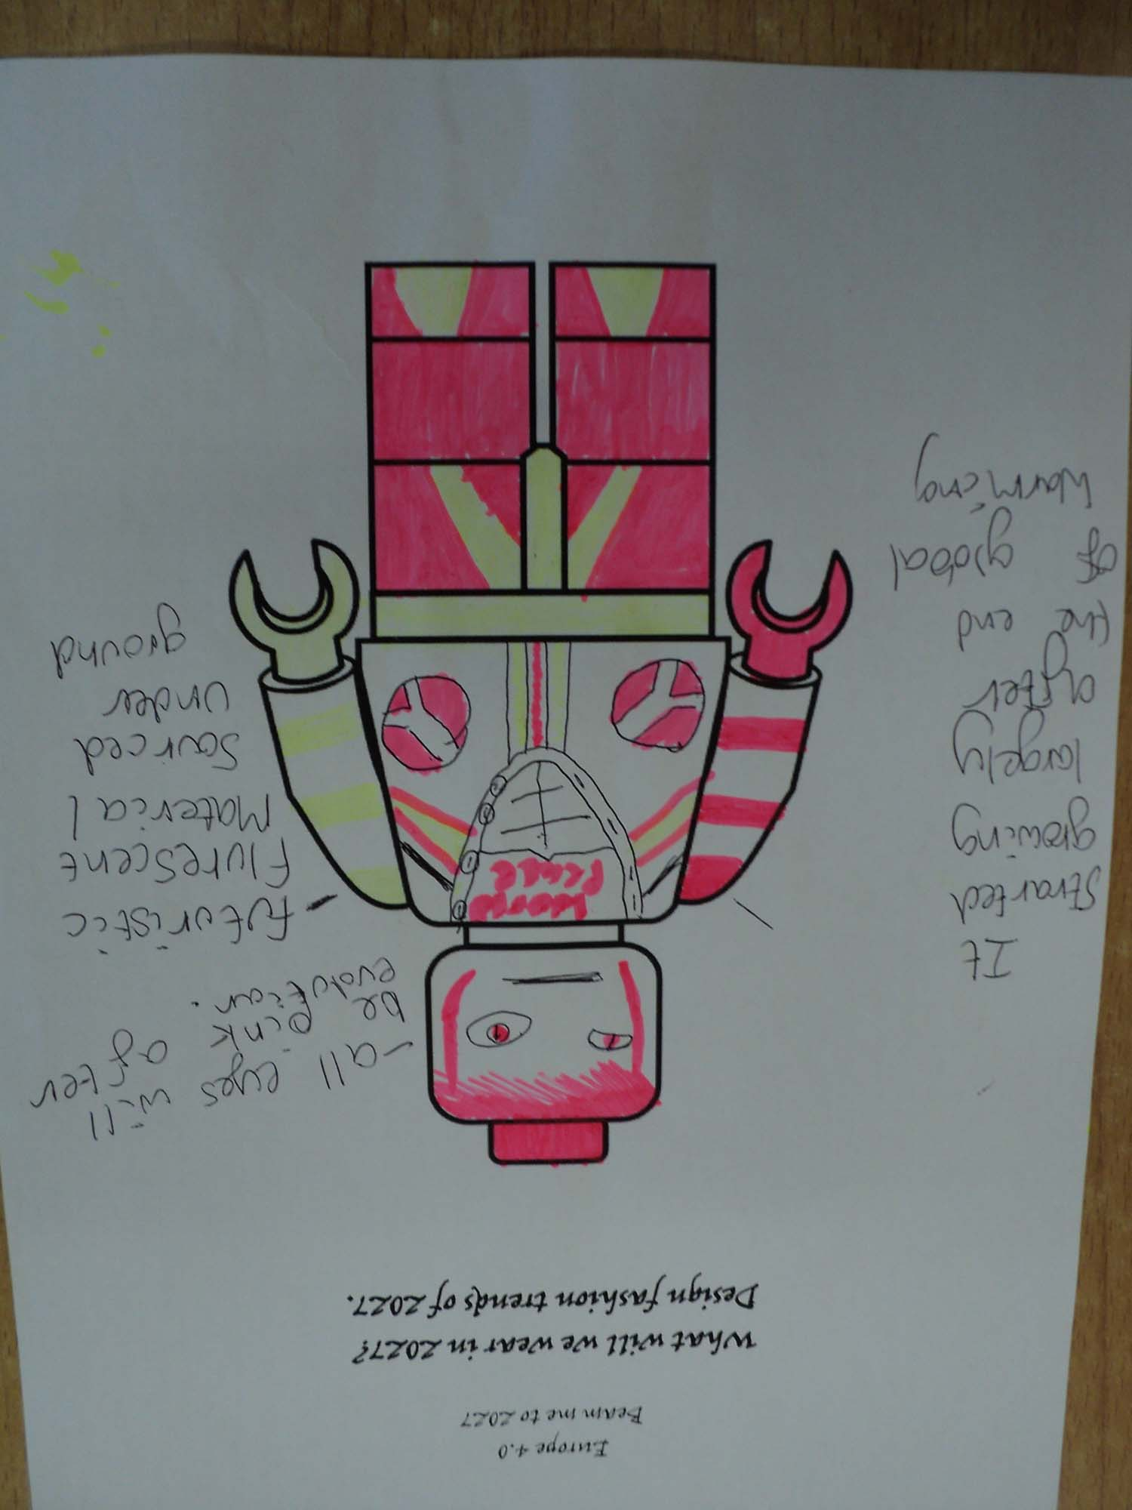
Step three:
Collaboration designing a fashion show

Slide 14
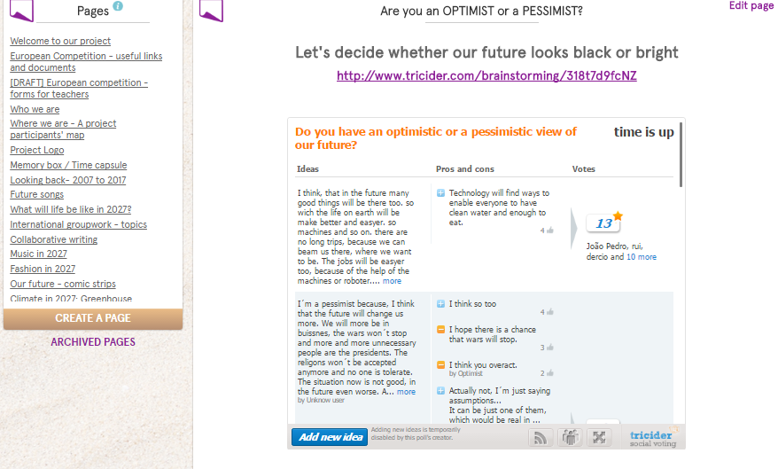
Step four:
Discussion on Tricider about futures: optimistic and pessimistic views

Slide 15
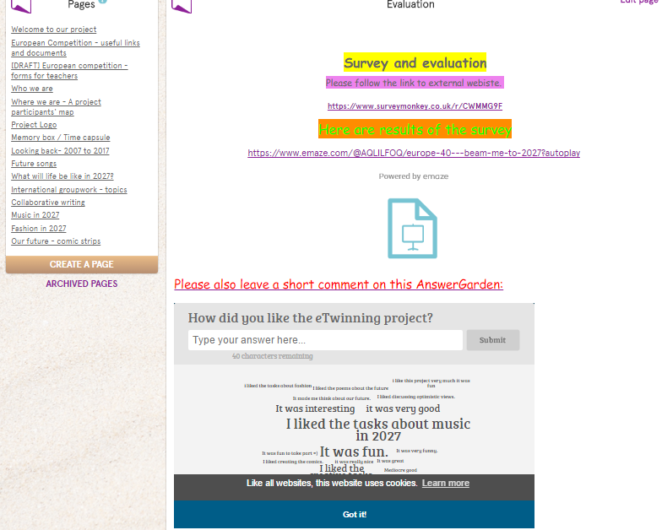
Step four:
Project evaluation: completing survey on Surveymonkey, using Answergarden for comments

Slide 16
List of web2 tools used in this project

