Slide 1
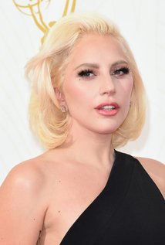
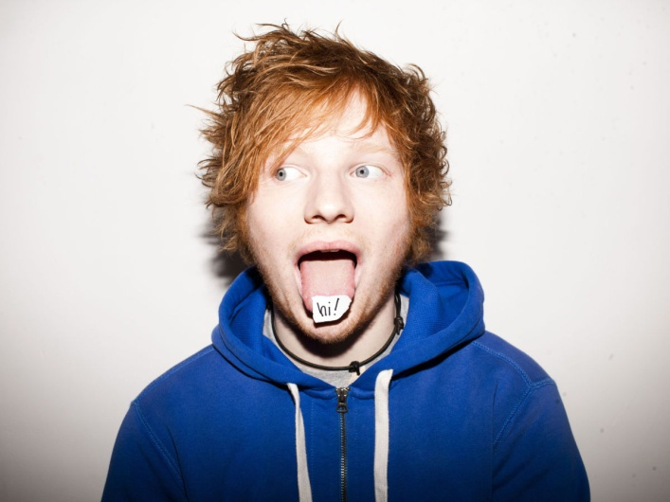
What we would pack in a memory box
Some Of Music of today's era
Lady Gaga
Ed Sherean
Skrillex

Slide 2
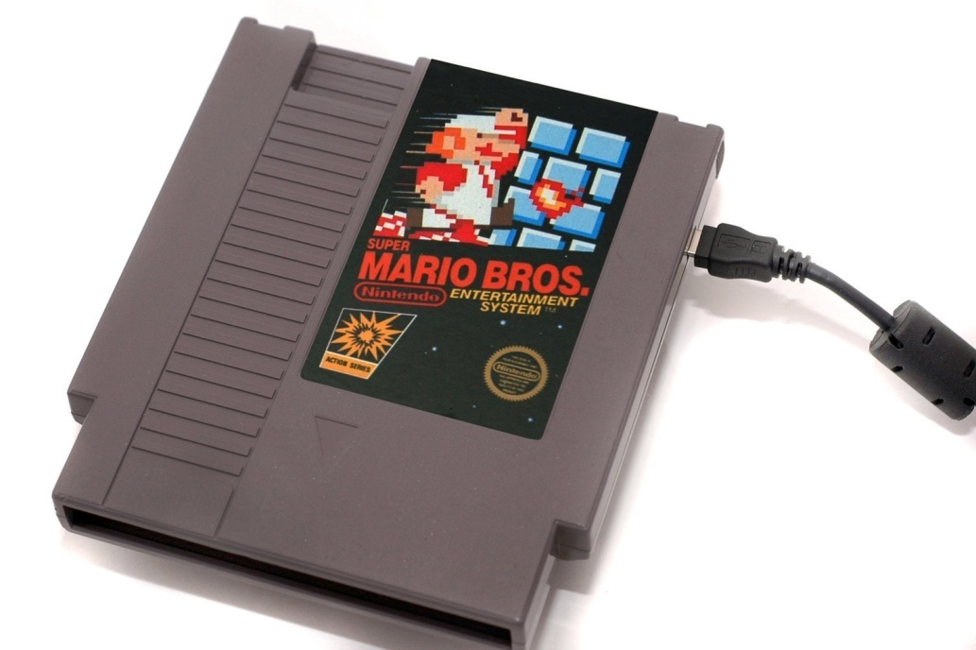
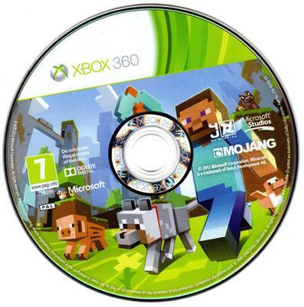
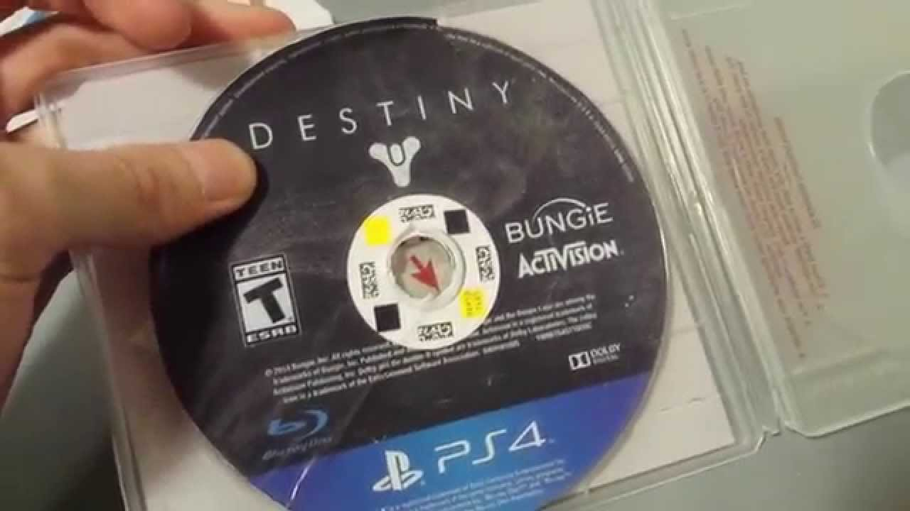
What we would pack in a memory box
Some Games of today's era
Super Mario Bros
Minecraft
Destiny

Slide 3
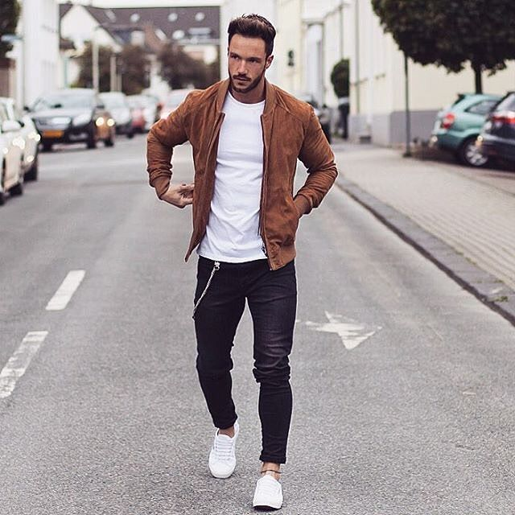
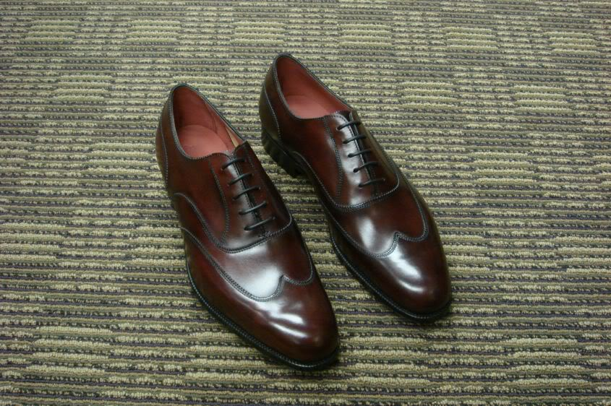
What we would pack in a memory box
Some fashion of today's era

Slide 4
What we would pack in a memory box
Some books of today's era

Slide 5
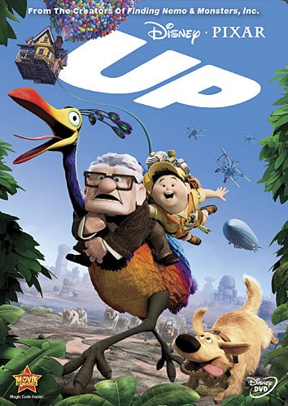
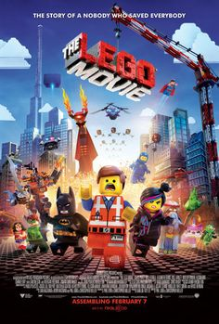
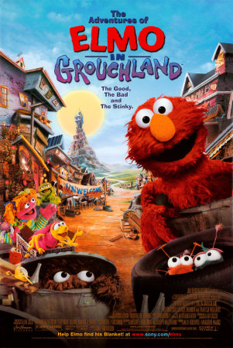
What we would pack in a memory box
Some films of today's era

