Slide 1
My Time Capsule!
Written and produced by Freya Taylor and Cerys Reynolds

Slide 2
Fashion
The latest fashion trends now are brands like Nike, Adidas, Ellesse, etc. but in the next ten years this will all change! No one knows what it’ll be like in the future but we all know that it will change.

Slide 3
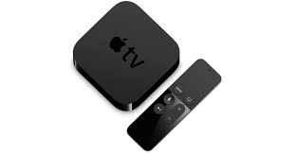
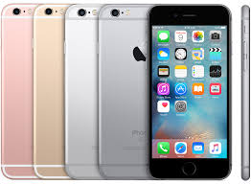
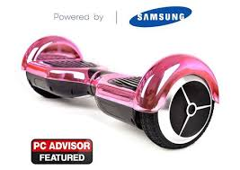
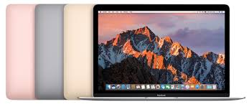
Technology
There was a MASSSIVE craze with swegways and hoverboards.. Who knows what will happen in ten years!? The iPhones and Samsungs will all change – the iconic logos may even change slightly! In the last ten years cameras have been improved, along with phones, Tvs, cars, etc. The possibilities are endless!

Slide 4
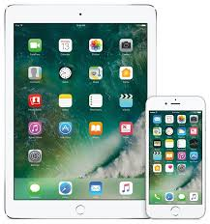
Social Media
Musical.ly, Instagram, facebook, etc. are a few of the most successful, yet reasonably new, apps on technology. They have been updated massively and they are still being improved to this day.

