Slide 1
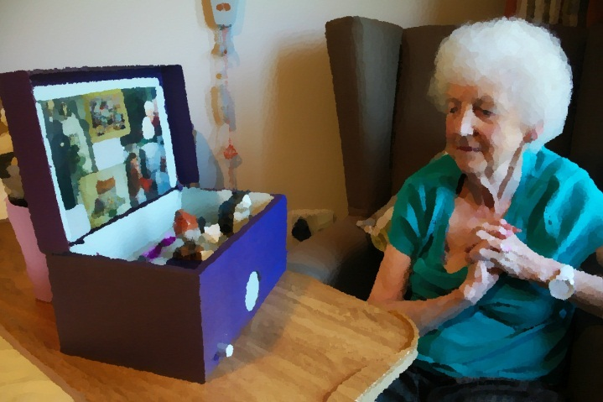
Beam me to 2027
Memory box
Done by: Dércio, João, Ricardo and Rui

Slide 2
Old Games
Clash Royale;
CS:GO;
Minecraft;
GTA V;
Resident evil 7;
.io Games;
Etc.

Slide 3
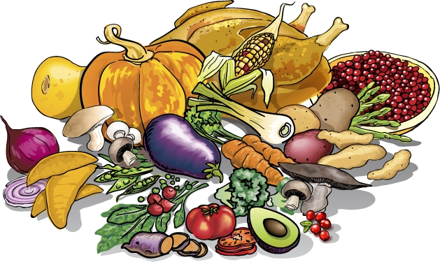
Food changes
Biodiversity will reduce till 2027

Slide 4
Landscapes for memory

Slide 5
Our school will be an old building

