Slide 1
TURKEY

Slide 2
WHAT WE HAVE DONE
Because of our interest in the project ,which our school carries on, ESC- A Global Challenge, We wanted to be a part of this project.
We aimed to have a better world with renewable energy so we created a system which works with solar energy. We worked on a subject ,which is a part of this project, solar device.

Slide 3
FIRST STEP

Slide 4
SOLARİS B-G

Slide 5
THE DRAWING ON BOTTOM OF THE CAR
SOLARİS B-G

Slide 6
There isn’t anything in the car except a shaft.
We attached gear on the shaft of the wheel.
We connected the 1.5V engine which is available for our gear.
SOLARİS B-G

Slide 7
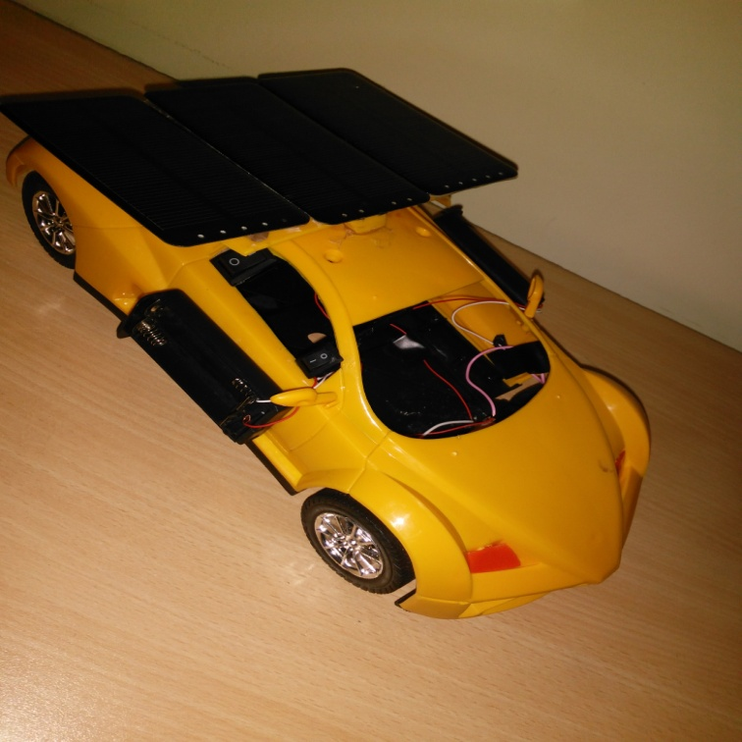
We connected 3 pieces of Solar Panel (6V 180mA) to each other parallel. And attached to the car.
We added battery beds to run the car without sunlight.
After we added battery beds, we added a system to charge the batteries.
SOLARİS B-G

Slide 8
LAST DRAWING
SOLARİS B-G

Slide 9
SOLARİS B-G

Slide 10
SOLARİS B-G

Slide 11
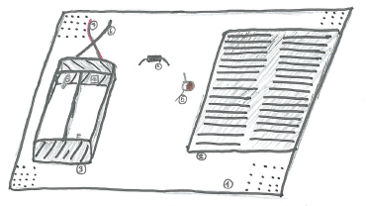
BATTERY CHARGING SYSTEM
We used a perforated board to stick them together..
We used 60x60mm 5V Solar Panel for energy.
We used diode to make current one-way (Avoid to discharge the battery.
We used a led light to see this system accurately.
SOLARİS B-G

Slide 12
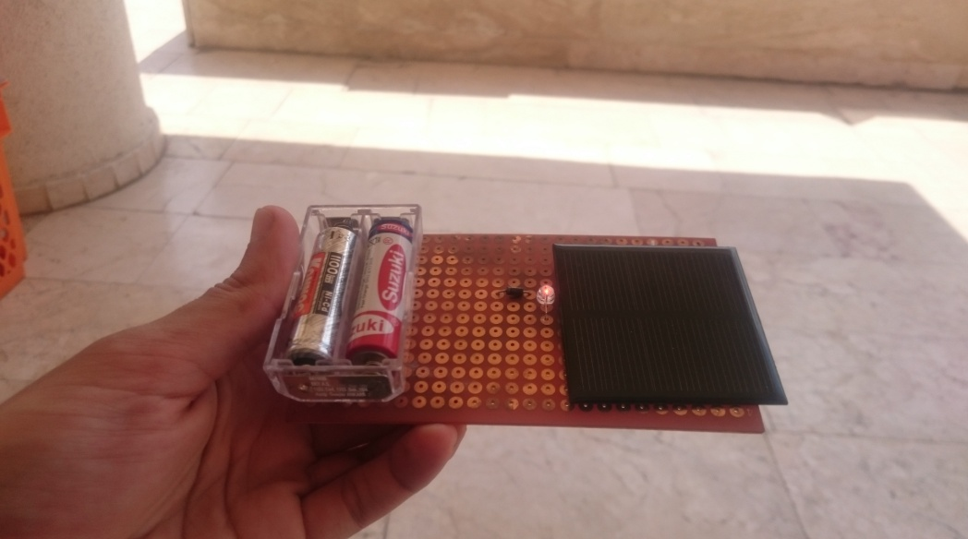
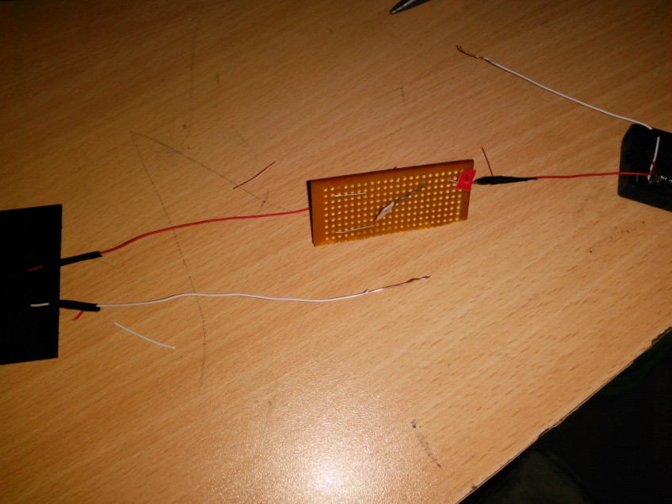
SOLARİS B-G

Slide 13
SECOND STEP

Slide 14
Solar Strip

Slide 15
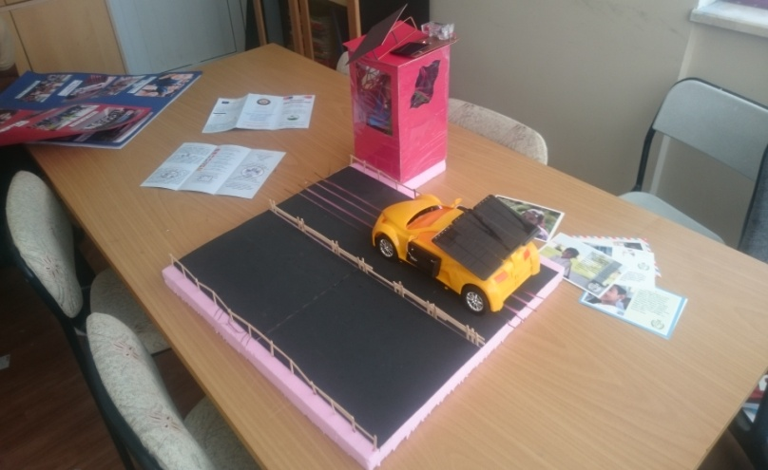
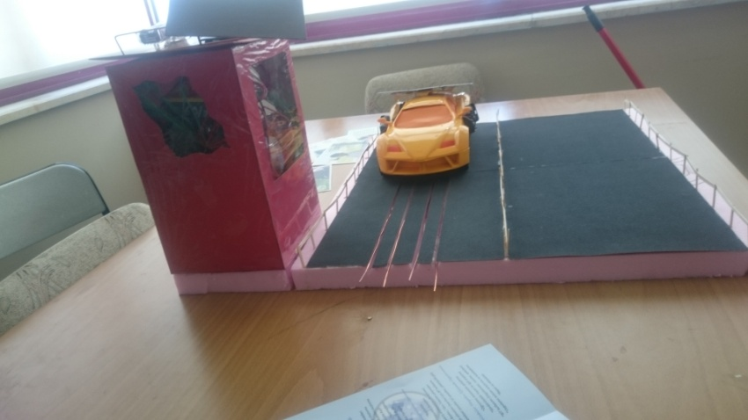
We decided to design a system which works on some different roads without energy and charge the battery in the car.
Solar Strip

Slide 16
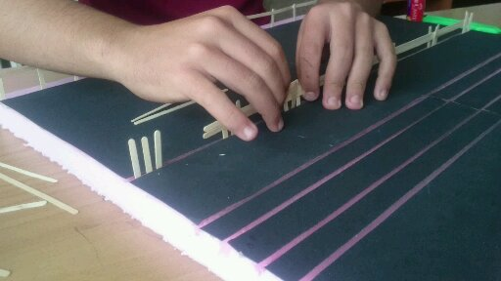
We made a little highway section with styrofoam. After that we made a hut which can move on the road. This hut is using the solar energy and transmitting the energy to the way.
Solar Strip

Slide 17
WORKİNG STAGE
Solar Strip

Slide 18
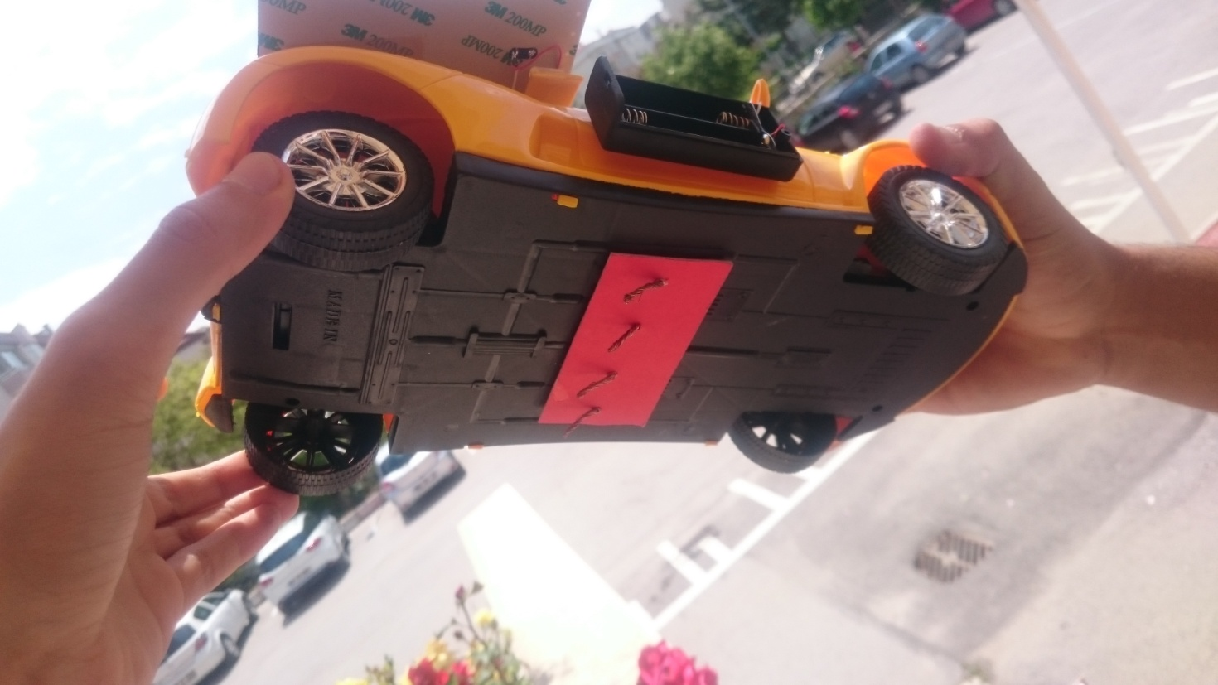
We used 2 cables to make the car work and other 2 cables to charge the battery.
We added 4 cables under our car to connect the cables under the way. 2 Cables for engine and 2 cables for battery.
Solar Strip

Slide 19
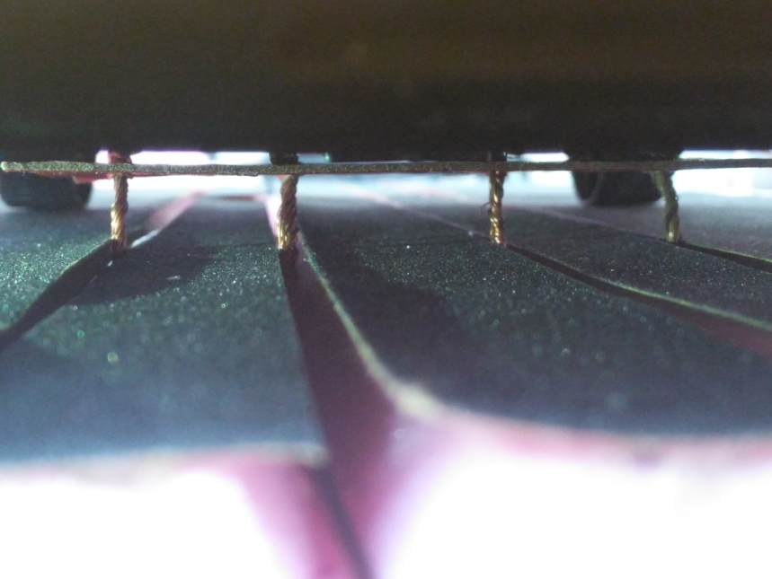
We connected four cables which are transmitting energy by hut to the way. We put these cables under the way to avoid the danger. And we covered this way with fences for safety.
Solar Strip

Slide 20
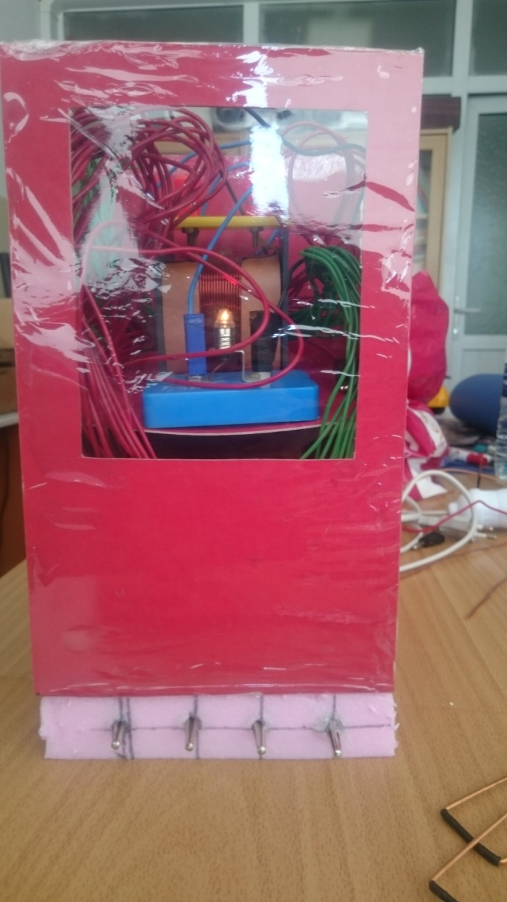
We can add an auditor system in the hut. If we make a software , the solar panels can change its direction according to the sun and it can follow it. Also to avoid the accidents , this system can manage the speeds of the cars.
Solar Strip

Slide 21
Solar Strip

Slide 22
IF we can adopt this project in real life, we can :
Provide free transportation
Save the enviroment because we use solar energy
Provides secure traffic because we can control the speed of cars and we can prevent accidents.
We can save money and use it expend the system
Solar Strip

