Slide 1
ECOSHISH
Moments with fun
Group 2: Adrian Barnutiu
Elena Garraín
Paula Miranda
Eszter Kajtar
Kristof Bene Luís Amorim

Slide 2
Advantages:
A lot of people smoke;
The material is recyclable;
The normal ones are very expensive;
Less negative impact on the environment;
Less nicotine levels and for that reason is better for the health.

Slide 3
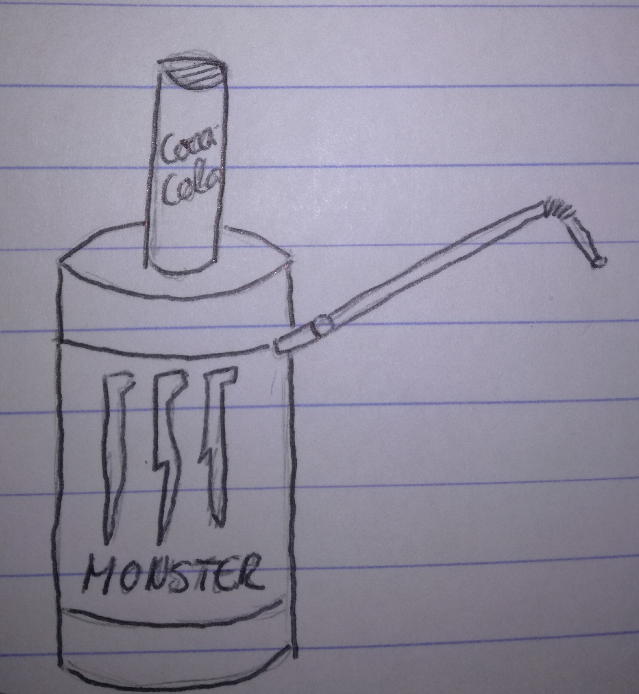
Materials:
Melted recycled tin cans ;
Hoses;
Premade materials ( Taste);

Slide 4
Where can you buy it?
Online;
Stores;
Who can buy it?
Pubs;
People who are +18;

Slide 5
Advertisment:
Online ads
Newspaper ads
Radio ads
Outdoors

