Slide 1
GROUP 1
Blanca Lepe
Bruno Silva
Henrique Cunha
Diogo Pereira
Clara Nogales
Liza Mohai
Mate Fonyodi

Slide 2
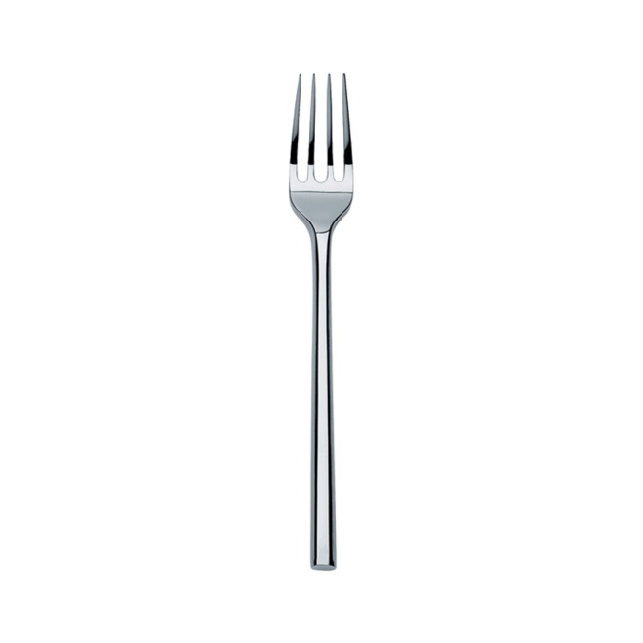
Portspaingary

Slide 3
The most unusual Restaurant ever
Never seen,
never tried…

Slide 4
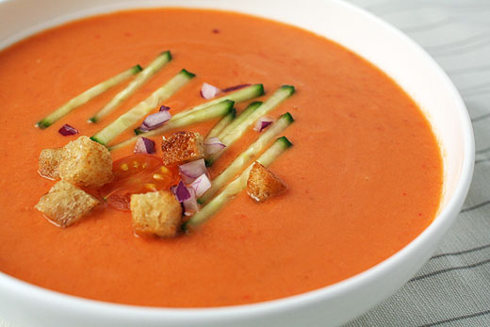
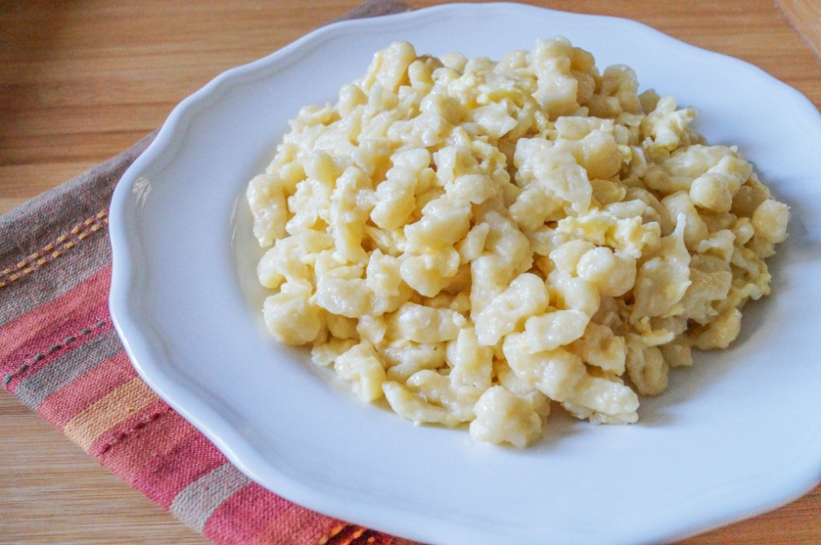
Main dishes
Nokedli with gazpacho

Slide 5
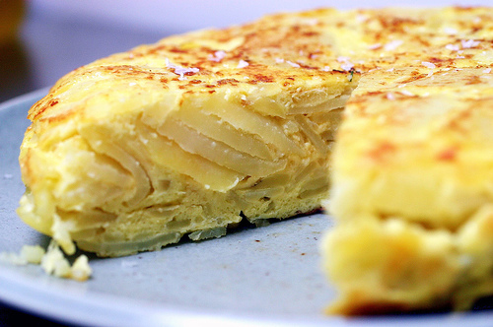
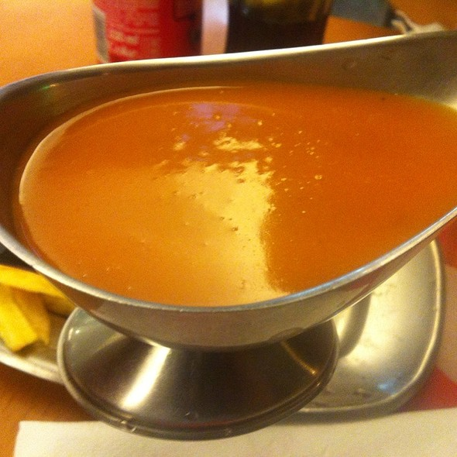
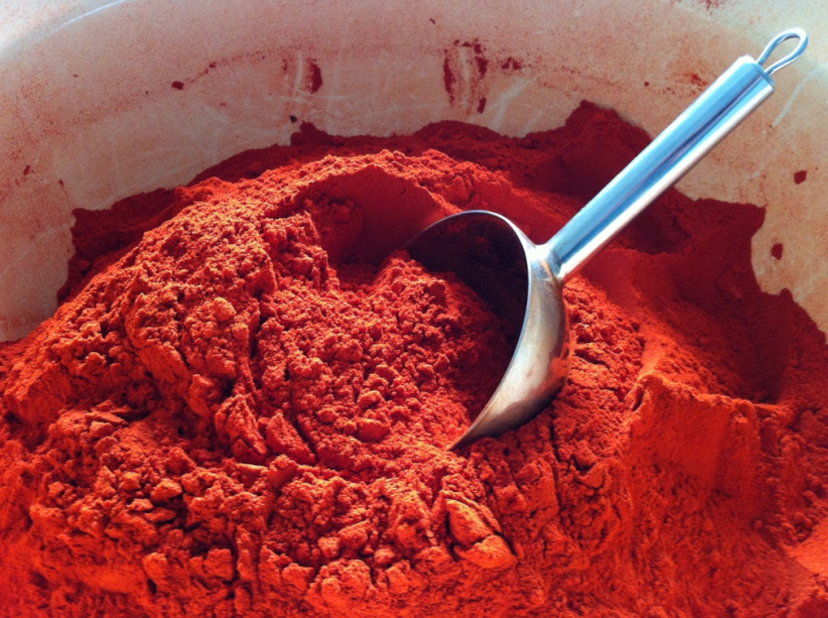
Spicy Tortilla
Tortilla de patata
Molho de francesinha
Pirospaprika

Slide 6
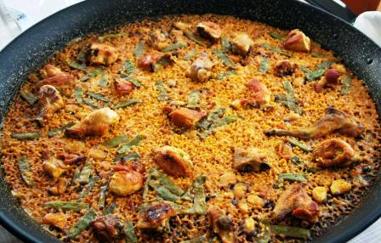
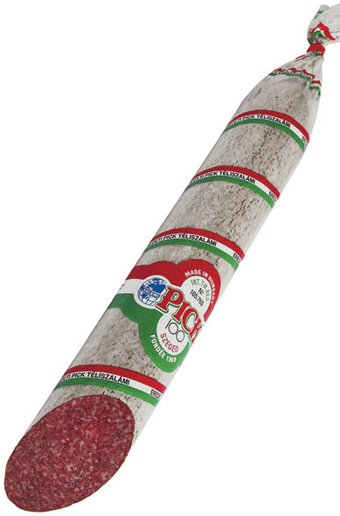
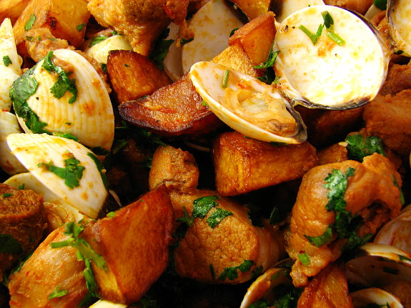
Crazy paella with Portuguese and Hungarian ingredients
Paella
Carne à alentejana
Pick szálami

Slide 7
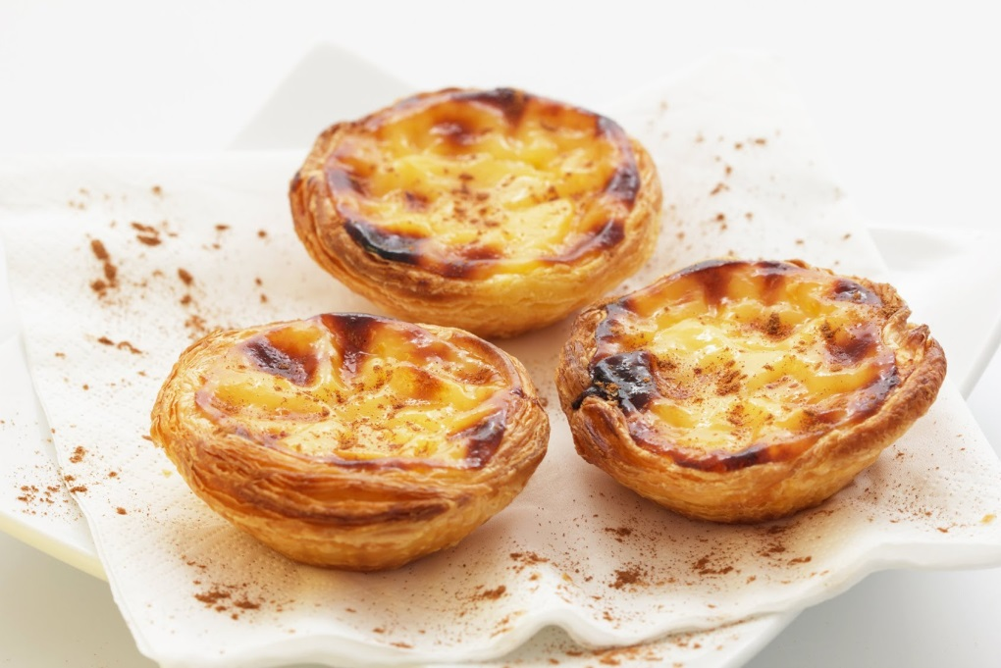
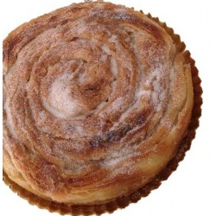
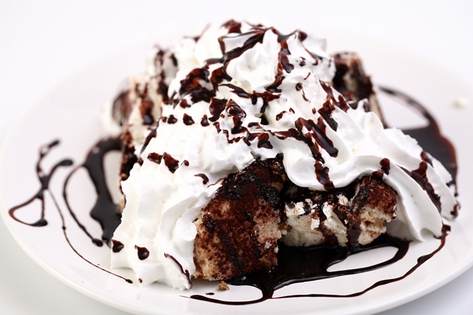
Desserts
Pastel de nata
Hojaldra
Somlói galuska

Slide 8
How we would work
Ingredients must be organic
We will use fotovoltaic panels to produce energy for the restaurant
A big part of the building could be made of glass (the solar light would go inside more easily and we wouldn’t need to have the lights on during the day)
We would create a aromatic herbs garden to use them in our food
The materials used to build the restaurant will be local
The building wouldn’t need to be heated or cooled like the Plako building
Multicultural work also provides sustaintability

