Slide 1
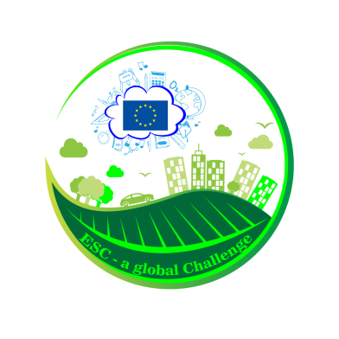
RESOURCES MANAGEMENT AND SUSTAINABLE DEVELOPMENT
The last Transnational Learning Activity,
Tamasi, Hungary
18 -24.05.2017

Slide 2
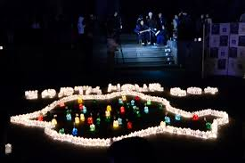
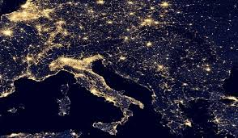
Do you have an education for sustainable consumption and sustainable lifestyle?
“Earth hour”
March 25th (light turns off 1 hour, from 20,30 to 21,30) – a symbolic gesture in the fight against the climate change
WE SAVED A RESOURCE: ENERGY

Slide 3
What is the resources?
Elements taken from nature or produced by the man and exploited in order to improve the conditions of life.
Natural resources
Anthropic resources
air,
water,
landforms,
rocks,
plants,
animals,
soil,
sun,
wind,
oil,
iron,
aluminum,
gold
human resource,
human intelligence,
human settlements,
agricultural lands,
transport networks,
financial resources,
inventions

Slide 4
what is the Sustainable development?
Economic
development
Economic
growth
natural
resources
Economic
restructuring
raising general prosperity of society
the process of producing more goods and services based on the use natural and anthropic resources
New reliable industries:
wind turbines,
solar cells,
Hydrogen use,
non-polluting means of transportation,
ecotechnologies for waste water and air pollution,
hi-tech equipment for communications
are on the verge of exhaustion
SUSTAINABLE DEVELOPMENT

Slide 5
Sustainable development
EDUCATION - TRAINING - INFORMATION
DIRECTIONS
MOBILITY MANAGEMENT | PRODUCTION AND SERVICES | MANAGEMENT OF RESOURCES
1. Land planning 2. Infrastructure programming 3. Traffic Management 4. Automobile pollution control | 1. Issuing exploatation permits 2. Pollution control 3. Eco-accounting 4. Product policy 5. Industrial waste management | 1. Air quality control 2. Management of water resources 3. Preservation of natural sites 4. Maintenance of soil quality 5. Energy security and efficiency 6. Demographic management 7. Waste Management

Slide 6
the GENERAL OBJECTIVE of sustainable development = the optimal interaction between systems
in conclusion
SOCIAL
ENVIRONMENT
ECONOMIC
supportable
equitable
sustainable
viable

Slide 7
what is the SUSTAINABLE CONSUMPTION?
"the use of goods and services that satisfy the basic needs and allow the improvement of life quality while minimizing the consumption of natural resources, of generating toxic materials and pollutants emission and waste, during a life cycle, so as the needs of future generations would not be affected."
NO!
YES!

Slide 8
1. Give examples of resources used by you directly or indirectly, from the moment you wake up in the morning until you leave school.
Grouped them into the following categories:
a) the resources used in the industry energy:
b) resources used in the metallurgical industry:
c) resources used in the chemical industry:
d) resources are used in the wood industry:
e) resources used in the industry of construction materials:
f) resources used in the food industry:
g) resources used in the textile industry:
h) resources used in the leather industry:

Slide 9
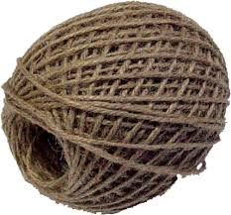
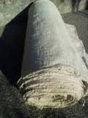
2. Imagine that you are the character of Daniel Dafoe, Robinson Crusoe, you wrecked on an island in the subtropical region and you have to survive for 6 months, with only a few items such as: a knife, a lighter, a clew/ball of string, a bale of canvas, a container water
a) What are the resources that you will need to identify in the first 24 h?
b)What are the resources that you need to search in the first week?
c) What are the resources that you will have to identify in the first month?

