Slide 1
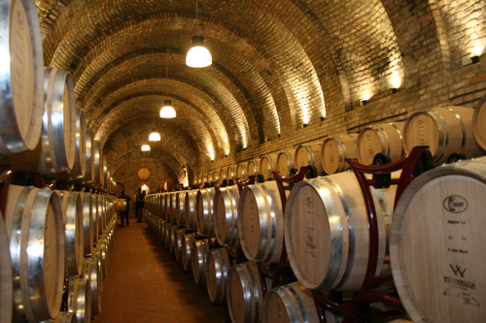
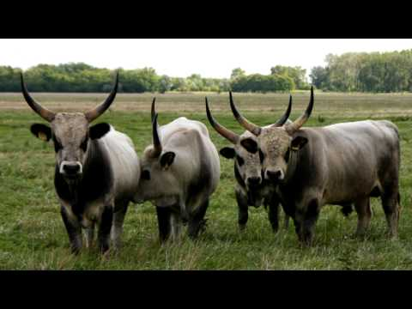
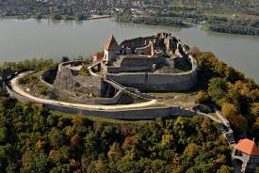
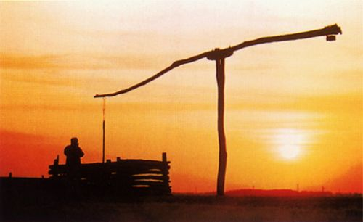
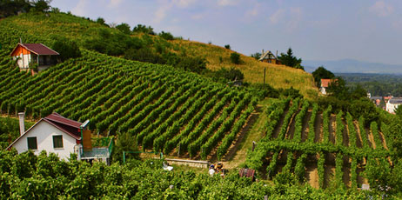
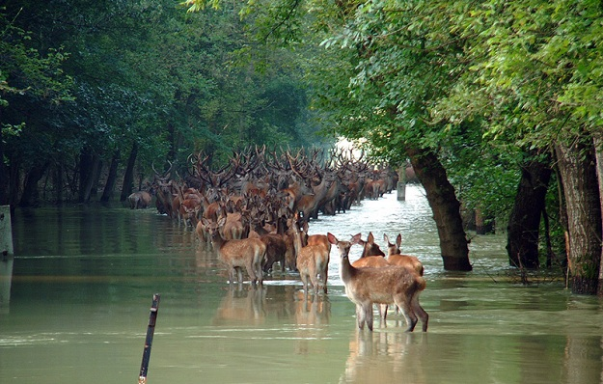
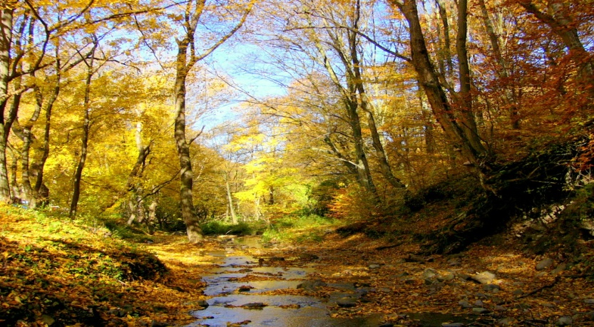
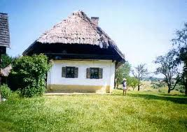
Hungarian plants

Slide 2
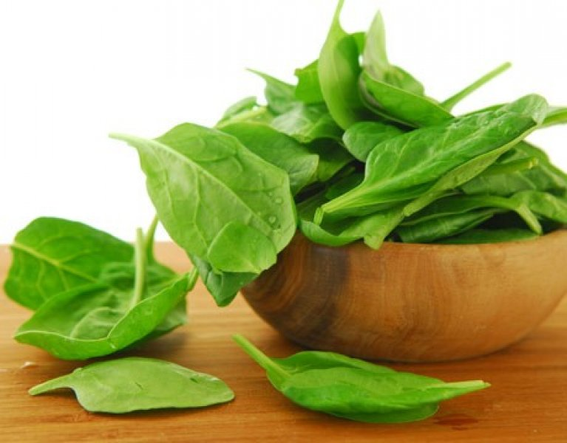
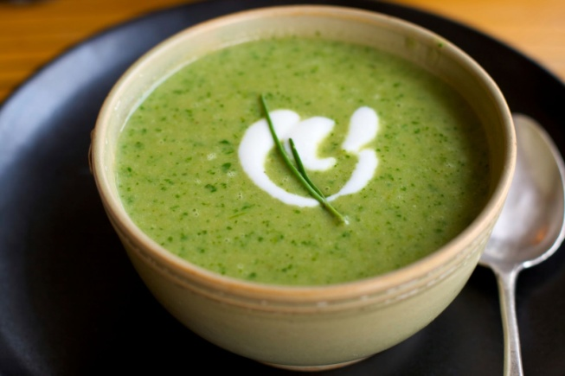
Sorrel
arrow-shape
run deep into the ground
taste like a sour apple
puréed in soups, salad, souce
oxalic acid

Slide 3
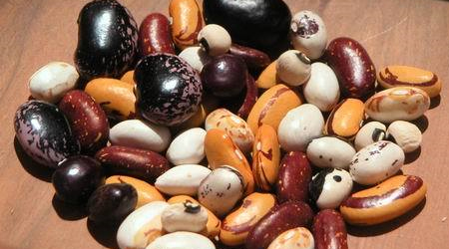
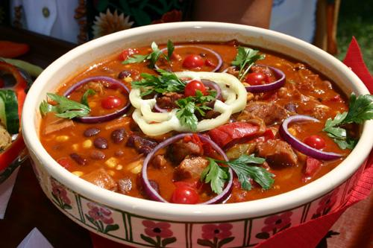
Bean
Need warm temperatures
Mature:turn yellow and dry up
Need external support
High in protein
Provide nitrogen for the corn

Slide 4
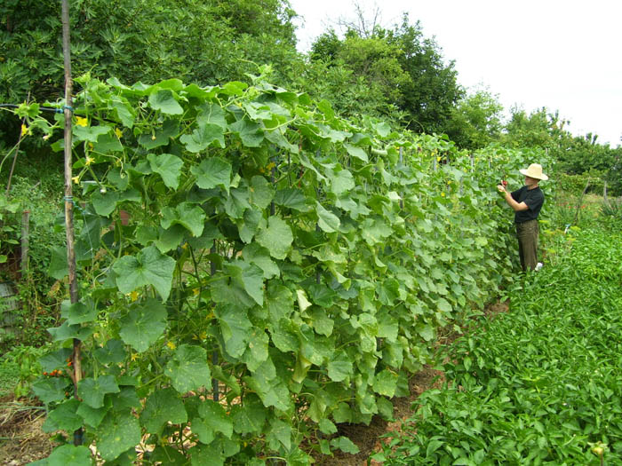
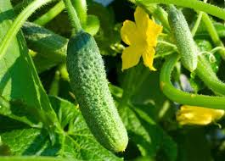
Cucumber
They are more than 90% water
They are pollinated by bumblebees and other bees
supply of Vitamin K

Slide 5
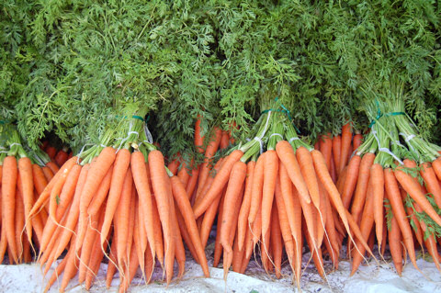
Carrot
Carotenes are metabolized into vitamin A
Good source of vitamin K and B6
Can be eaten in a variety of ways
They grow best in full sun

Slide 6
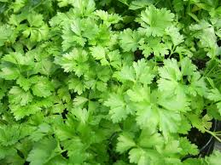
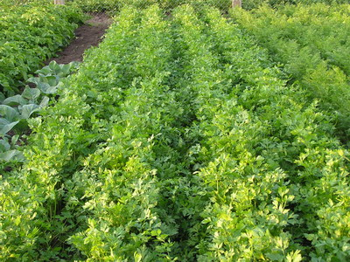
Parsley
Bright green, biennial, plant in temperate climates
A taproot used as a food store
Attracts several species of wildlife
Used as a garnish,

Slide 7
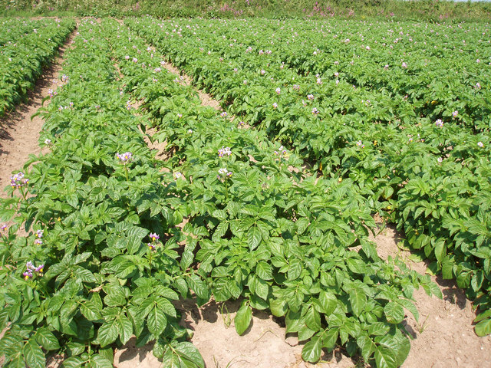
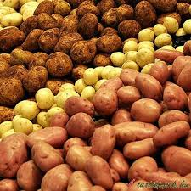
Potato
They are sensitive to frost
It contents carbonhydrate and natural phenols
It is the world's fourth-largest food crop

Slide 8
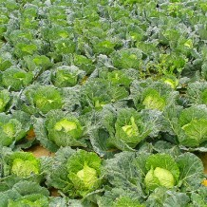
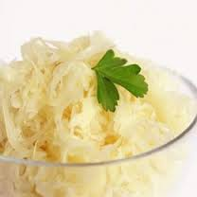
Cabbage
is a leafy green or purple biennial plant
It is prepared and consumed in many ways
used as a medicinal herb for a variety of purported health benefits.

Slide 9
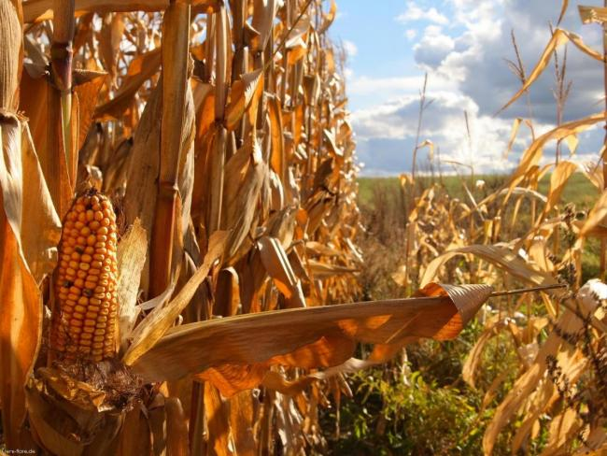
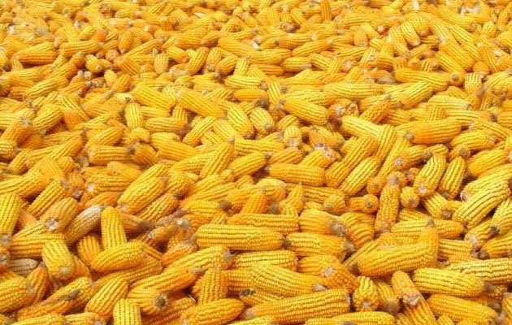
Maize
Short day plant because it is cold-intolerant
the plant is dependent on soil moisture.
is central to Mexican food
constitute a staple food in many regions of the world

Slide 10
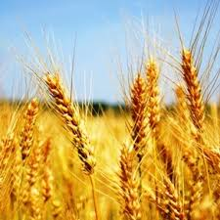
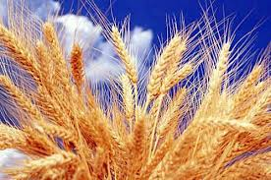
Wheat
is grown on more land area than any other commercial food
is the leading source of vegetable protein
used to make flourfor leavened

Slide 11
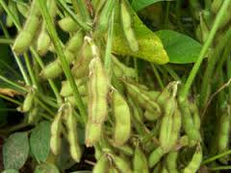
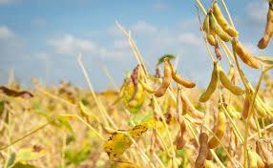
Soybean
Is cheap source of protein for animal feeds and packaged meals
they are a globally important crop, providing oil and protein
Vegetable types cook more easily

Slide 12
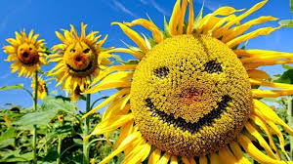
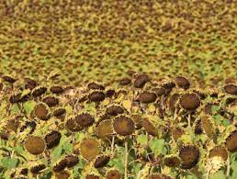
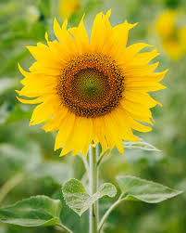
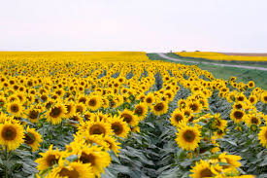
Sunflower
The lower leaves are opposite
bright yellow ray florets
sunflowers tilt during the day to face the sun
By the time mature: sunflowers face east
it surced of oil

