Slide 1
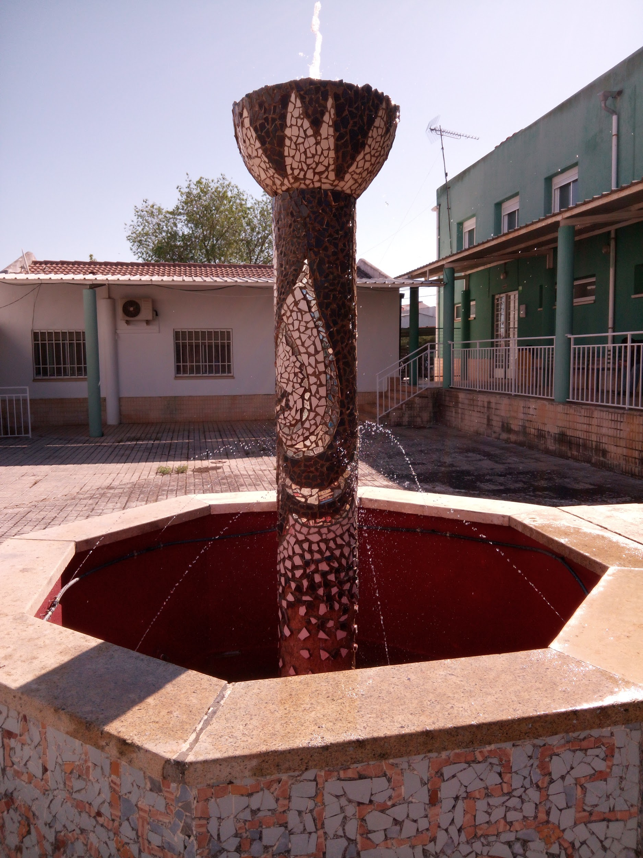
Solar power fountain

Slide 2
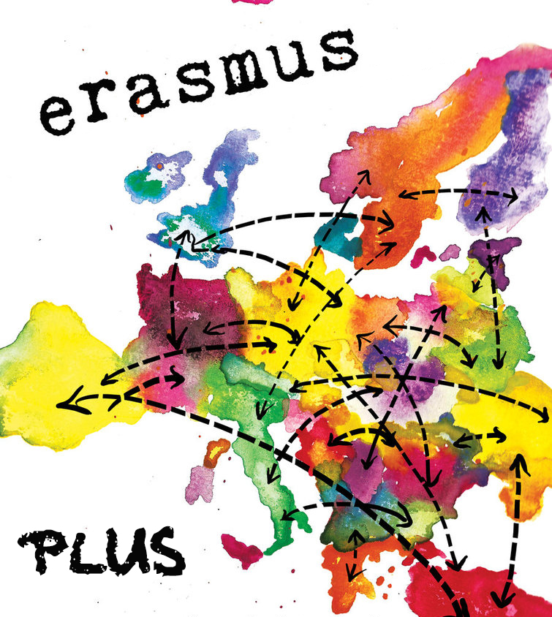
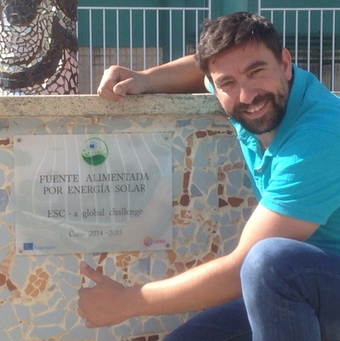
Where does this idea come from?
This is an initiative from the Erasmus’ project and it finished one year ago

Slide 3
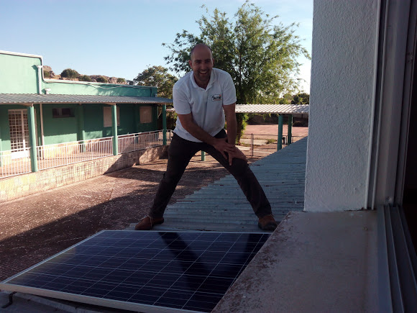
The fountain works with a water pump from a well propelled by a solar panel.
(renewable energy, we don’t use any other type of energy).

Slide 4
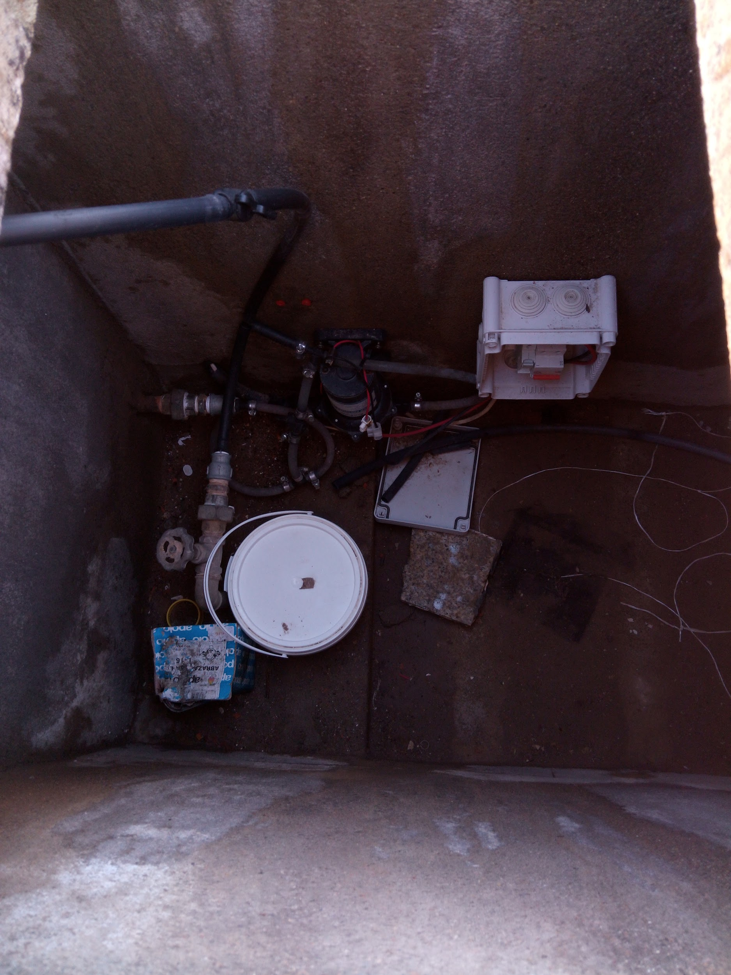
This fountain doesn’t work on cloudy days because the solar panel can’t get the sun power to propel the water pump.
On/Off
The pump uses always the same water, so, we don’t use more water than we need.

Slide 5
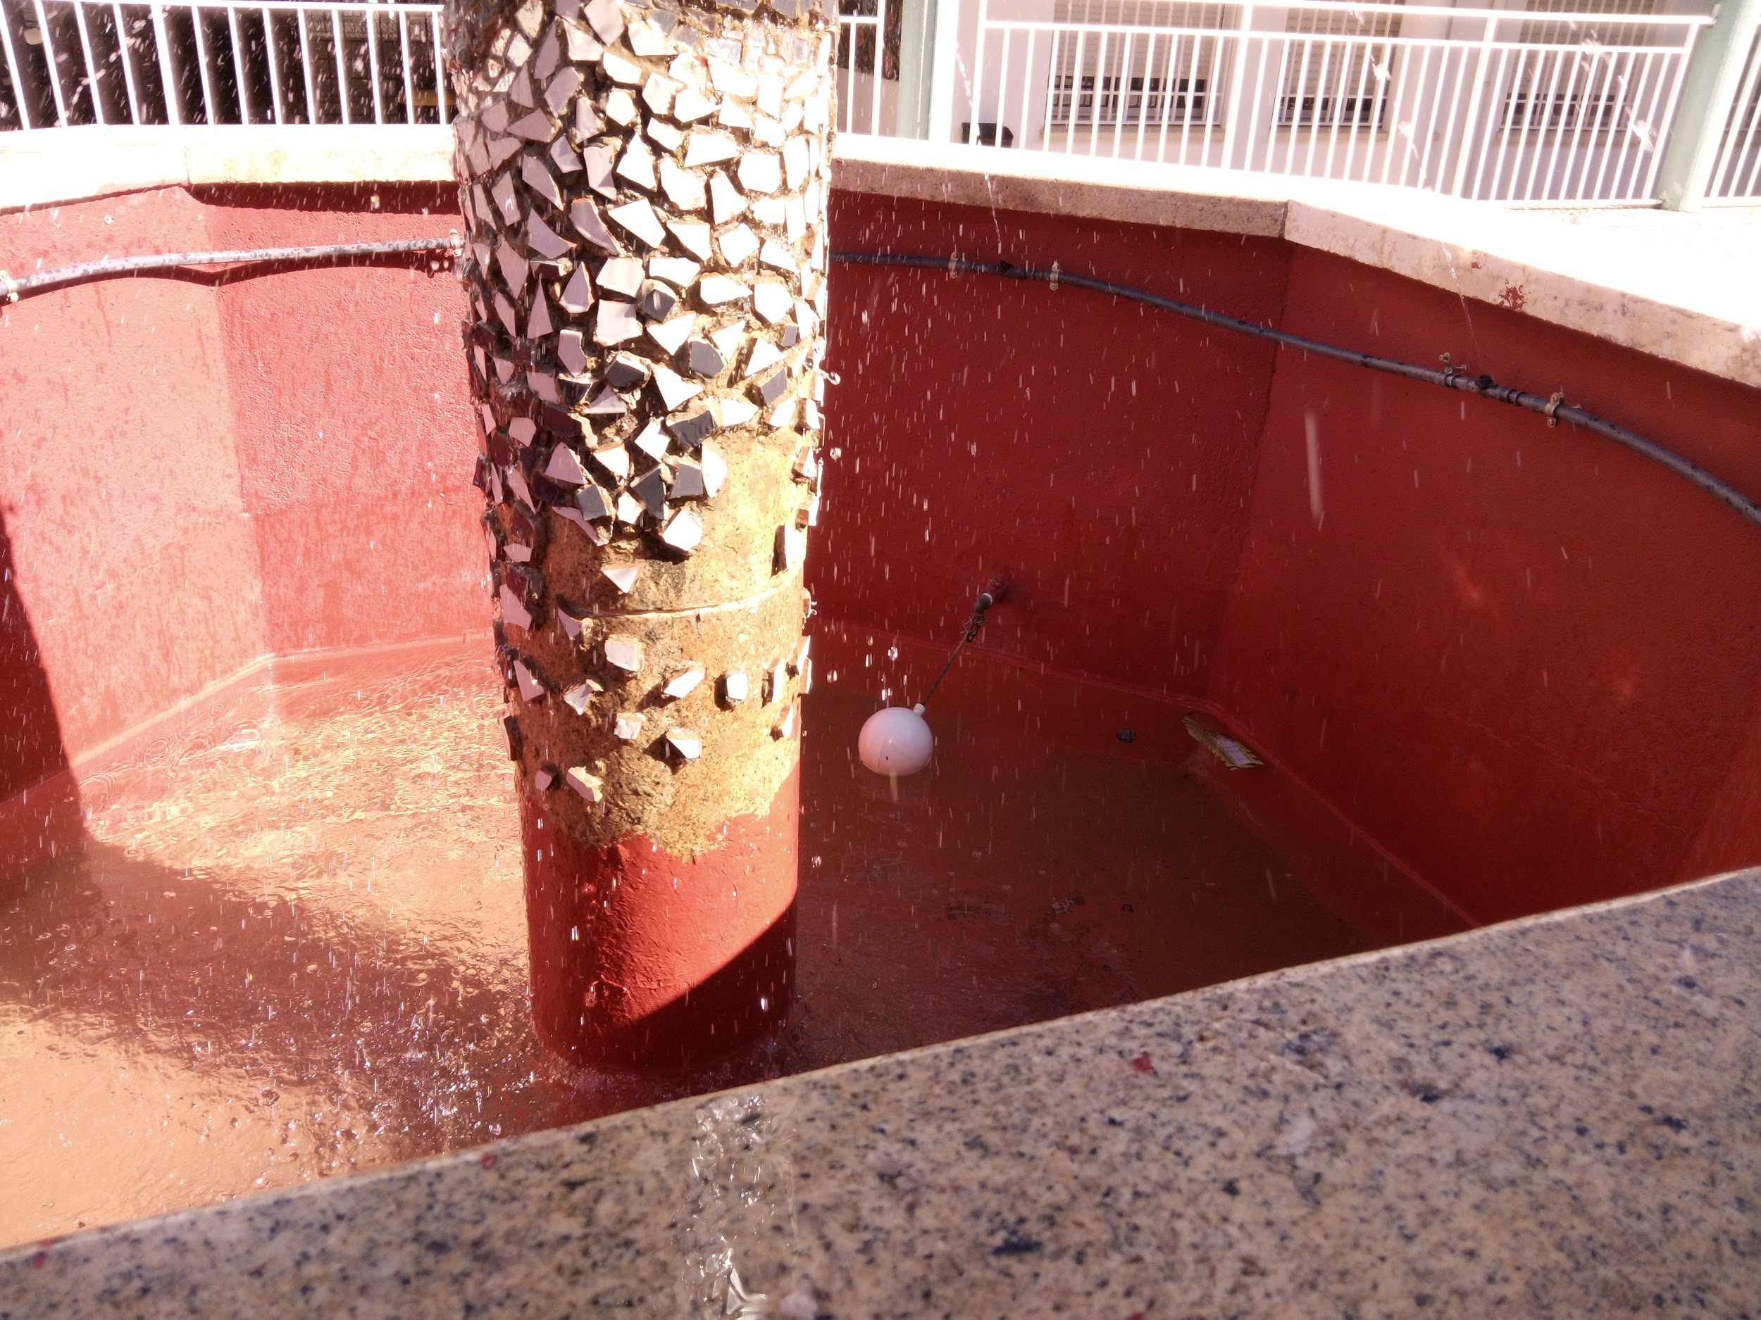
There is a white buoy. If this buoy is lower than usual, a tap which throws some water is activated
The tap
The buoy

Slide 6
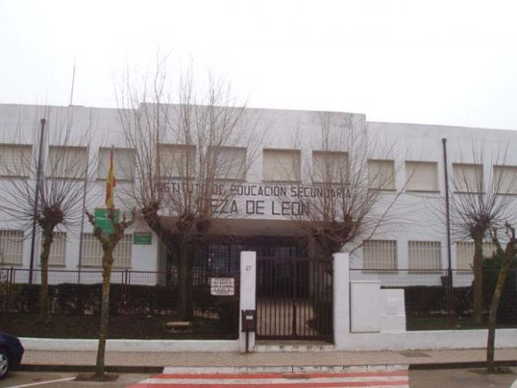
This fountain is located in I.E.S. de Llerena (Cieza de León’s building, where people from Bachillerato and profesional formation study)

