Slide 1
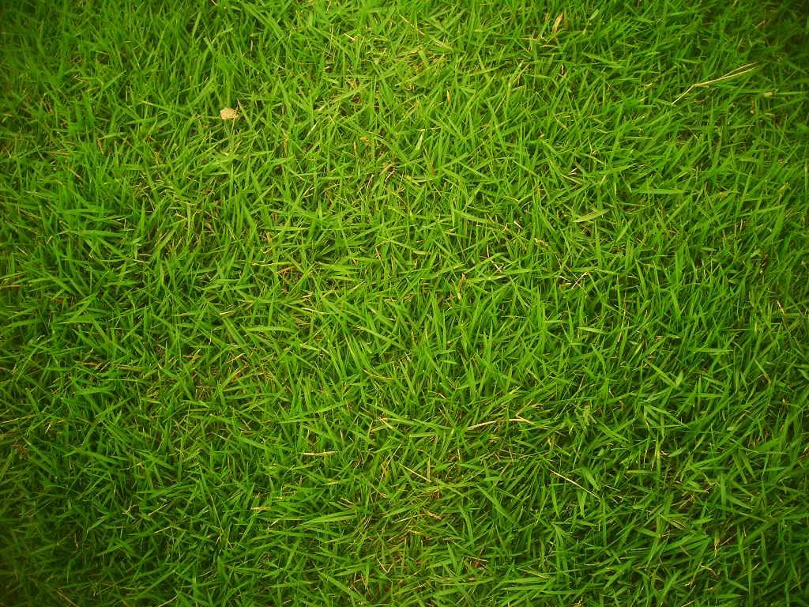
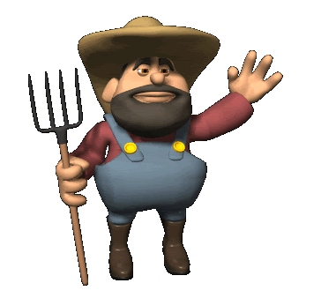
Spanish Eco-Garden

Slide 2
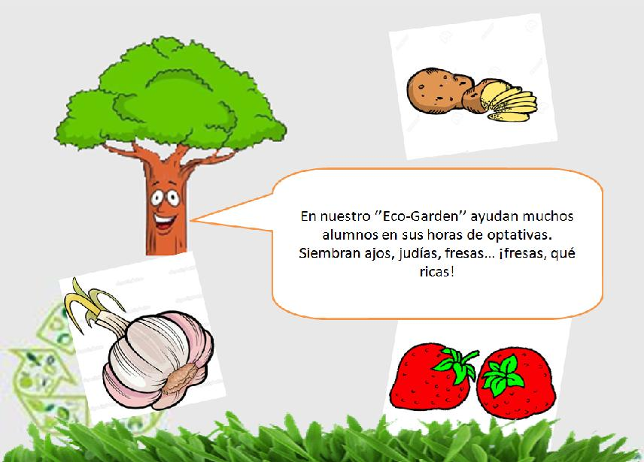
Selection process
To come to Italy, we had to pass a selection process.
In my selection project I talk about new ideas for our EcoGarden, for that reason, I’m going to talk about the EcoGarden.
I proposed to do a solar power system of irrigation

Slide 3
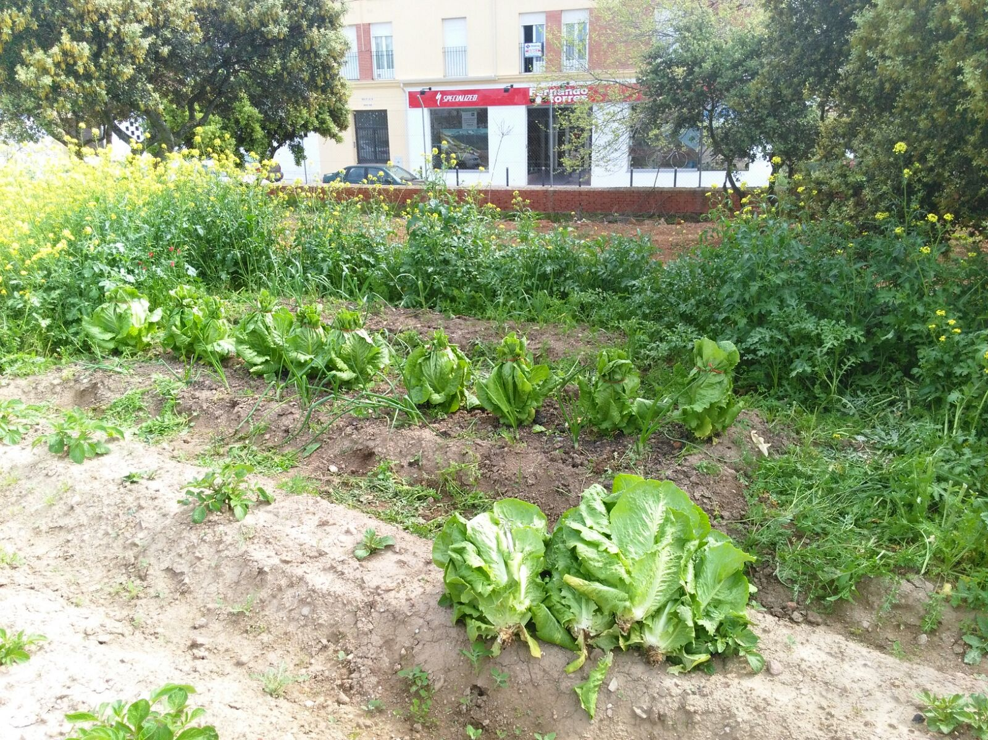
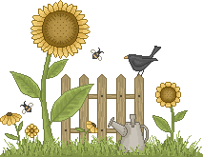
Placement
Our eco-garden is situated in the back part of our School garden. It is separated from the rest of the garden by a fence.
Around it, there are many native trees.

Slide 4
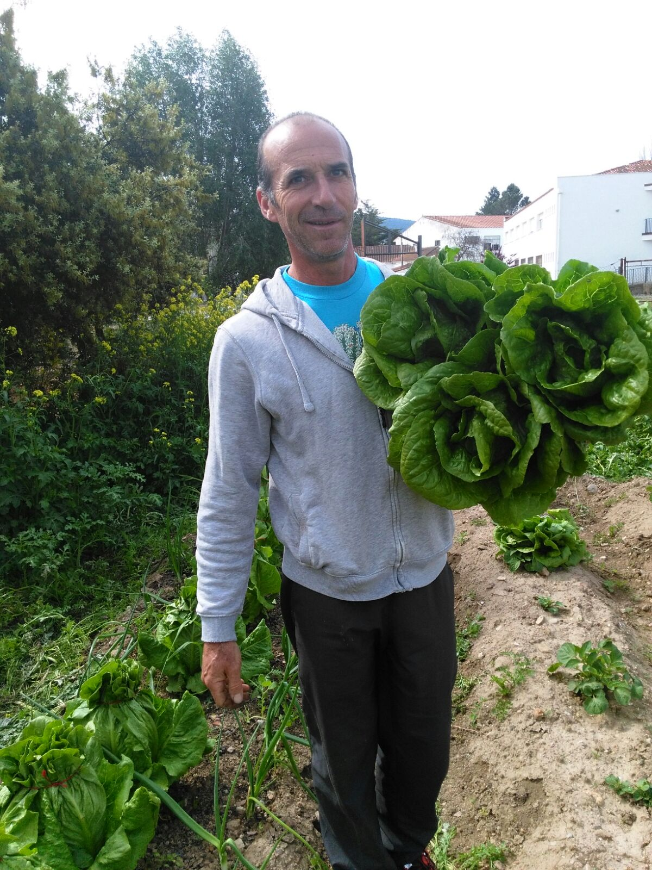
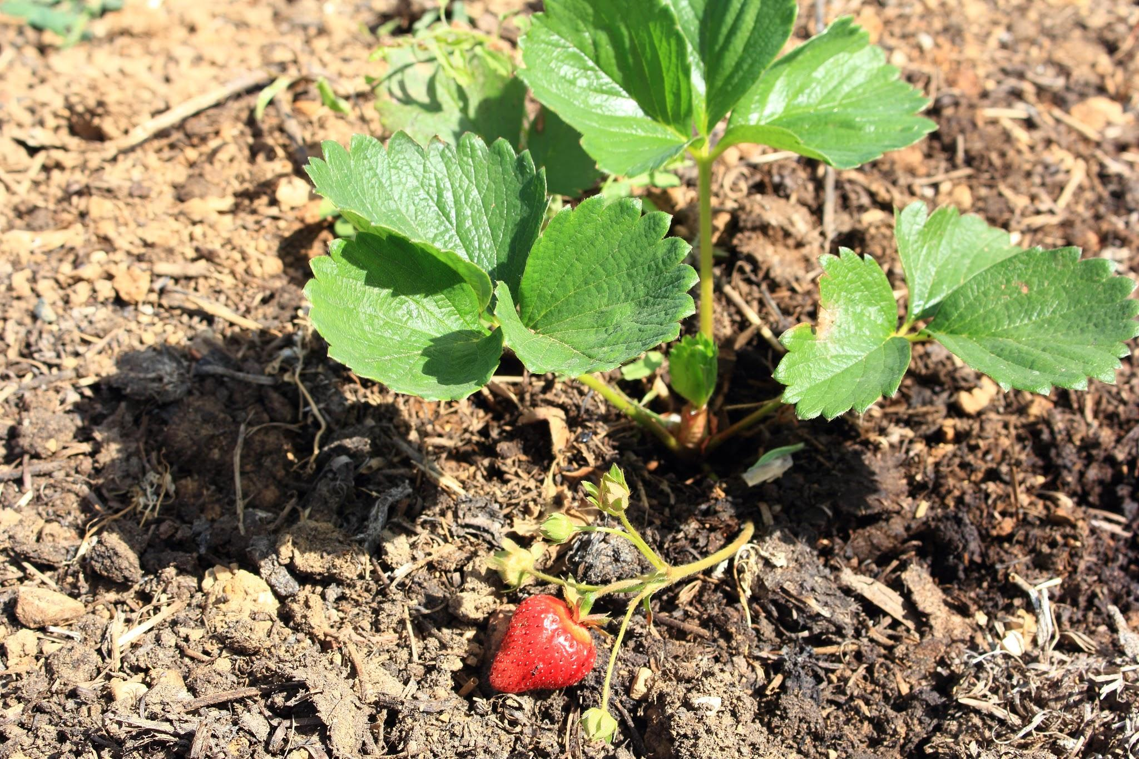
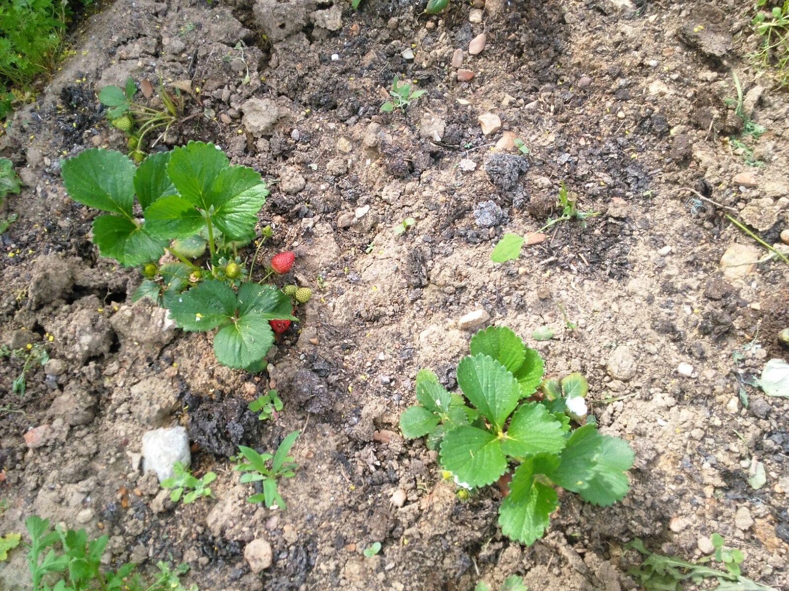
Vegetables we plant there
In our EcoGarden we plant delicious fruits and vegetables, such as strawberries, lettuces, garlics, onions, beans..

Slide 5
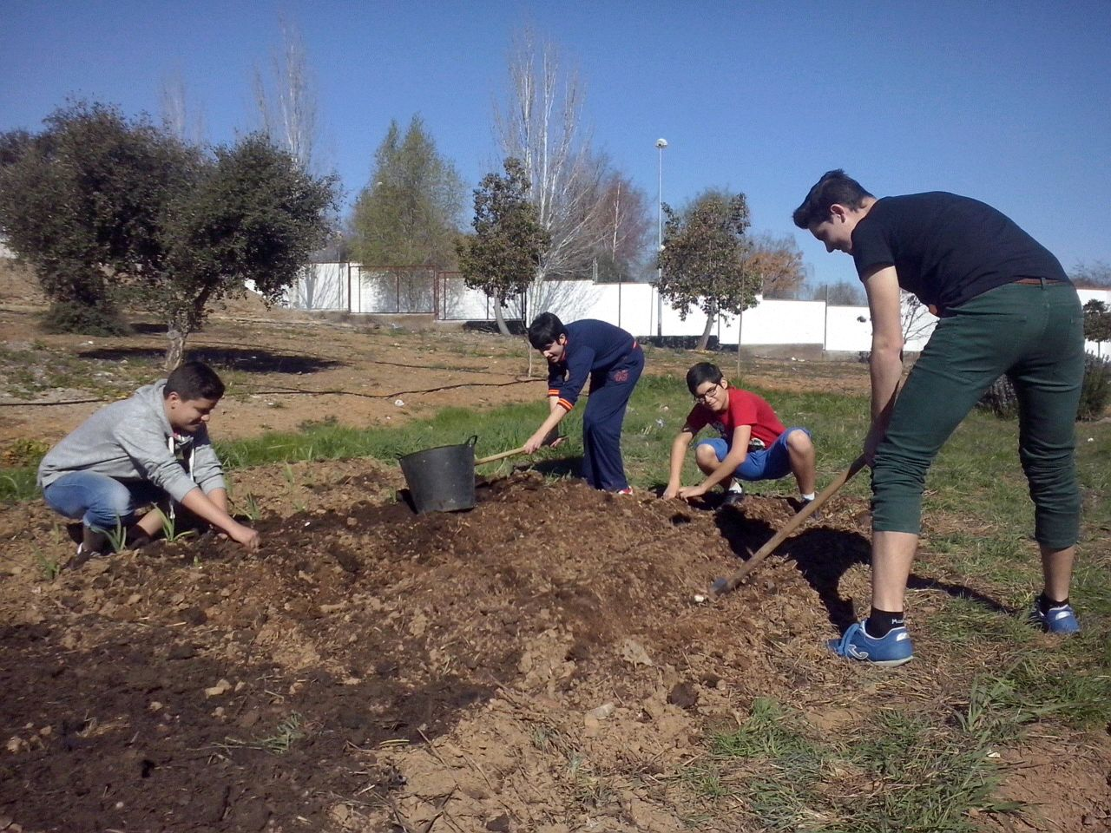
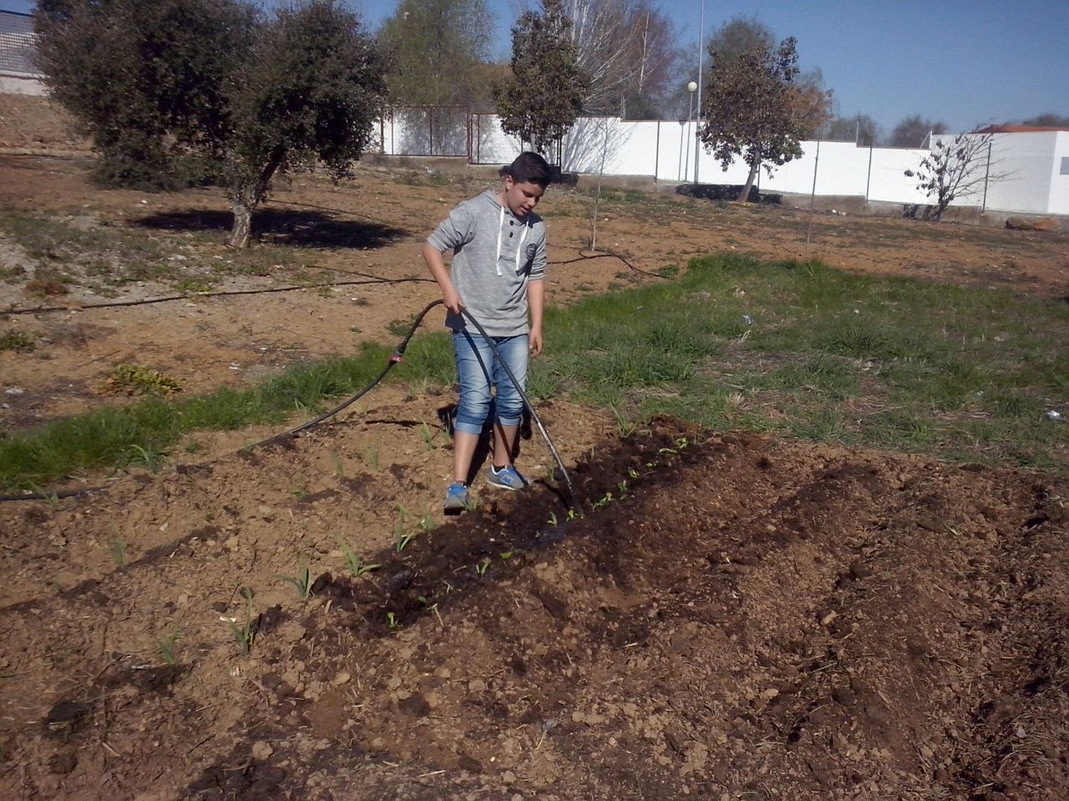
Farmers
The workers in the EcoGarden are our school’s students.
They collaborate voluntarily thanks to a project called EcoCentro. It teaches the students an ecological way to do the things.

Slide 6
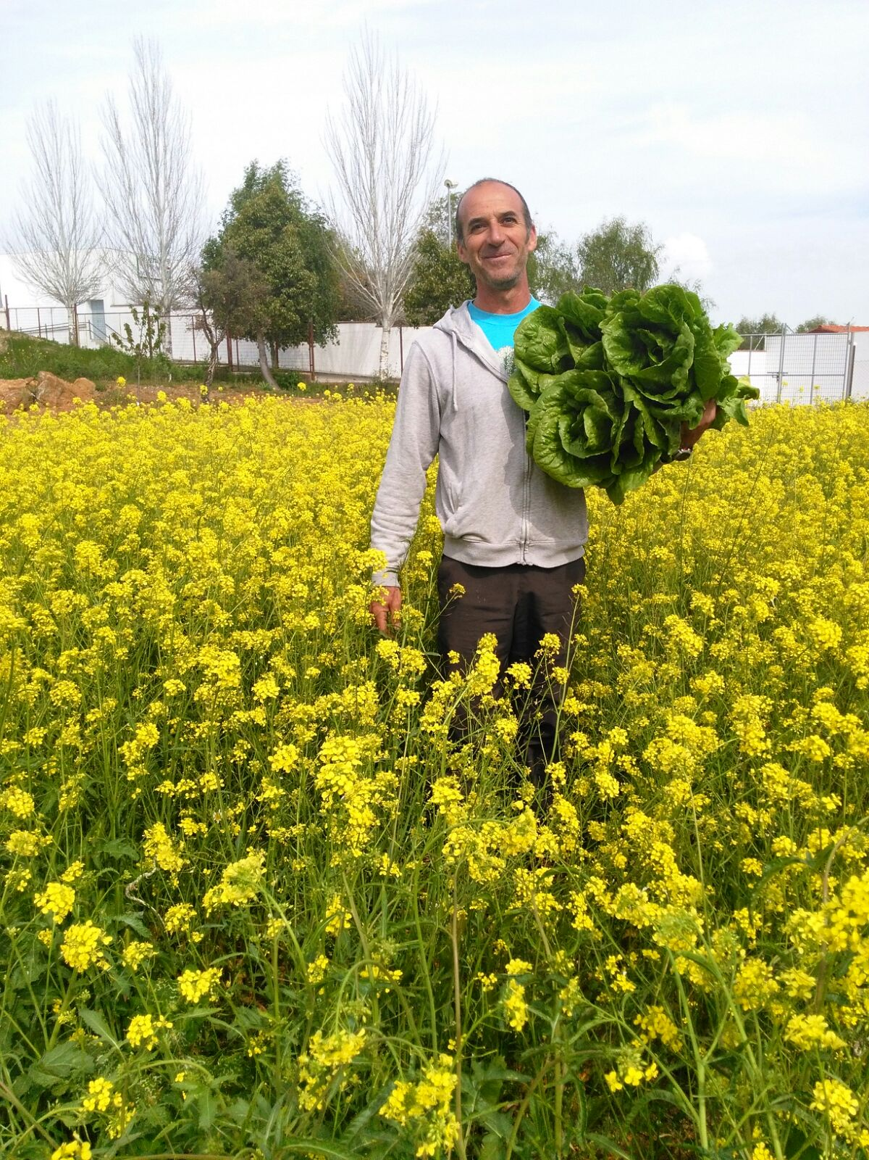
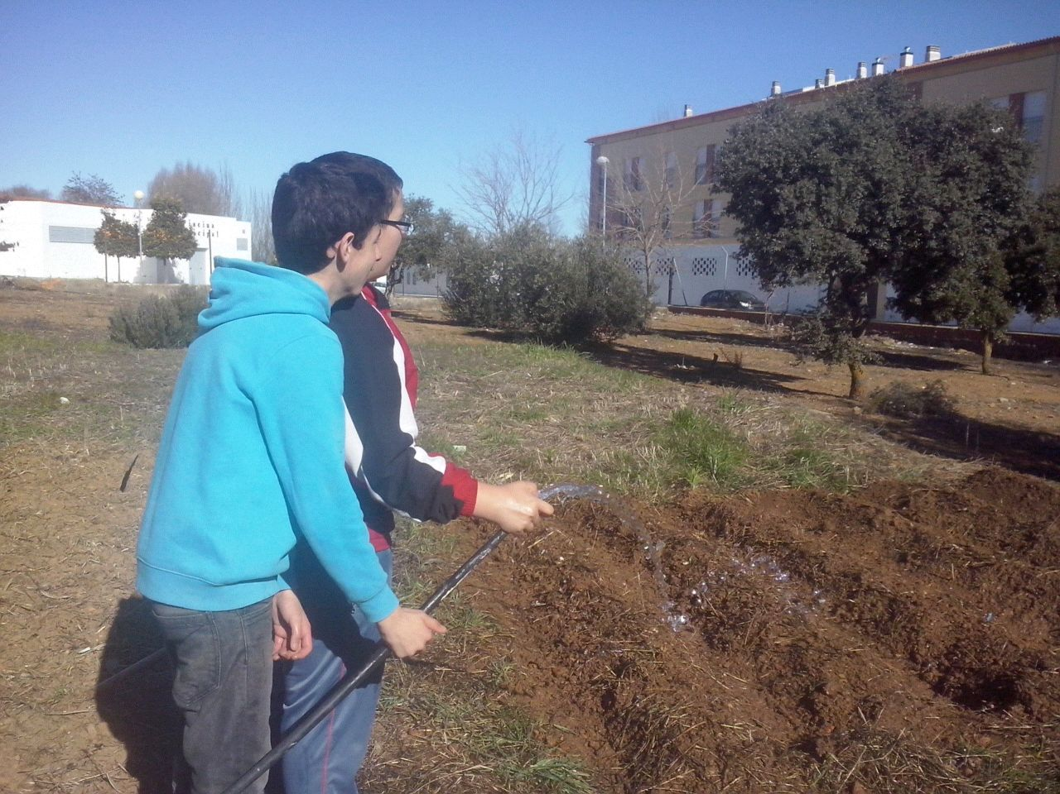
History
Our School garden was born in a project called EcoSchool.
Later, it was needed for this project, for the Erasmus project.. We had been working on it for the EcoCentro project and now we’re working for the Erasmus project.

