Slide 1
WHAT SHOULD WE DO for SUSTAINABLE CONSUMPTION?

Slide 2
OUR ENVIRONMENT
The causes of environment pollution are:
Harmful gases from factories
Chemical waste from factories ,hospitals…etc
Harmful gases from cars , some heating systems and chemical products like perfume
Wastes that we throw into environment like plastics,oil …etc
The most important environment problem because of these causes is greenhouse effect
However, we can prevent pollution and contribute to environment.

Slide 3
RECYCLING
Waste gives harm to our environment:
It causes explosions, air pollution,and global warming.
It damages vegetation.
There are some recyclable materials and we must try to recycle them to protect our environment and make use of waste!!!

Slide 4
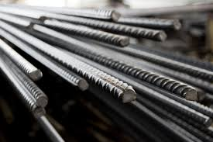
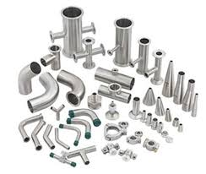
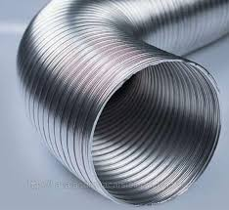
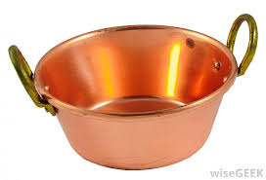
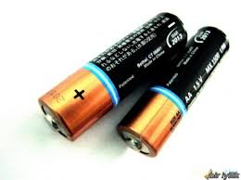
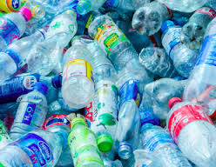
RECYCLEABLE MATERIALS
• Iron • Steel • Aluminum • Copper
•
Batteries • Paper • Plastic •Glass

Slide 5
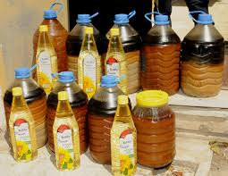
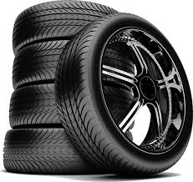
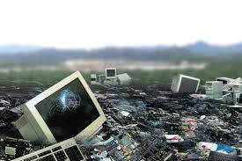
RECYCLEABLE MATERIALS
•Waste oil • Tyres • X-rays
• Electronic waste • Organic waste

Slide 6
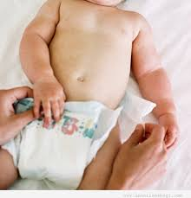
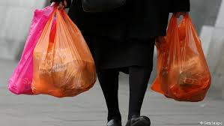
NON-RECYCLABLE HOUSEHOLD WASTE
1. wax paper, soaked paper,
2. window glass, mirrors, crystals, wired glass
3. Nylon, foam, pipette
4. Light bulbs, toys
5. Diapers, ceramics
6. motor oil, antifreeze

Slide 7
We should recycle plastics because:
it takes 450 years a plastic bottle to decompose in nature !
Plastic is made of petrol.
One recycled plastic bottle would save enough energy to power a 30-watt light bulb for 6 hours !

Slide 8
We should recycle paper because:
Recycling 1 ton of paper saves 17 trees !
We can make packaging boxes, toilet papers, copying papers, egg cartons by using recycled papers !

Slide 9
We should recycle glass because:
Glass can always be recycled again and again with th same quality !
100 % of glass can be recycled.
It takes 4000 years a glass bottle to decompose in nature !

Slide 10
We should recycle aluminium because:
It takes 80-100 years an aluminium can to decompose in nature.
But recycling an aluminium can takes only 2 months.
One recycled aluminium can save enough energy to run a television for 3 hours !!!

Slide 11
We must be careful about the oil we have used at home.
We shouldn’t pour the used oil to the sinks because, 1 liter of used oil pollute 1 million liters of water and this causes the death of sea creatures.
We must save it and give it to saving centers.

Slide 12
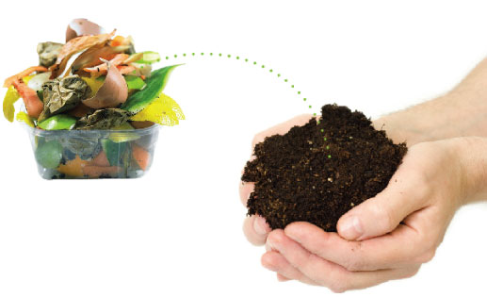
Organic waste is another waste source that we can make use of.
We can make compost by using organic waste.

Slide 13
SIGNS FOR RECYCLING
Recycleable
Green Point
Made of recycled material

Slide 14
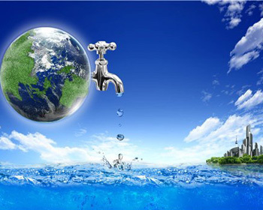
SOURCES on EARTH
WATER
It is the main liquid source for human body.
A person can only live 7-10 days without water.

Slide 15
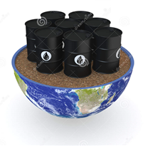
SOURCES on EARTH
OIL(PETROL)
It is the most widely used energy source in the world.

Slide 16
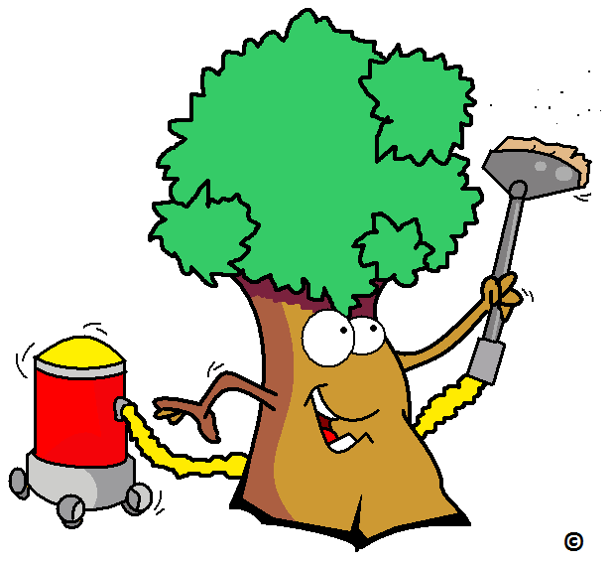
SOURCES on EARTH
TREES
Trees provide oxygen for the environment.
They prevent erosion.
Planting trees is the best way to struggle with greenhouse effect.
So, we should plant trees as
many as we can.

Slide 17
SOURCES on EARTH
Renewable energy sources are:
Solar , Wind ,Hydroelectric , Biomass , Hydrogen and fuel cells , GeothermalEnergy from tides, the oceans and hot hydrogen
We can get coal, oil , natural gas from renewable energy sources
They are called environmental friendly energy sources.

Slide 18
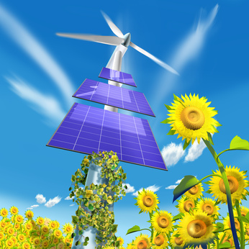
SOLAR ENERGY
The Sun / Solar Energy is the main source of all currently existing energy sources.
Solar energy can be converted to kinetic,heat and electric energy

Slide 19
SAVING ENERGY
We should turn off all appliences to standy-by when not in use.
Items such as cell phones chargers, coffeemakers, desktop printers, radios etc., consume energy even when they are turned off. So, we should turn off and unplug all appliances when not in use.
We should turn off all lights when not in the room.

Slide 20
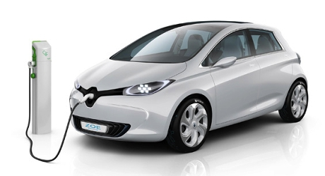
We should prefer electrical households with A class label because they save energy more.
We shouldn’t put our fridge next to the heating system.
We should prefer energy saving bulbs.
We can prefer electric cars because they protect environment.

Slide 21
Heating and cooling rooms consume the most energy ! So:
*We shouldn’t keep the windows closed as much as possible in cold weather.
*We shouldn’t use air conditioning in hot weather as much as possible.

Slide 22
TO SUM UP:
We should learn:
to recycle
to save energy
to save the sources of energy
to learn about sustainable consumption

