Slide 1
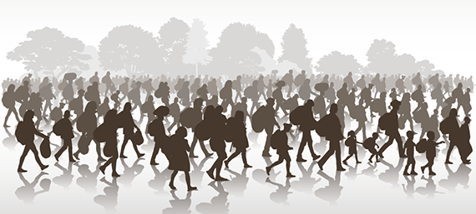
To understand better Migration

Slide 2
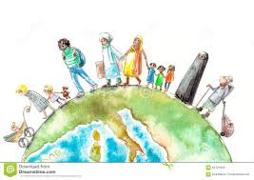
GLOSSARY
Types of Migration:
Internal Migration: Moving to a new home within a state, country, or continent.
External Migration: Moving to a new home in a different state, country, or continent.
Emigration: Leaving one country to move to another (e.g., the Pilgrims emigrated from England).
Immigration: Moving into a new country (e.g., the Pilgrims immigrated to America).
Population Transfer: When a government forces a large group of people out of a region, usually based on ethnicity or religion. This is also known as an involuntary or forced migration.
Impelled Migration (also called "reluctant" or "imposed" migration): Individuals are not forced out of their country, but leave because of unfavorable situations such as warfare, political problems, or religious persecution.

Slide 3
Step Migration: A series of shorter, less extreme migrations from a person's place of origin to final destination—such as moving from a farm, to a village, to a town, and finally to a city.
Chain Migration: A series of migrations within a family or defined group of people. A chain migration often begins with one family member who sends money to bring other family members to the new location. Chain migration results in migration fields—the clustering of people from a specific region into certain neighborhoods or small towns.
Return Migration: The voluntary movements of immigrants back to their place of origin. This is also known as circular migration.
Seasonal Migration: The process of moving for a period of time in response to labor or climate conditions (e.g., farm workers following crop harvests or working in cities off-season; "snowbirds" moving to the southern and southwestern United States during winter)

Slide 4
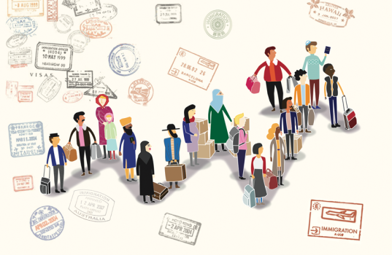
Why Do People Migrate?
People move for a variety of reasons. They consider the advantages and disadvantages of staying versus moving, as well as factors such as distance, travel costs, travel time, modes of transportation, terrain, and cultural barriers.
Push Factors: Reasons for emigrating (leaving a place) because of a difficulty (such as a food shortage, war, flood, etc.).
Pull Factors: Reasons for immigrating (moving into a place) because of something desirable (such as a nicer climate, better food supply, freedom, etc.).

Slide 5
Several types of push and pull factors may influence people in their movements (sometimes at the same time), including:
1. Environmental (e.g., climate, natural disasters)
2. Political (e.g., war)
3. Economic (e.g., work)
4. Cultural (e.g., religious freedom, education)

Slide 6
Which of these things would most make you want to leave your home city or country?
• Unemployment
• Poor housing and services
• Poverty
• Famine
• War/unsafe social situation
• No job propescts for your skills/qualifications
• Government persecution
• Discrimination
• Climate
Others…

Slide 7
Try to imagine you are “that person”.
Tell your group about
• what you miss about your old country.
• what you like about your new city/country.
• the negative things about living where you live.
• how you keep in touch with family and friends back home.
• the new friends and people you have met.
• your hopes for your children.
• your plans for the future.

