Slide 1
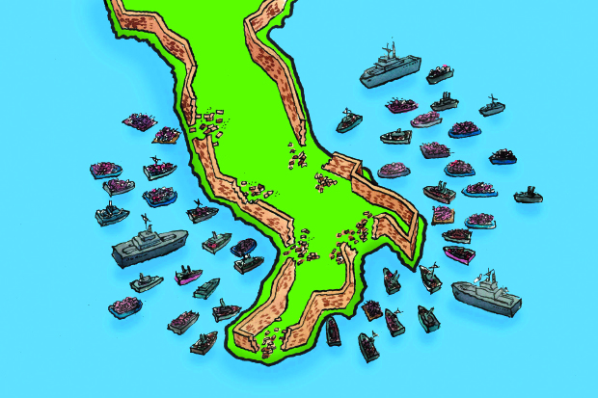
Immigration to italy

Slide 2
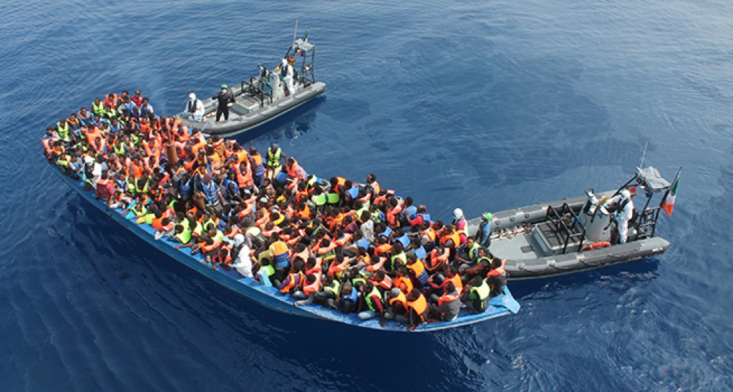
Immigration: the international movement of people into a destination country of which they are not natives or where they do not possess citizenship in order to settle or reside there, especially as permanent residents or naturalized citizens, or to take-up employment as a migrant worker or temporarily as a foreign worker

Slide 3
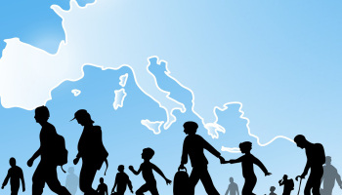
DEFENITION
To migrate: To move from one place to another

Slide 4
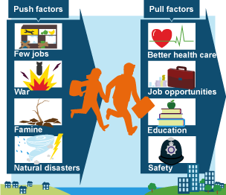
Why do people migrate?
.To escape conflict or violance
. To find refuge after being displaced due to envirommental factors
.To seek superior healthcare
. To escape poverty

Slide 5
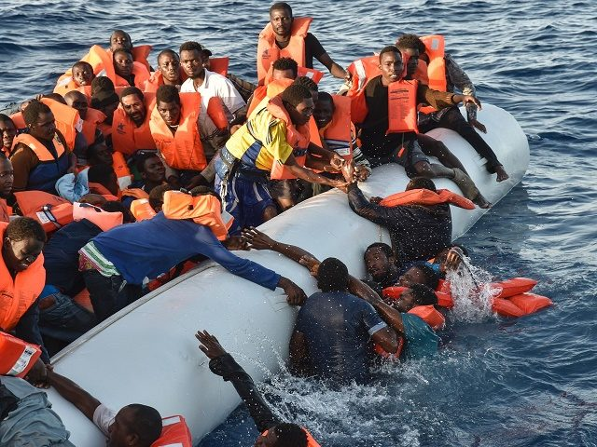
The danger they face
Many illegal immigrants from Africa make the dangerous boat journey across the Mediterranean Sea to Italy. This has led to numerous disasters such as the 2013 Lampedusa migrant shipwreck, and the 2015 Mediterranean Sea migrant shipwrecks.Once in Italy, immigrants seeking asylum often are unable to leave due to the Dublin Regulation requirement that they stay in the first country where they are processed

Slide 6
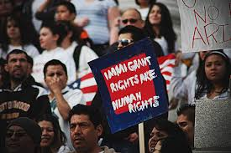
Discrimination against immigrants
Immigrants to Italy are affected by a totally separate type of discrimination. Some people feel as though the large amounts of people being allowed into the country are cause for alarm, therefore discriminate against them

Slide 7
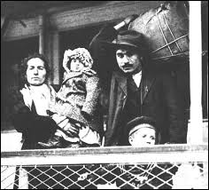
Italian emigration
The Italian diaspora is the large-scale emigration of Italians from Italy to America, after the II world war

Slide 8
Immigrants in Italy

Slide 9
By:Wathmini Mutukuda

