Slide 1
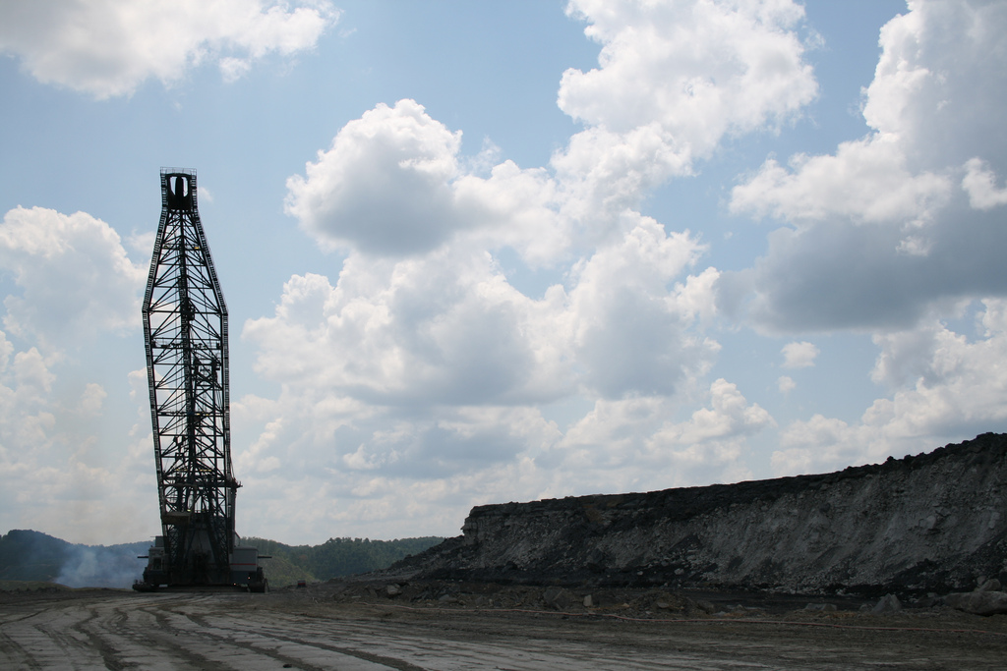
Alternatives to coal power.
Aleksander Kopyto, 2017

Slide 2
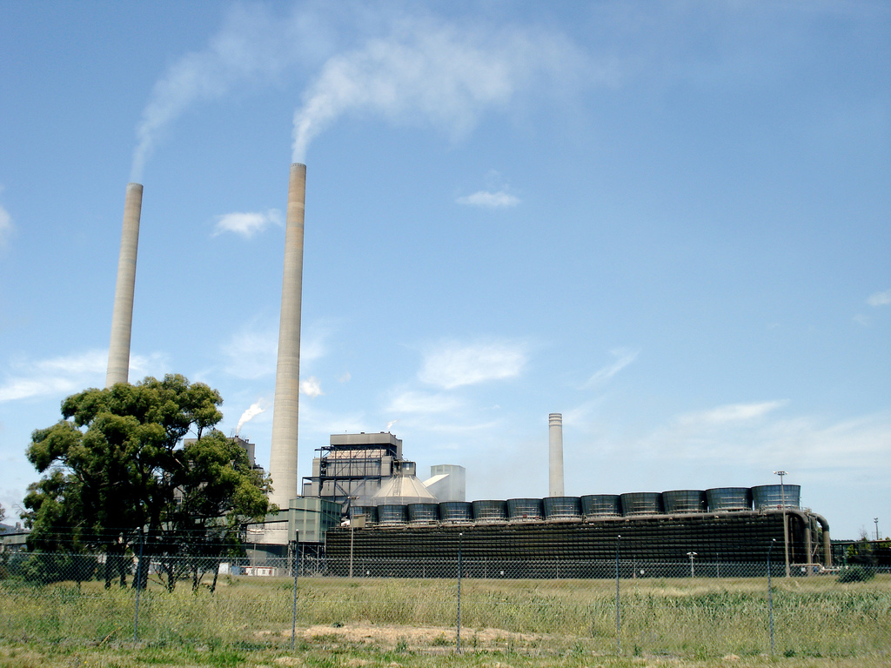
Advantages and disadvantages of coal power:
Advantages:
Relatively inexpensive fuel,
Abundant supply of fuel,
Light upfront investments.
Disadvantages:
Coal is non renewable,
Coal burning releases SOx and NOx which both cause acid rain,
Coal emits the most CO2 per Watt,
Coal mining is the second highest emitter of methane.
For these reasons it’s a good idea to start thinking about replacing coal with another energy source.

Slide 3
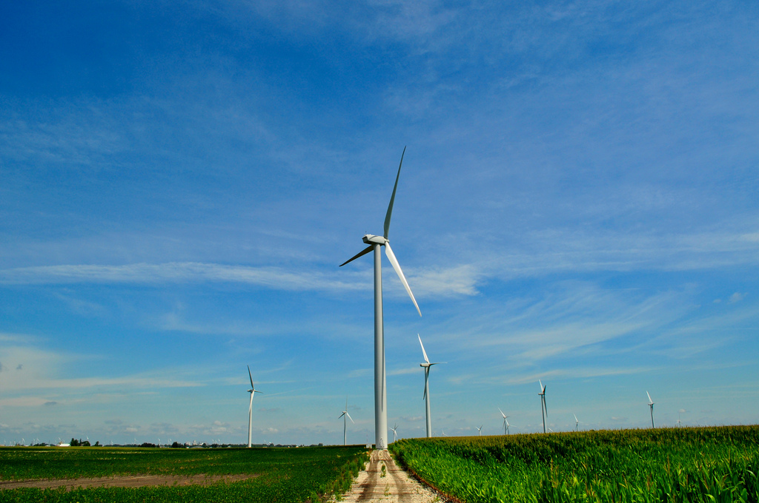
Wind
Advantages:
Wind energy does not cause pollution.
The operational costs associated with wind power are low.
Wind turbines are incredibly space-efficient.
Wind power is renewable.
Disadvantages:
Wind turbines can be a threat to wildlife,
They emit loud noise,
Heavy upfront investments,
Wind is a fluctuating, the amount of energy produced changes.
Wind is a good energy source in countries like the UK but not in Finland, where there is very little wind.

Slide 4
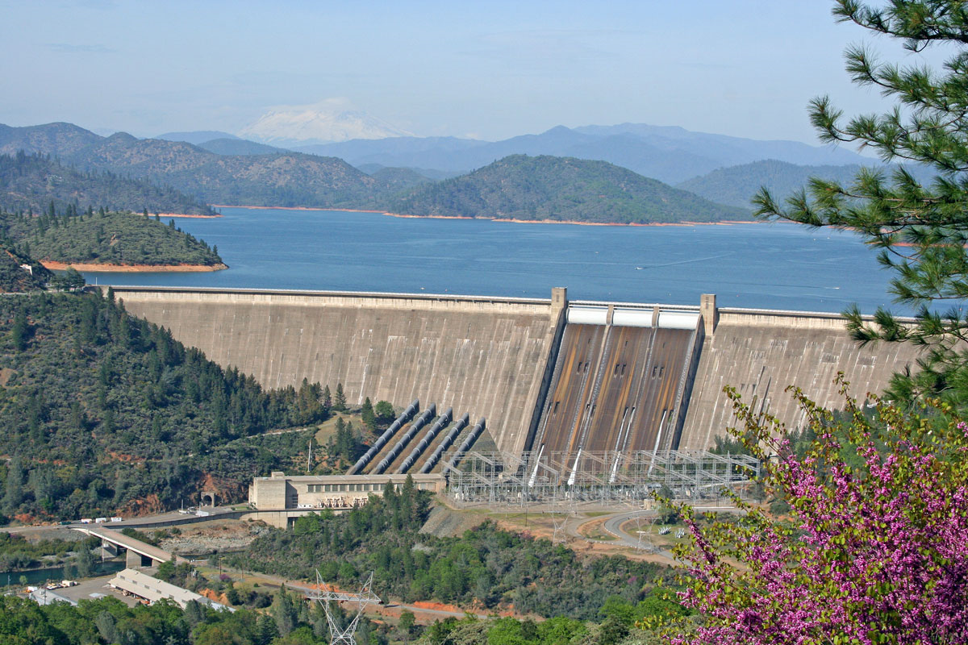
Hydroelectric
Advantages:
Hydroelectric dams cause little pollution.
They create many new jobs,
Hydroelectric dams attract tourists,
Hydroelectric energy is renewable,
The amount of energy produced is flexible.
Disadvantages:
Hydroelectric dams can be a threat to wildlife and change the local microclimate,
They emit loud noise,
Heavy upfront investments,
They emit methane by flooding large areas of greenery.
Hydroelectricity is a good energy source in countries like Norway but not in Lithuania, where the terrain is flat.

Slide 5
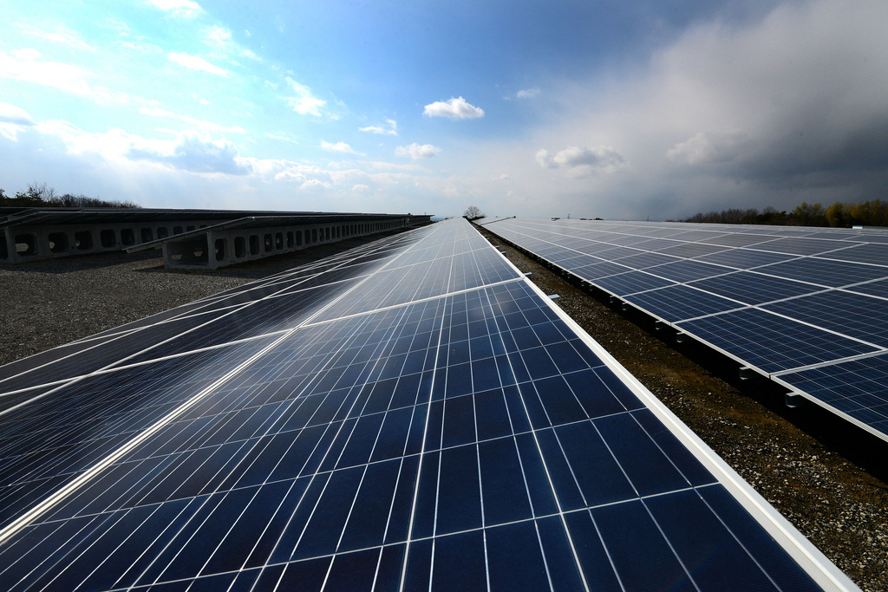
Solar
Advantages:
Solar panels don’t create pollution,
They are silent,
They are low Maintenance,
Solar power is renewable.
Disadvantages:
They are quite expensive,
They can generate lower amounts of energy during cloudy days
They don’t generate energy during the night,
They require a lot of space,
Their manufacturing process requires exotic materials
Solar energy is a good energy source in countries like Spain or Italy but not in Iceland, where it’s cloudy.

Slide 6
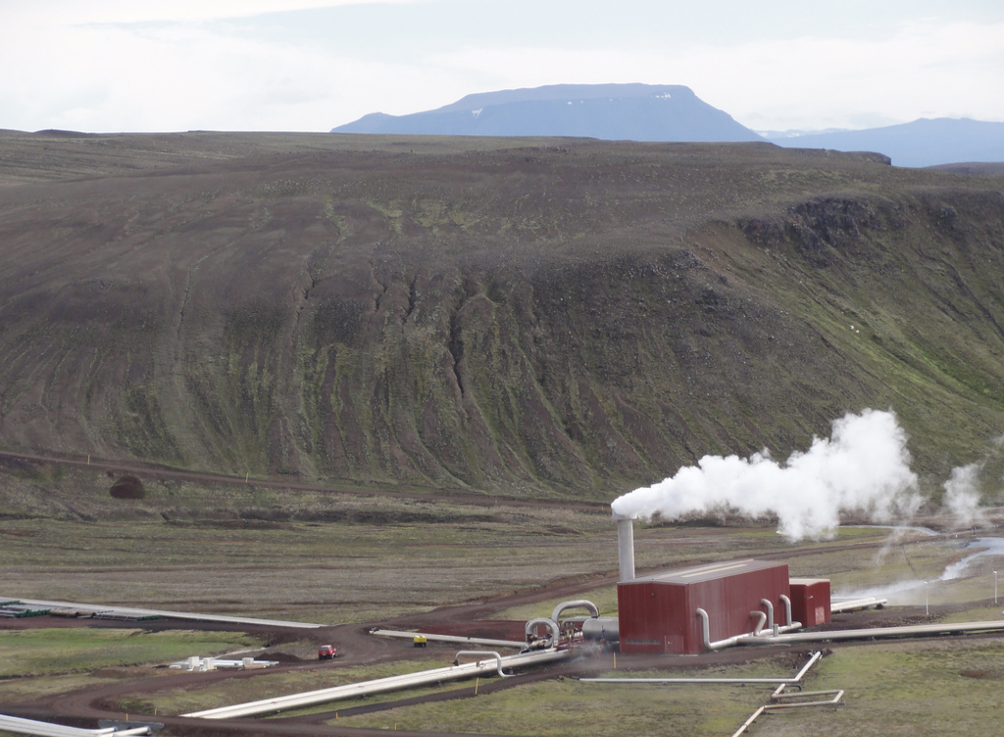
Geothermal
Advantages:
Geothermal plants are mostly pollution-free,
They are very small and can be built underground,
Geothermal energy is renewable,
The amount of energy produced is flexible.
Disadvantages:
In extreme cases they can cause earthquakes
They are very location specific,
Heavy upfront investments,
They are not 100% environmentally friendly.
Geothermal energy is a good energy source in countries like Iceland, because of the geological activity there.

Slide 7
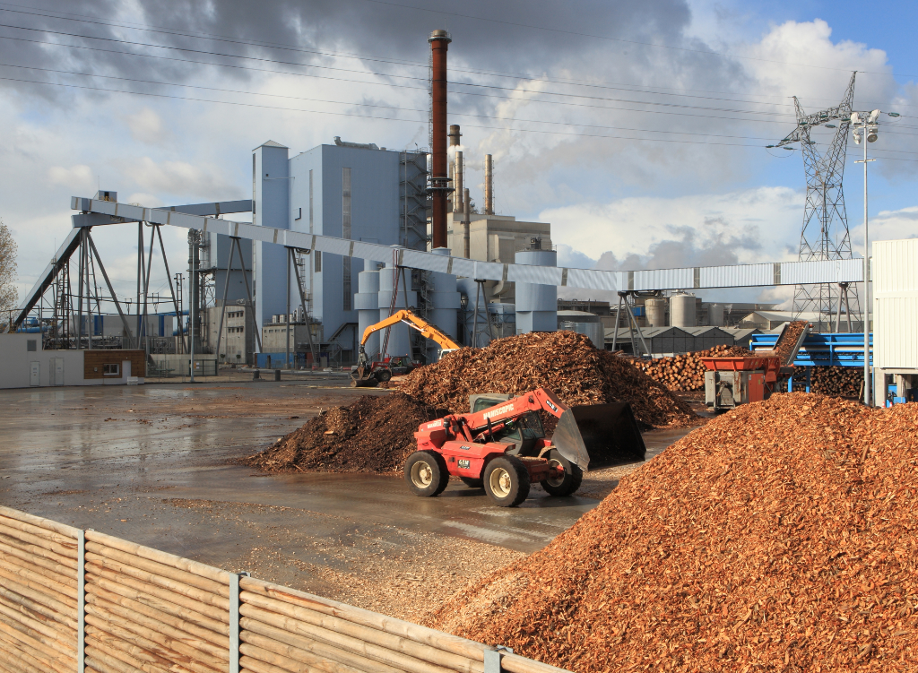
Biomass
Advantages:
They are rather cheap and can be made by converting coal plants,
The fuel (I.e. wood or hemp oil) is renewable,
They can produce high amounts of energy.
Disadvantages:
They generate CO² and CO.
They require a lot of space to grow their fuel
They can be built everywhere. It is also a potential replacement for fossil fuels. The fuel is also very plentiful but requires a lot of water to grow.

Slide 8
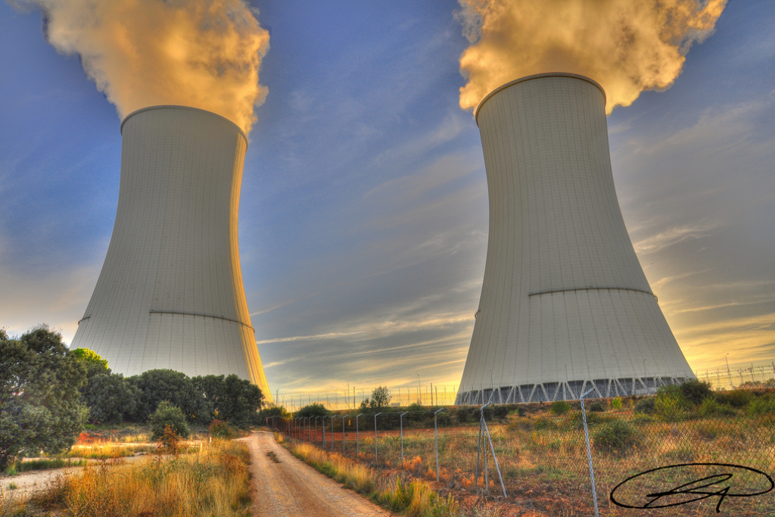
Nuclear Fission
Advantages:
They generate a lot of energy,
They create many new jobs,
The cost of energy is pretty low.
Disadvantages:
Their waste is dangerous and hard to get rid of,
They require a lot of water,
Heavy upfront investments,
The fuel cost is very high.
They can cause a lot of damage in the event of a natural disaster or an accident (Chernobyl, Fukushima).
Fisson can be a good energy source everywhere where is water. They are very safe, all accidents were man-made or caused by natural disasters.

Slide 9
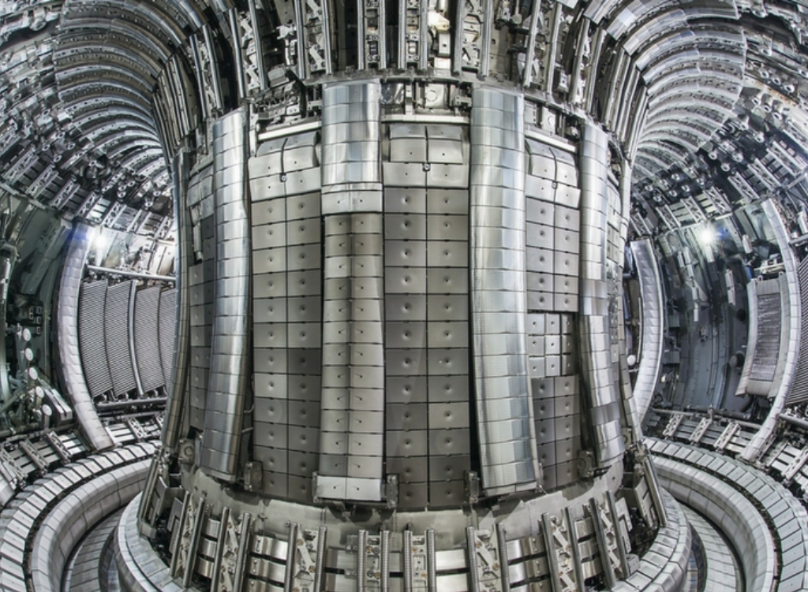
Nuclear Fusion
Advantages:
Fusion plants don’t create pollution.
They are very safe,
They run on hydrogen, which is in water,
Fusion energy is renewable,
The amount of energy produced is extremely high.
Disadvantages:
The technology for them is not yet researched,
They are very big
Heavy upfront investments.
Fusion is the way stars generate energy, they can be set up everywhere, even on the moon. Although ITER is making great progress in this field, the first commercial ones are to be built in 2030s.

Slide 10
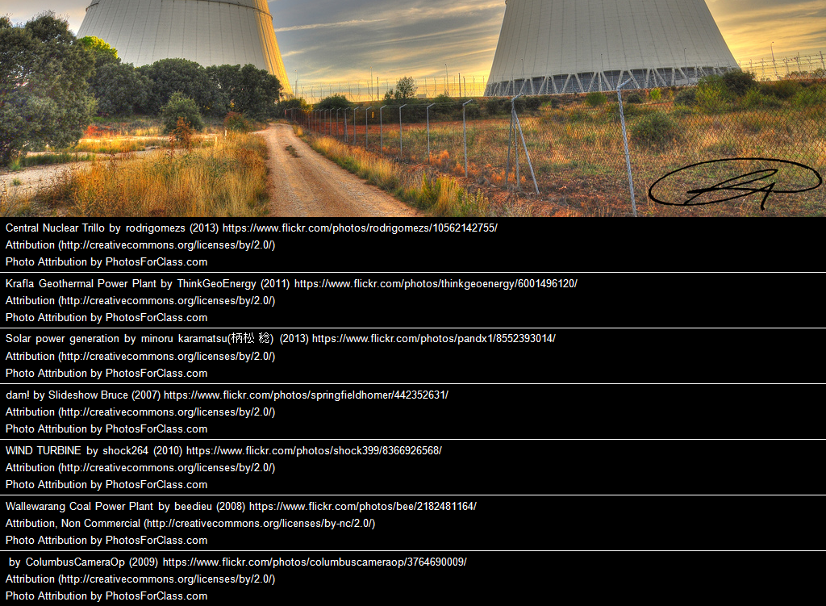
http://www.triplepundit.com/special/energy-options-pros-and-cons/clean-coal-pros-cons/
http://energyinformative.org/wind-energy-pros-and-cons/
http://energyinformative.org/hydroelectric-energy-pros-and-cons/
http://www.nigeriaelectricityhub.com/wp-content/uploads/4756-1-full.jpg
http://energyinformative.org/solar-energy-pros-and-cons/
http://energyinformative.org/geothermal-energy-pros-and-cons/
http://energyinformative.org/nuclear-energy-pros-and-cons/
http://energyinformative.org/biomass-energy-pros-and-cons/
Sources
ITER, EU,
made in LibreOffice
Made in Poland
2017 © Aleksander Kopyto
Thanks for your attention!

