Slide 1
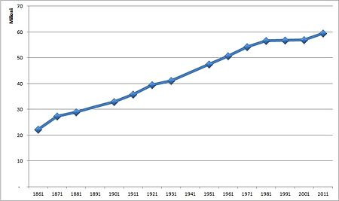
HOME
HELP
OUR
MIGRANT
EMERGENCY

Slide 3
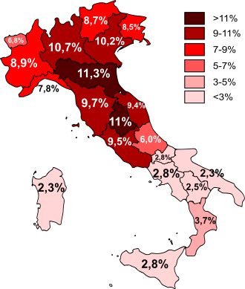
IMMIGRATION
Foreign residents as a percentage of the regional population, 2011
Immigration to Italy occurs from a variety of countries.
As of 1 January 2015, there were 5,014,437 foreign nationals resident in Italy. This amounted to 8.2% of the country's population and represented an increase of 92,352 over the previous year. These figures include children born in Italy to foreign nationals but exclude foreign nationals who have subsequently acquired Italian nationality. Many illegal immigrants from Africa make the dangerous boat journey across the Mediterranean Sea to Italy. Once in Italy, immigrants seeking asylum often are unable to leave due to the Dublin Regulation requirement that they stay in the first country where they are processed.
Since the expansion of the European Union, the most recent wave of migration has been from surrounding European states, particularly Eastern Europe. About a million Romanians, around 10% of them being Roma are officially registered as living in Italy. As of 2013, the foreign born population origin was subdivided as follows: Europe 50.8 % Africa 22.1% Asia 18.8% America 8.3% and Oceania 0.1%

Slide 4
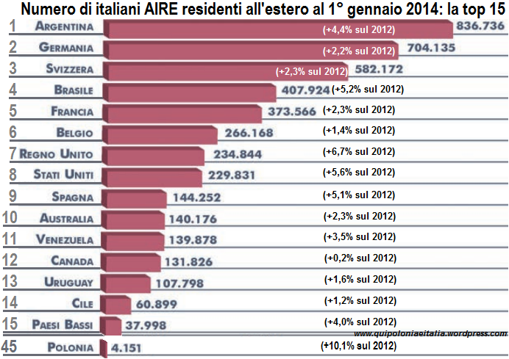
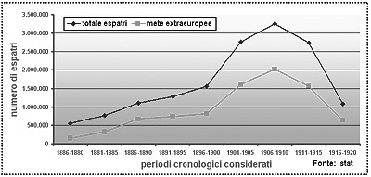
EMIGRATION
The Italian diaspora is the large-scale emigration of Italians from Italy. There are two major Italian diasporas in Italian history. The first diaspora began in 1861 with the Unification of Italy and ended in the 1920s with the rise of the Italian Fascism. The second diaspora started after the end of World War II and roughly concluded in the 1970s. Between the period of 1880 and 1976, the largest voluntary emigration in documented history, with about 13 million Italians leaving the country.[1] By 1978, it was estimated that about 25 million Italians were residing outside of Italy.

Slide 5
DISCRIMINATION
In human social affairs, discrimination is treatment or consideration of, or making a distinction in favour of or against, a person or thing based on the group, class, or category to which the person or thing is perceived to belong rather than on individual attributes.
The term discriminate appeared in the early 17th century in the English language. It is from the Latin discriminat- 'distinguished between', from the verb discriminare, from discrimen 'distinction', from the verb discernere. Since the American Civil War the term "discrimination" generally evolved in American English usage as an understanding of prejudicial treatment of an individual based solely on their race, later generalized as membership in a certain socially undesirable group or social category. "Discrimination" derives from Latin, where the verb discrimire means "to separate, to distinguish, to make a distinction".

