Slide 1
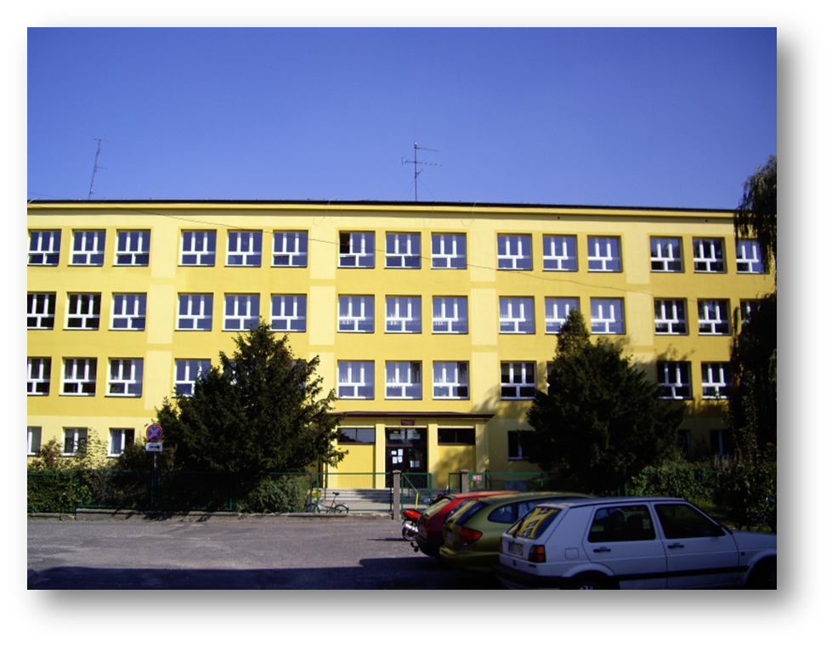
Welcome in our school

Slide 2
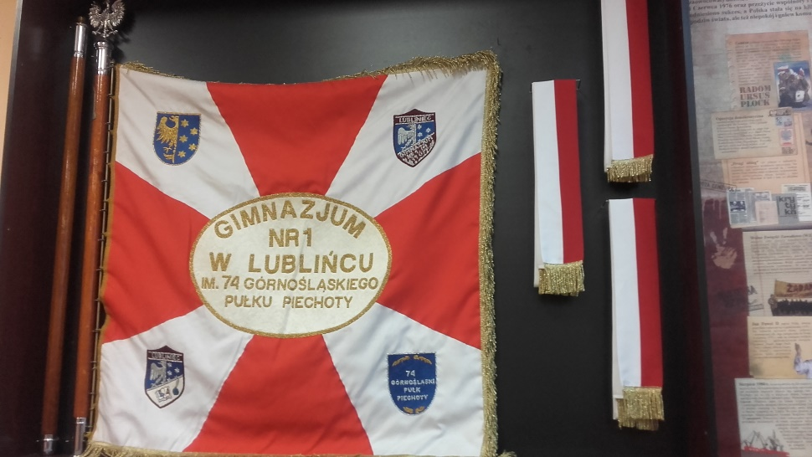
Welcome in Gimnazjum number 1 in Lubliniec!
As part of the project Erasmus+ „Conflict to cooperation” we will showes you our school. Our school is on płk. St. Wilimowskiego 8 Street. It has three floors. We have 32 Classrooms, a small and big sports Hall, a school shop and a new schoolyard.
Have a nice watching!

Slide 3
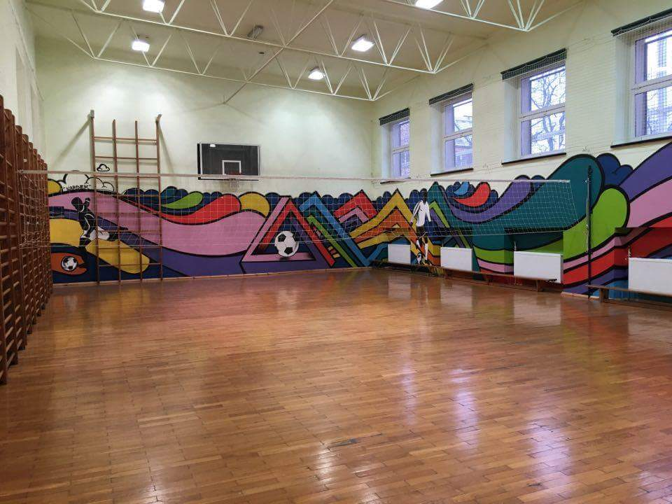
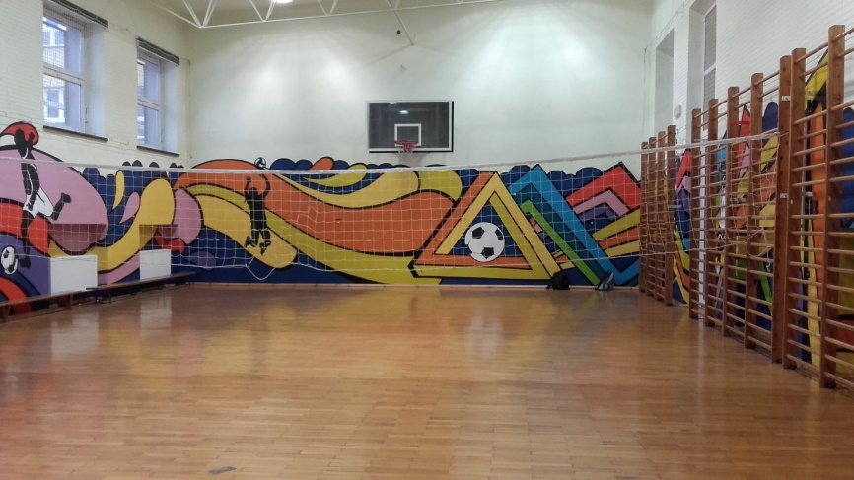
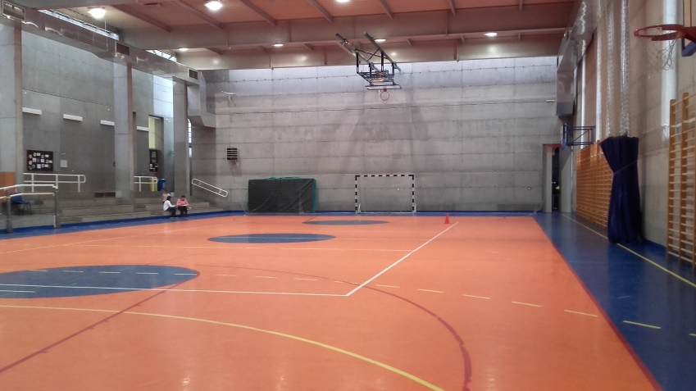
Sports hall
On the big Hall we have sometimes a handball match. Most of the players are boys from our school.
The small Sport Hall:
The big Sport Hall:

Slide 4
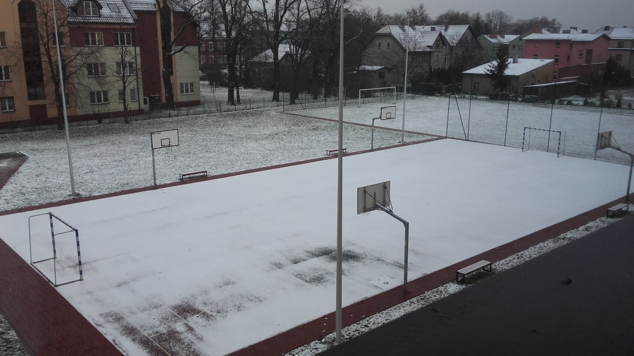
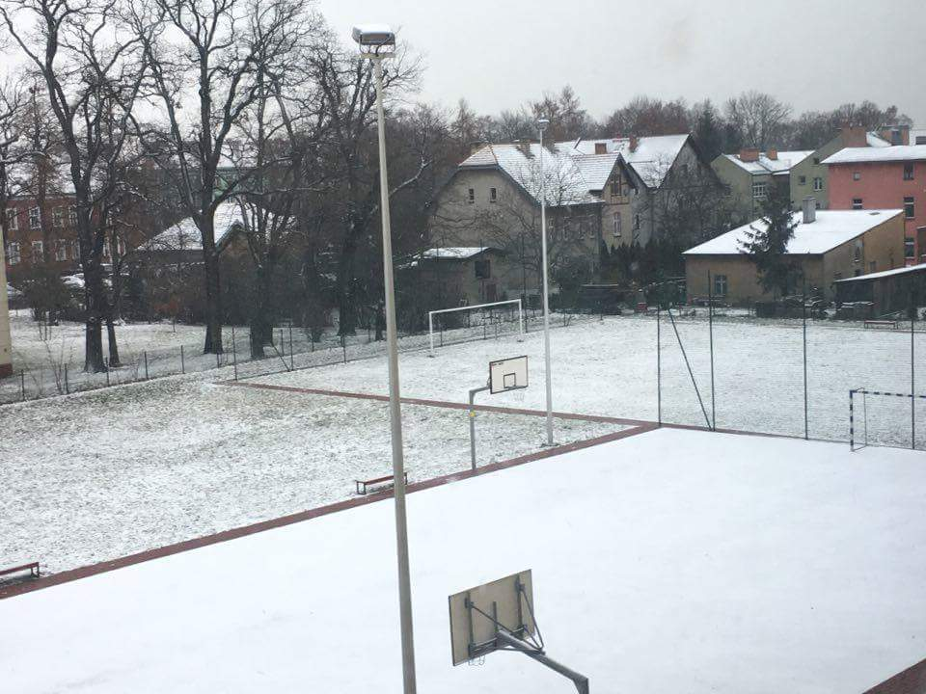
Schoolyard:
When it’s hot outside we go play on the schoolyard. There are a football pitch, a handball pitch and a basketball pitch. On breaks we go outside too.
Yes, on the pictures are snow because this fotos are making in December :D

Slide 5
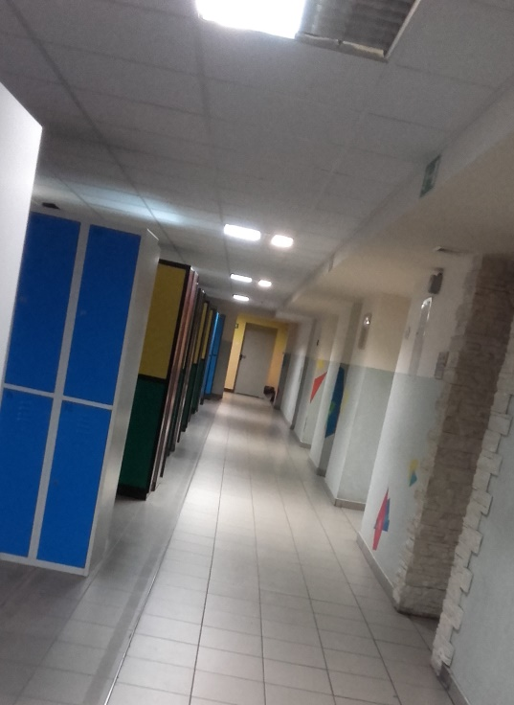
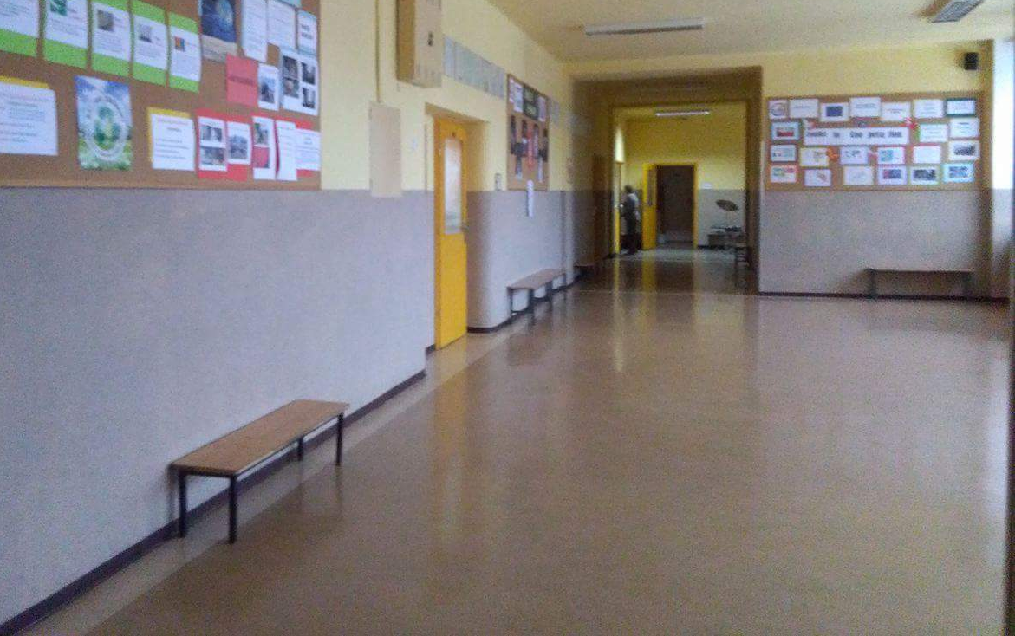
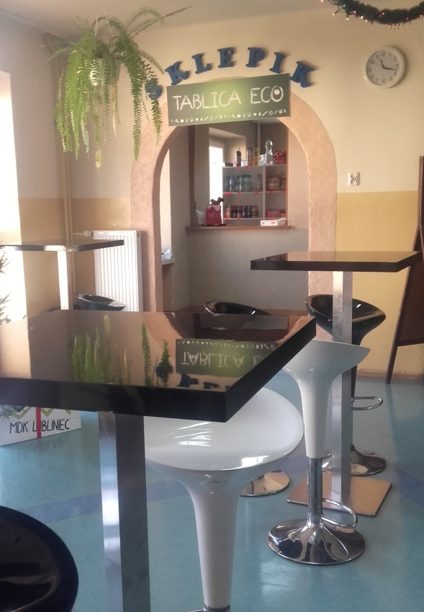
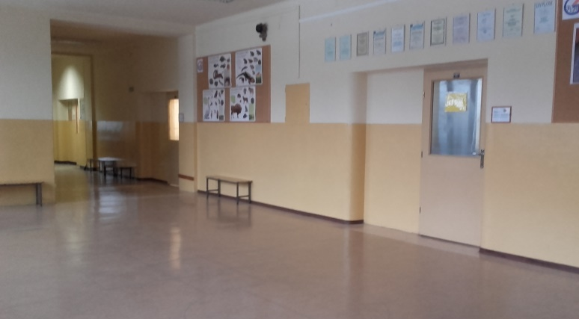
School shop, hallway, cloakroom
When we are hungry or thirsty we can go to a little school shop and buy some food or drinks. On the hallway we have benches to sit down. In the cloarkroom are many lockers. Every student has one locker.

Slide 6
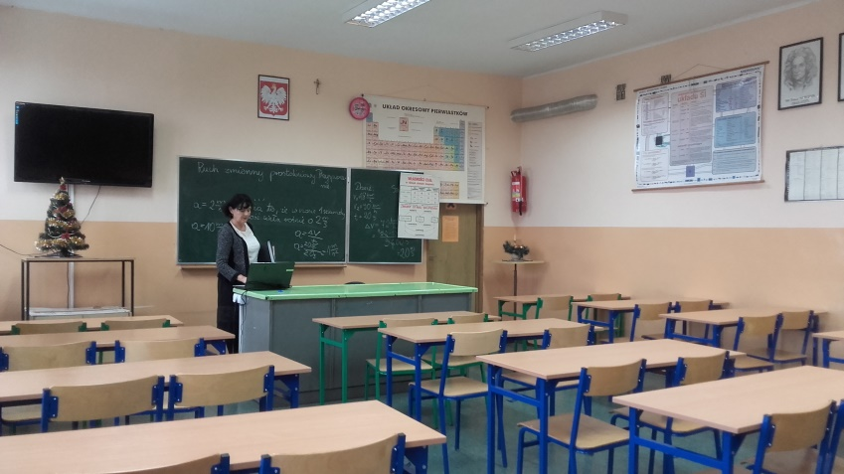
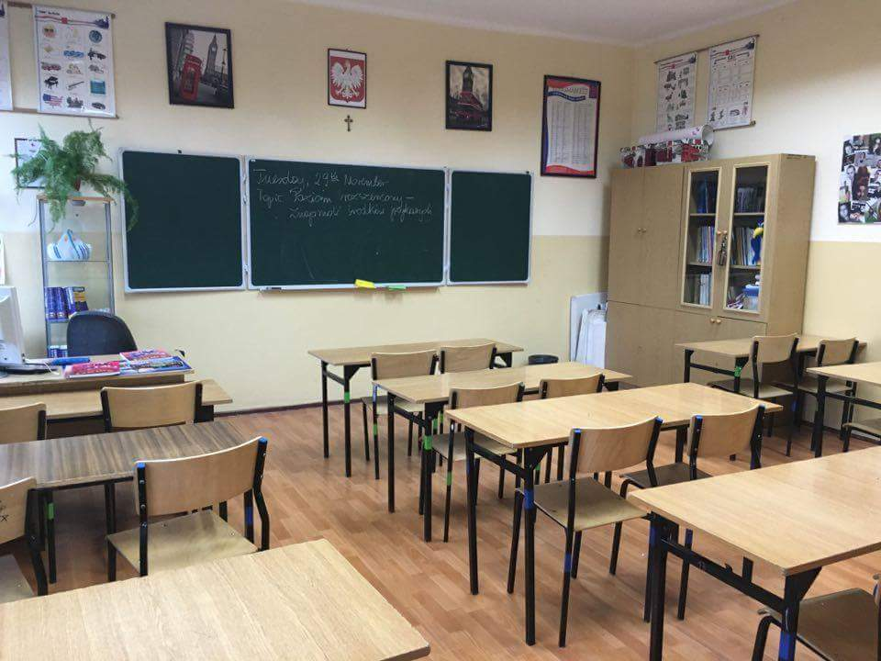
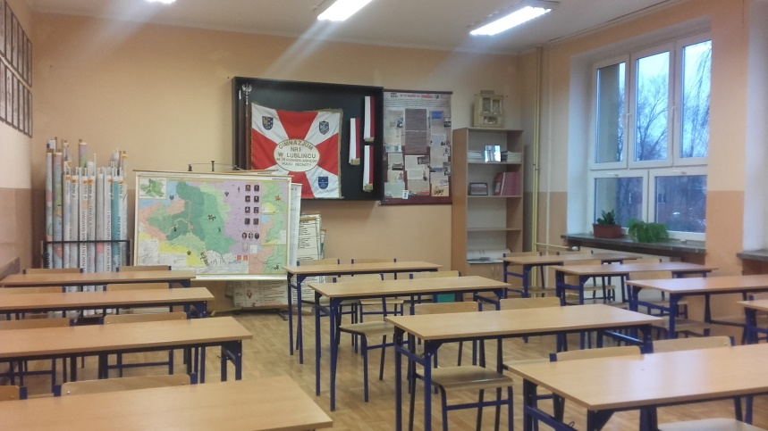
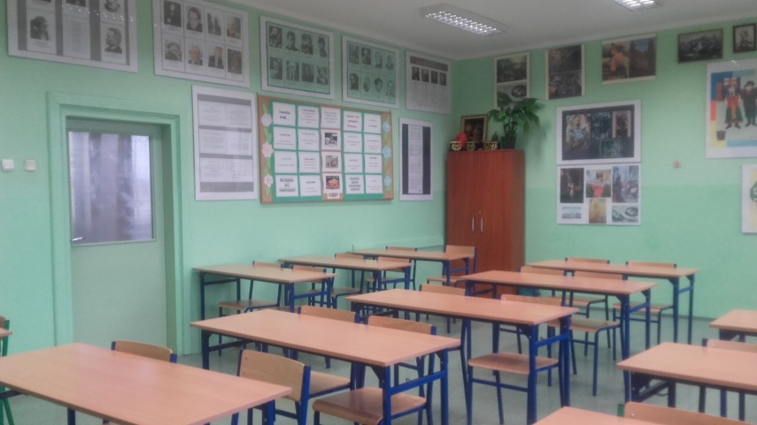
classrooms
Our school has three floors. There are many classrooms. We learn: polish, german, english, maths, geography, physics, chemistry, biology, history, art, social studies, music, physical education, ITC, Religious Edycation.
chemistry & physics classroom
english classroom
history classroom
polish classroom

Slide 7
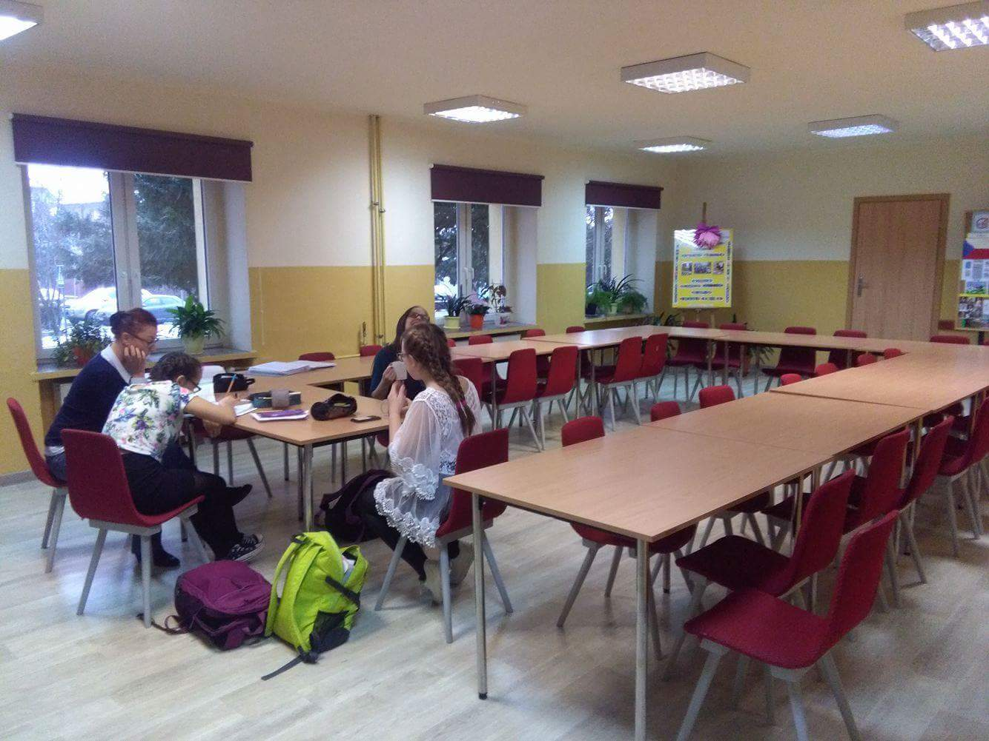
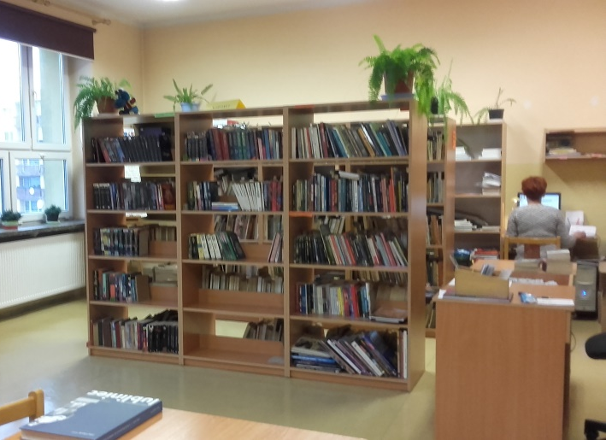
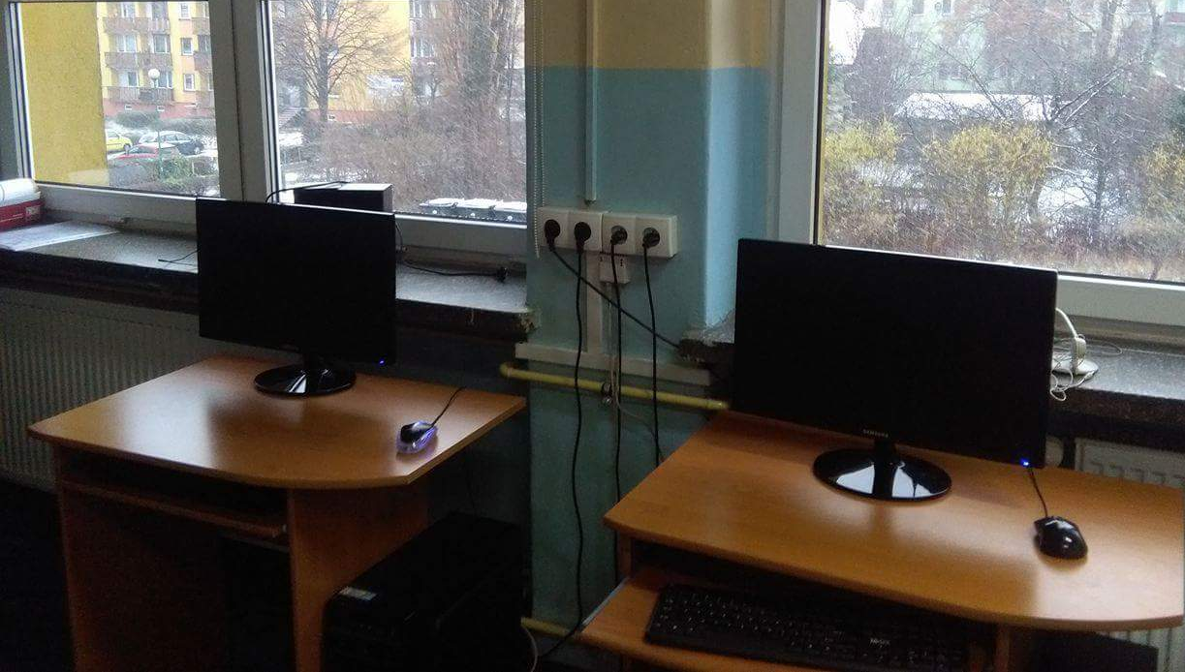
School library & after-school ro0m
In the library we have a lot of books and computers. We can do there our internet homework or do somethink for the school. And in the after – school room we cand wait for the next lesson or we can do our homework. Some one eat there the dinner but not all students from the school.

Slide 8
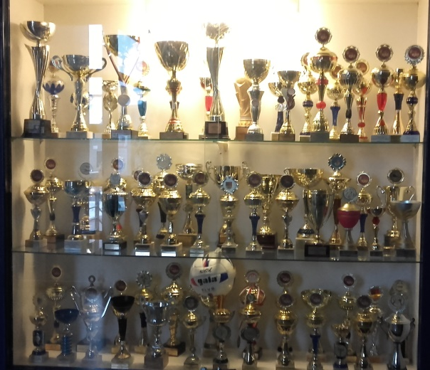
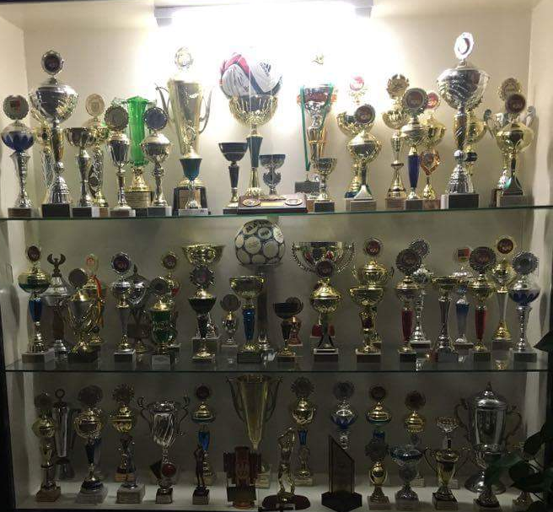
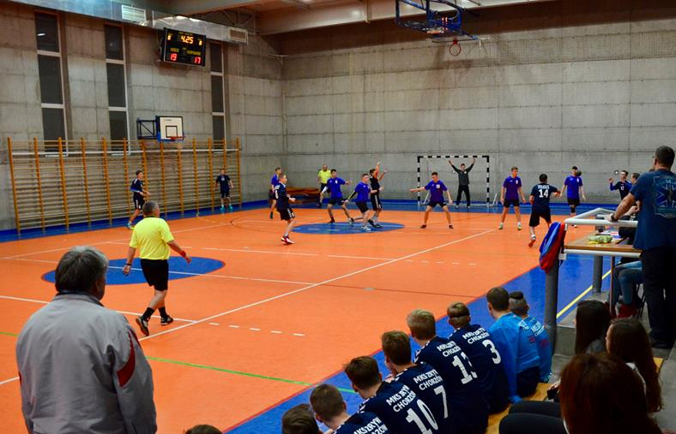
Our trophys, thematic days & handball match
Our all sports trophys:
Thematic Days:
Handball match in our school:
*tracksuit day
*house slippers day
*skirt day
*cuddle day…
… and more ☺

Slide 9
Creators: Klara Piosek
Anna Grzyb
Ewelina Szczepanek
Thank you
for watching! ☺
P.S. Greatings from Poland!!! :D <3

