Slide 2
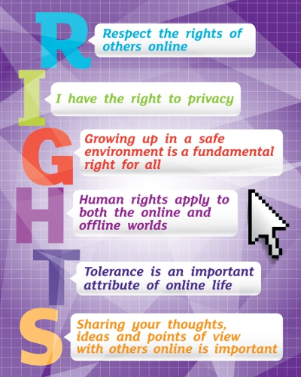
Discover the digital world together... safely!
Delete Cyber Bullying
Anti-Bullying Awareness -
Netiquette quiz

Slide 3
Click here and enjoy yourseves
netiquette: https://learningapps.org/watch?v=p0fknaryt01

Slide 4
Safer Internet Day – Insafe
Curriculum: Understanding YouTube & Digital Citizenship – Google in Education
Video from the European Commission
Cybermobbing

Slide 5
After these few recommendations on how to use Internet safely...
Let's enjoy our project!

Slide 6
CREATE THE LOGO OF YOUR PROJECT
Objectives of a logo
- to identify your product or project
to embody and adequately highlight the vales of your product or project
to be visually appealing
HOW?
💋
K.I.S.S.
K I S S
E T I I
E M L
P P L
L Y E

Slide 7
Tips for an effective logo
Focus on simplicity: Use a clean design (too many flashy elements can be distracting)
Think about where the logo will be used: consider how your logo will appear both online and offline
Think about a timeless logo: avoid anything that is trendy because it won't last for ever
Update the design over time: sometimes a simple change in type face or a cleaner icon can make a logo more fitting with the times.
The right process: craft a design that has the potential to effectively drive 'brand' recognition of your project and its values

Slide 10
Objectives
To encourage pupils to come up with ways to safeguard and promote their online rights.
To demonstrate understanding and critical awareness of the contribution of new media to the individual and to our society.
To promote a familiarity with the idea of rights and responsibilities including those online.
To assess the impact that new media has on the individual and society.
To analyse and discuss the advantages and disadvantages of widespread use and reliance on new media technologies.
To investigate the challenges and solutions new media present in our community/country.

Slide 11
Learning outcomes
Pupils will be able to critically reflect on their own online rights.
Pupils will be able to demonstrate understanding and critical awareness of the contribution of new media to the individual and to our society.
Pupils will have reflected on their own online rights with a critical approach.
Pupils will come up with concrete motions and proposals relating to safeguarding and promoting online rights.
Pupils will respect the feelings of others when using new media.
Pupils will be able to discuss and agree the consequence of inappropriate and irresponsible use of new media (for example, accessing or posting inappropriate or harmful material etc.)

