Slide 1
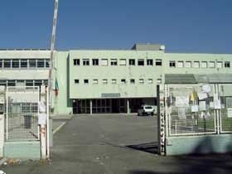
Our high school is in Casalpalocco, a suburb in the south of Rome. It’s called “Democrito”, like the Greek philosopher. It’s divided in scienific high school, where mainly scientific subjects are taught, and in classic high school, where mainly humanities are taught.
LICEO DEMOCRITO

Slide 2
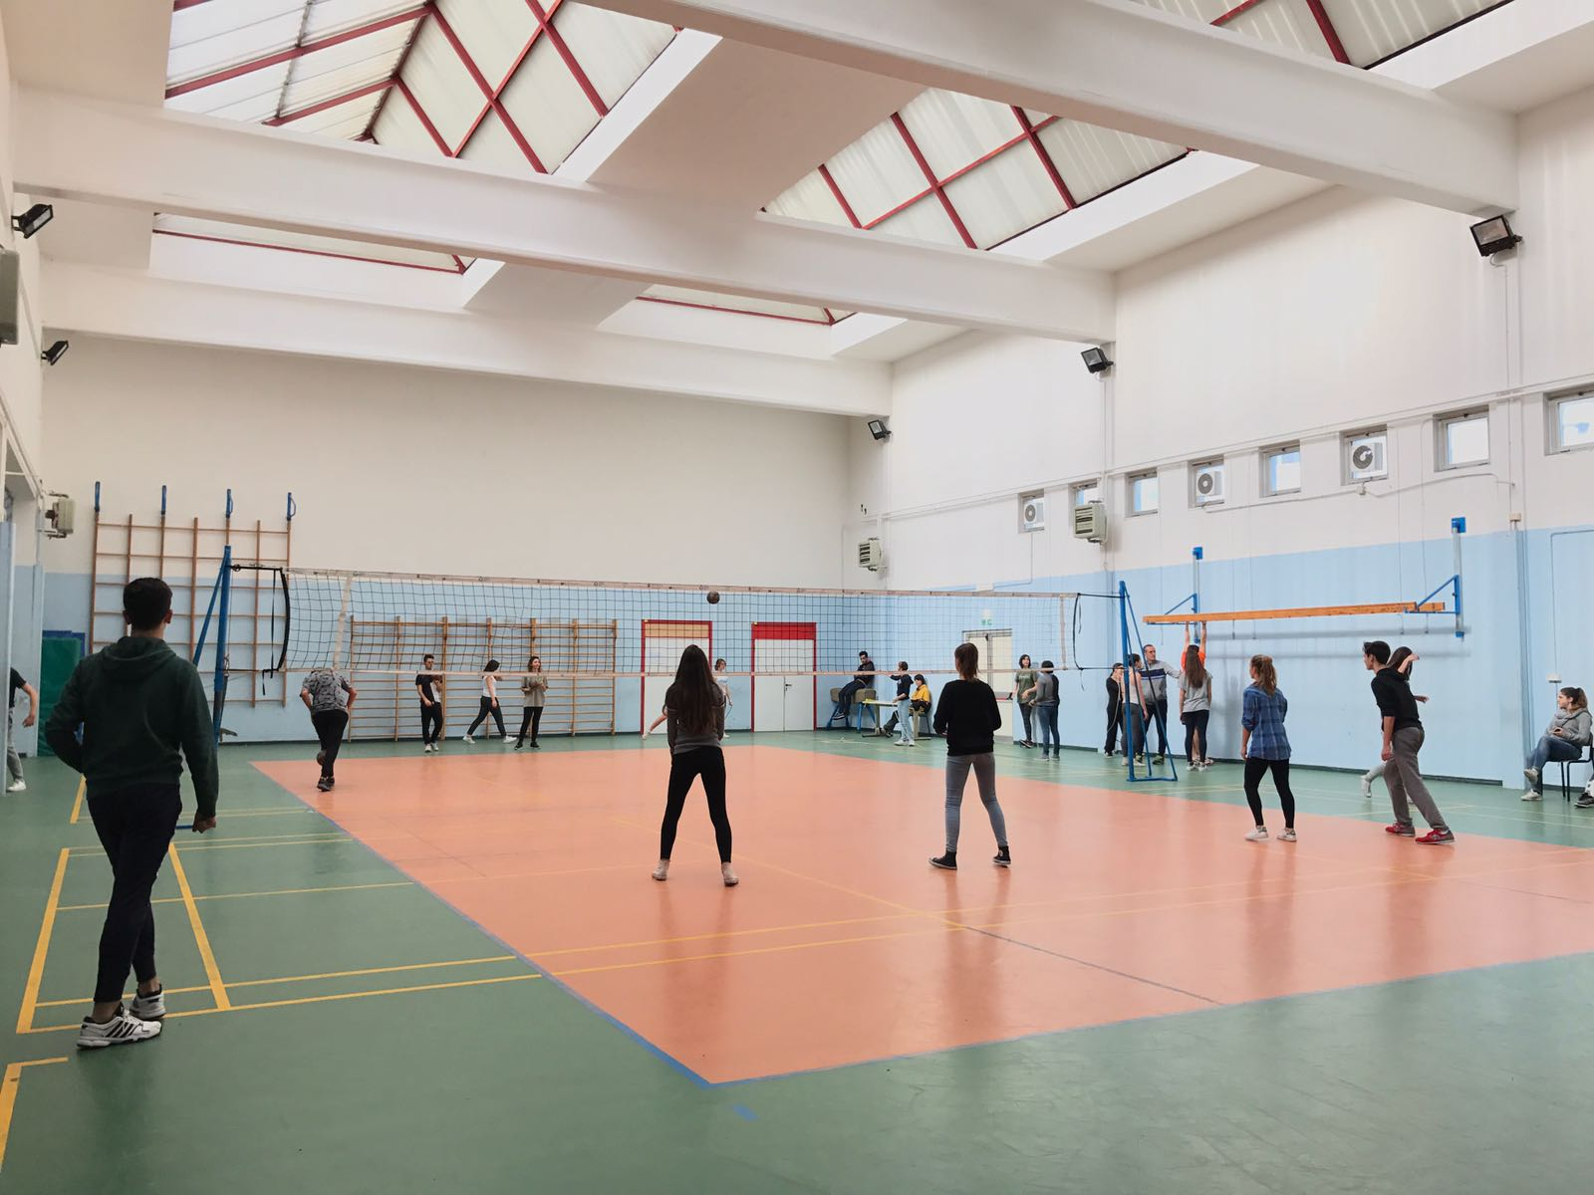
The scientific high school is the biggest building where the main activities are done. The classic high school students also go there to do these activitise. There are 37 classrooms, science labortories, chemistry and robotic classrooms, with computers and a big gym.
LICEO SCIENTIFICO

Slide 3
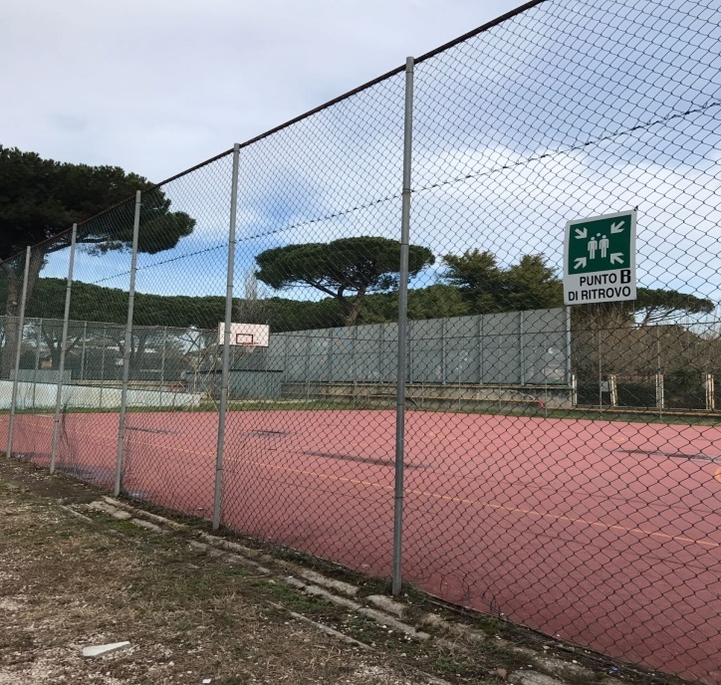
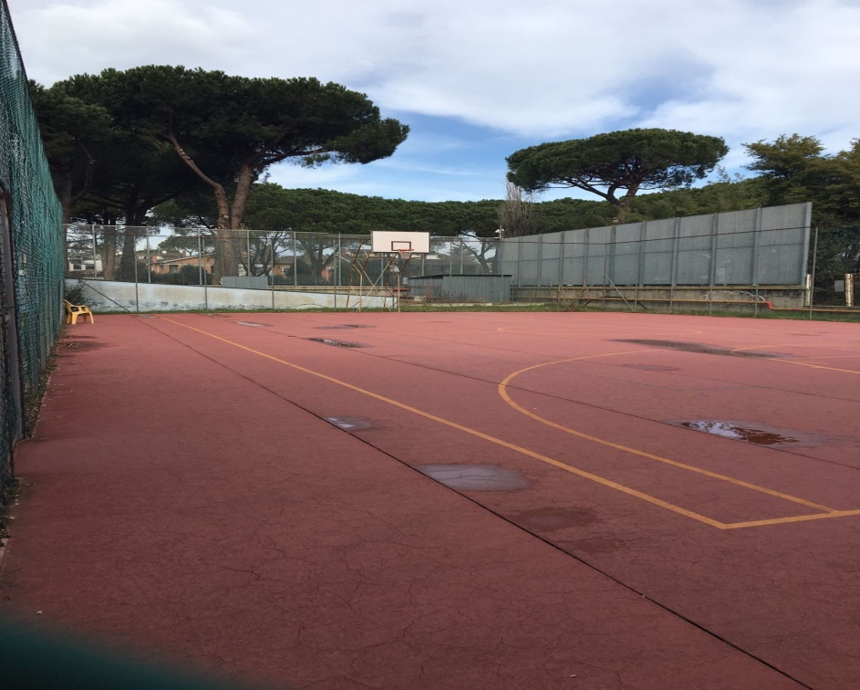
Outside the school, all students can play basket, football and volleyball.

Slide 4
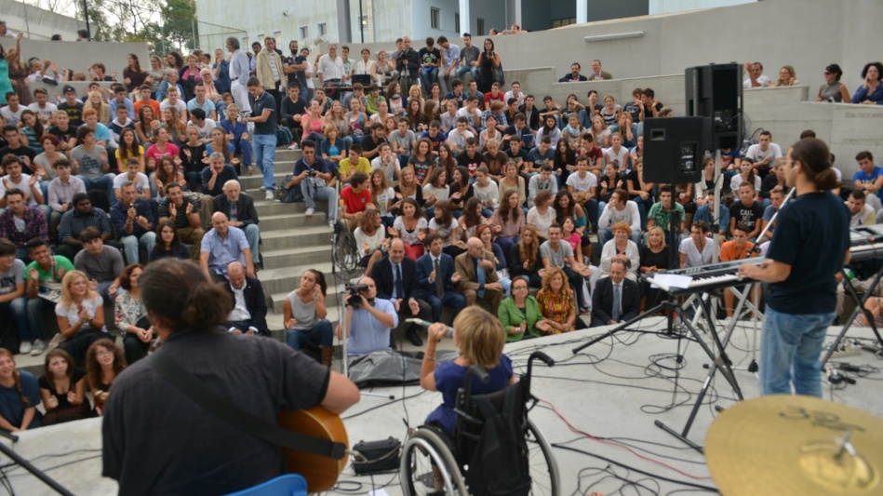
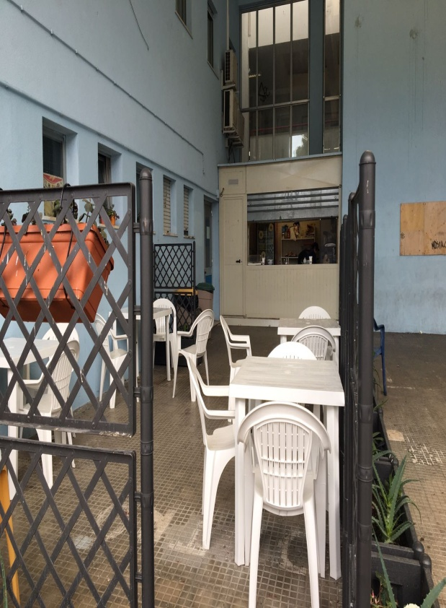
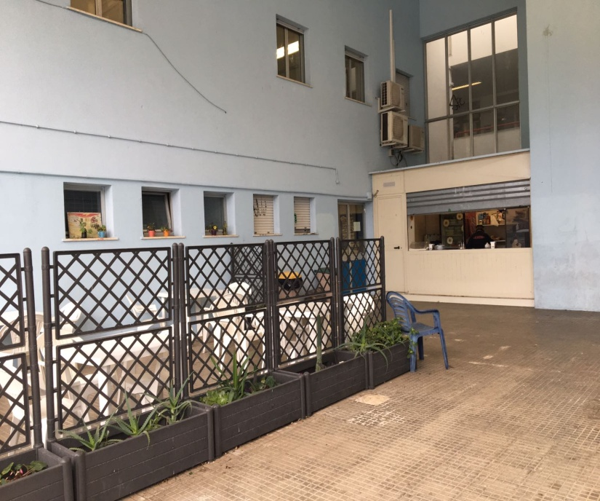
There is also the auditorium where the students can act, hold concerts, some presentations and shows.
There is also a cafè where you can eat whatever you want.

Slide 5
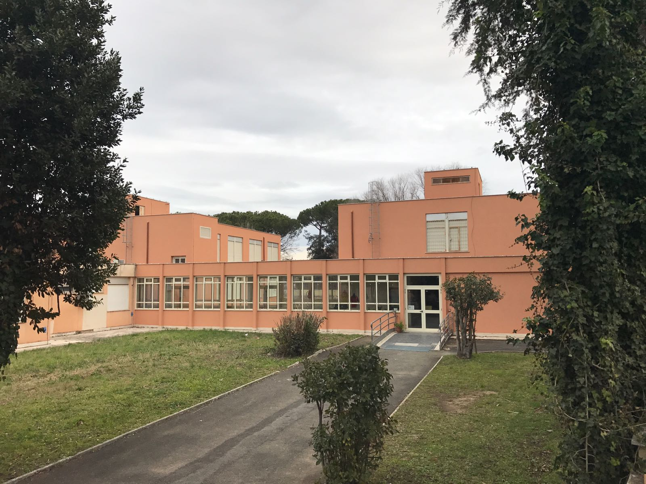
The classic high school is instead very little, has 10 classooms and a little lobby. In the Italian high school we study very hard; we are very hard-working! In the Scientific High School, Maths and Science are very difficult, as Greek and Latin in the Classic High School.
LICEO CLASSICO

Slide 6
The school lasts about six hours per day, from 8.10 to 14.10, but the time can change. At 11.00 there is the break that lasts 15 minutes, to eat and talk to each other. Every hour the bell rings and the teachers change, in fact the students don't change the classroom.In our school there are special classrooms, like ours, that is a Cambridge class, that means we have two more hours of English with a native language teacher. There are two robots classes too, that have lesson with the computers.

Slide 7
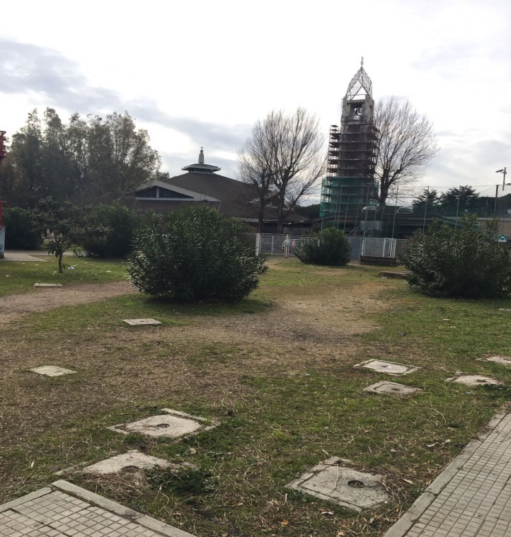
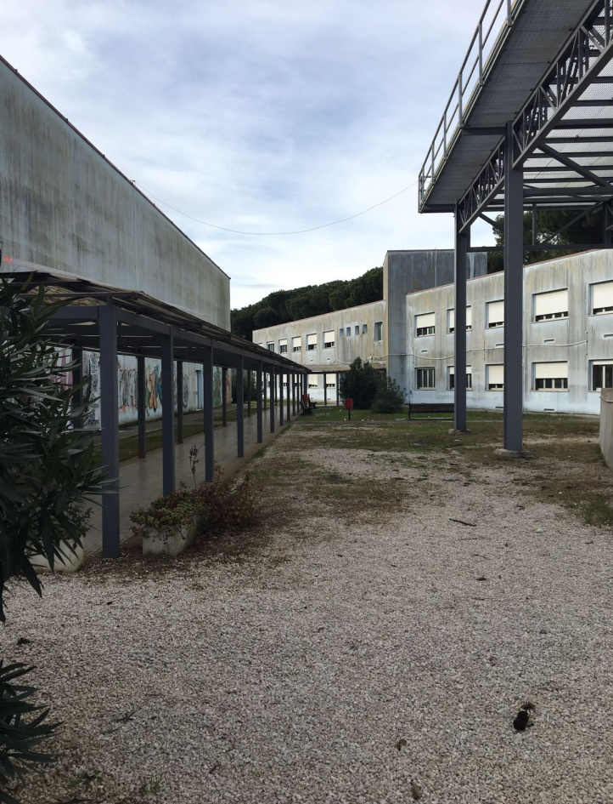
The school has afternoon courses too, such as: like sport courses, drama and the possibility to do the main subjects in English.

Slide 8
BELLEGGIA MATILDE
BIANCHI ANGELICA
CORRADINI CHIARA
MANENTE FLAMINIA
MANNATO CARLOTTA
&
ROMBOLI FLAVIA

