Slide 1
The Third Republic of France
The third Republic reinforced the main symbols and principles of the French republican model: the tricolour flag, Marianne, the national anthem: La Marseillaise , the motto « Liberté, Egalité, Fraternité ».
All of these things are a revolutionary legacy.

Slide 2
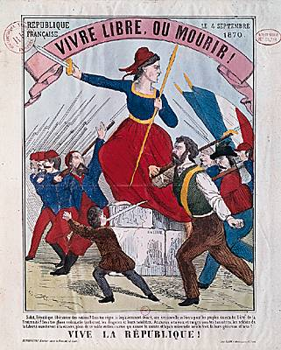

Slide 3
The Third Republic began in 1870 and ended in 1940.
The President was elected for 7 years.
The State didn’t want the young French to attend catholic schools anymore.

Slide 4
So the State created the public instruction which was free, compulsory and secular (non religious) in 1882.
In 1905, there was the separation between the Church and the State.
It created secularism, which is one of the most important values of the Republic of France. Liberty of conscience and of cult

Slide 6
Separation between the Church and the State

Slide 7
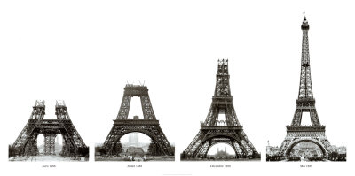
1889 : The Eiffel Tower

Slide 9
In 1936, the left wing won the legislative elections and sat at the Parliament. It was called “le Front Populaire”. It took some importants social laws as the “Congés payés”. The French population could enjoy paid holidays for one week: that was extraordinary!

Slide 10
It also limited the number of hours of work: the French could only work 40 hours per week! Nowadays, the time of work is 35 hours per week.
The population was happy but these laws were very expensive and this government had to leave. The third Republic ended because of world war II. The system of Vichy otherthrows the Republic and floot the democracy for 4 years (1940 - 1944).

Slide 11
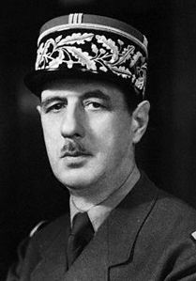
The Fifth Republic of France
It was created by “Général de Gaulle” in 1958. He had been elected President and he proposed a new constitution in September. He reinforced the executive power.

Slide 12
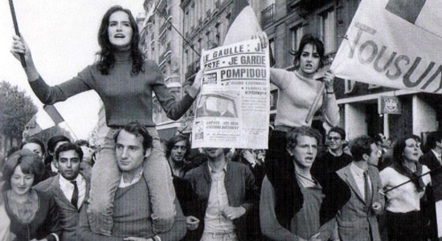
May 68
First, Général de Gaulle was loved by the French. However, some people and students thought he was too harsh and they organised huge demonstrations in Paris in May 1968. Charles de Gaulle resigned in 1969.

Slide 13
In 1981, François Mitterand became the first socialist President of the fifth Republic. He promulgated some social laws such as the abolition of the death penalty in 1981.
In 1995, Jacques Chirac, who was from the right wing, was elected. He decided to reduce the presidential mandate from 7 to 5 years.

Slide 14
Nowadays, our president is François Hollande and he is the second socialist president. He was elected in 2012.

Slide 15
The political organisation of the 5th Republic in France art.2 : The Republic is “indivisible, secular, democratic and social”
As we told you before, there are 3 important powers in France:
The executive power (President and ministers)
The legislative power (the Parliament: Assemblée Nationale + Sénat).
The judicial power (magistrates :judges+prosecutors). It has to sanction people when they break rules/disobey to a law.

Slide 18
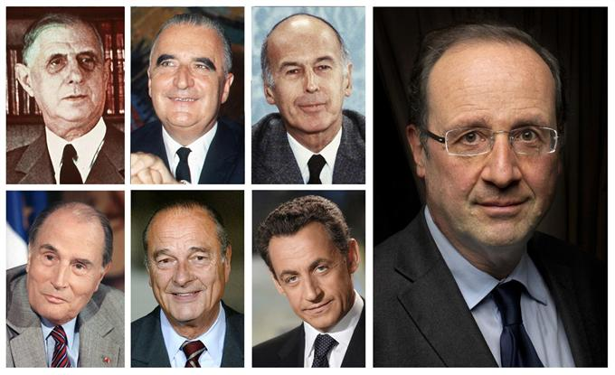
The Presidents of the fifth Republic

