Slide 1
Edible mushrooms
PREPARED BY-KÜBRA AYTUĞ

Slide 2
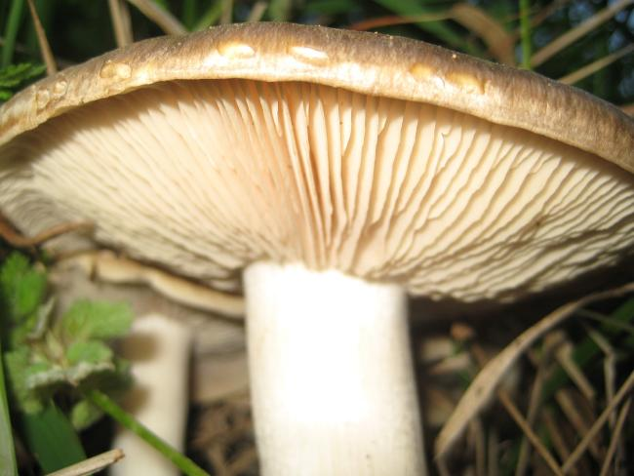
Mushrooms, do not carry organism chlorophyll. Are not discussed in the realm of classifying plants among scientists have debated for many years. As parasites on other plants, dead vegetation on the saprophytic (saprofit) or other creatures with a symbiotic life appetites. Fungi reproduction takes place through spores.

Slide 3
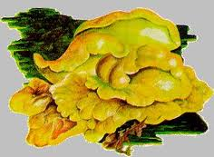
Sulfur fungus
Sulfur fungus (Polyporus sulphureus) and (Laetiporus sulphureus) is a type of fungus that can refresh in the family Polyporaceae. The taste resembles chicken. Fungus grows in large clumps, kilo weight could be. Especially eucalyptus, Elm, walnut and is seen in trees.

Slide 4
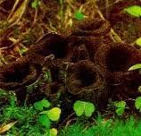
trumpet mushrooms
Trumpet mushroom (Craterellus cornucopioides) due to the black color in foreign languages "death Dragon Horn," he isimlendirilse the poison not a mushroom, taste, aroma and is extremely pleasant with the color, shape, an interesting mushrooms with ... is.This mushroom, Sam is a relative of mushrooms (chantarel). Meanwhile, smaller in size, color, black, too right. Artebella's products in dry and fresh as it is taking place. Especially fish meal is a highly compatible with fungus mushroom Trumpet.

Slide 5
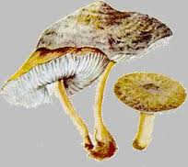
Meanwhile, the mushroom
Meanwhile, the mushroom (key to determining Tricholoma terreum) Western Black Sea coast, also eaten mushrooms, known with the name kind of like Kant is one of the vs. Meanwhile, the fungus grows in areas with pointy-leaved trees and loves moisture.. ..roadsides, chewed the grassland grows in the park. Calcareous soils during the months of September, October and may occur in clusters.

Slide 6
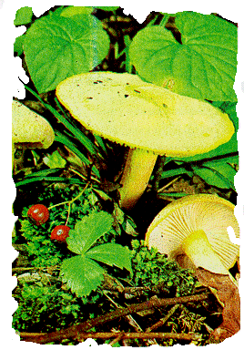
Bell snow fungus
Snow bells (key to determining Hygrophorus chrysodon) Diameter 3-7 cm wide, convex to Plano-convex, generally with low shaped umbo; margin inrolled at first with a hairy, yellowish granules; time, the scattered yellow granules white as the second disc concentrates on the damp adhesive surface; the flesh is soft, thick, white.

Slide 7
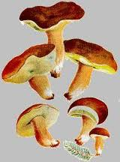
Chestnut-colored puffy mushroom
Chestnut-colored puffy Mushroom (Boletus badius) mixed woodlands in Europe and North America, while Eastern Canada from West to Minnesota and South of North Carolina are common in the fall..

Slide 8
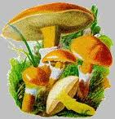
hybrid mushrooms
Hybrid mushroom (Boletus elegans) is eaten mushrooms. Bell or hemisphere-shaped, 5-15 cm pinpoint in..When the weather is especially humid it is sticky. The outer cover as easily peel off the membrane. Dice with a thin covering, such as sapa baglanır, it remains in a thimble on the handle later cover Hat gold, lemon, orange yellow, orange or orange is a brunette.Short, colored, yellow, lemon-colored when young, sulfur is, then it would be olive green.

Slide 9
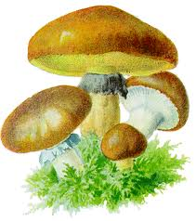
slippery mushrooms
Slippery Mushroom (Boletus luteus) features what is Color varies from Dark chestnut color in terms of the verengiye is dark yellow, rarely morumtrak hah. When I was young with a cloth like the dice turn depends on, the remains of that first turn into a thimble of purplish white Brown stays on top in bumps the cone-looking ...

Slide 10
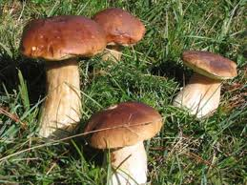
Boletus Edulis
Boletus Edulis (Boletus edulis) mushrooms growing in our country is a delicious and eaten. Donut mushrooms properties-ranging from light brown above, dark brown Hat colors can be. There are non-uniform rough Groove on the edges of the hat. Has a fine white line on the edge of the hat-. -Contains a layer of spongy tubule under your Cap. This tier young tuber in gray-white color.

