Slide 1
"The world of mushrooms"
Tamar gelashvili
Megi muladze
Country Georgia
City Rustavi
The Public school #5

Slide 2
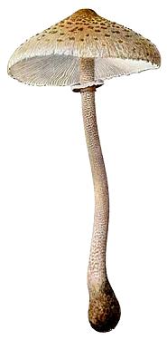
Parasol Mushroom (Lepiota procera)
The Parasol Mushroom grows in temperate regions around the world alone or in groups and fairy rings in pastures & forests. It may be eaten raw, but the stem is inedible. The cap of fresh specimens are a favorite when soaked in butter, but how are you going to identify it? There are look-alikes that can destroy your liver! Buy your morel mushrooms at the grocery store!

Slide 3
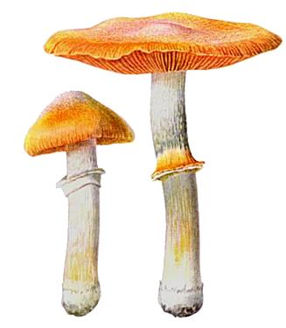
Gypsy Mushroom (Cortinarius caperatus)
Careful! The Gypsy Mushroom is edible, but may be confused with similar poisonous mushrooms that can kill!. Not for the novice. The Gypsy Mushroom is found in North America and Europe and is edible, but don’t be guided by these pictures alone – Identifying mushrooms can be confusing for non-experts and some mushrooms are deadly poisonous!

Slide 4
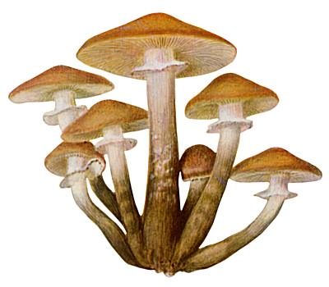
Honey Mushroom (Armillaria Mellea)
The Honey Mushroom or Oak Mushroom (Armillaria Mellea), grows on decaying and living trees and other plants the world over. It varies in shape and color – all the more reason to leave mushroom hunting to the experts! The Honey Mushroom is edible, but don’t be guided by these pictures alone – Mushroom identification can be confusing for non-experts and some mushrooms are deadly poisonous!

Slide 5
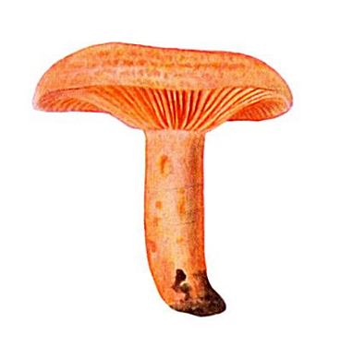
Saffron Milk Cap (Lactarius deliciosus)
Saffron Milk Cap (Lactarius-deliciosus) can be found in North America and Europe, often under conifers. It is an edible mushroom with a luscious rich gravy flavor of mussels, but remember, identifying mushrooms should be left to the experts because some mushrooms are deadly poisonous!

Slide 6
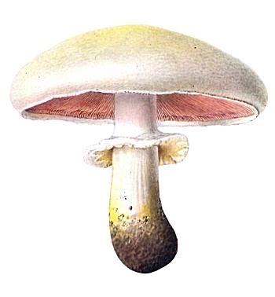
Horse Mushroom (Agaricus arvensis)
The Horse Mushroom grows through out most of Europe and North America in meadows and near stables and in pastures (it likes nutrient rich soil) where it may form fairy rings. It is usually quite large. Look for the Horse mushroom from late summer to November. The Horse Mushroom is edible, but don’t be guided by these pictures alone – Identifying mushrooms can be confusing for non-experts and some mushrooms are deadly poisonous!

Slide 7
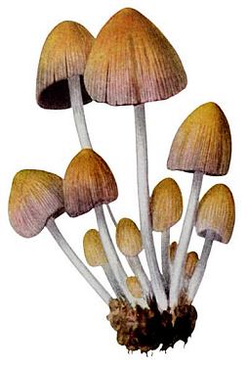
Glistening Coprinus (Coprinus micaceus)
Glistening Coprinus is a pretty, often honey brown or amber mushroom which grows from April through October throughout most of North America and Europe in clusters on stumps and decaying wood. Coprinus micaceus is edible, but don’t be guided by these pictures alone – Buy your morel mushrooms at the grocery store - Mushroom identification can be confusing for non-experts and some mushrooms are deadly poisonous!

Slide 8
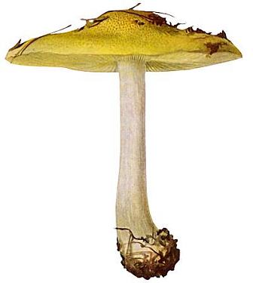
Yellow Knight (Tricholoma equestre)
Here’s a good reason to let the experts identify and harvest mushrooms. Supposedly, Man on horseback or Yellow knight has been considered delicious all over the world. However, research has revealed it to have poisonous properties and cases of poisoning have been reported from eating it. So there you go. Wear these mushrooms on T-Shirts, but get your mushrooms from the grocery store!

Slide 9
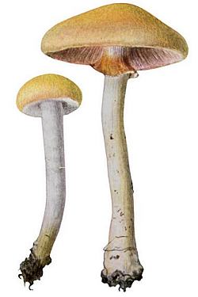
Early Pholiota (Pholiota praecox)
Early Pholiota sprouts in late spring and in summer, usually after long rains. It can be found open grassy areas, lawns, forest meadows, pastures, and roadsides. Pholiota praecox is edible, but don’t be guided by these pictures alone – Identifying mushrooms can be confusing for non-experts and some mushrooms are deadly poisonous!

Slide 10
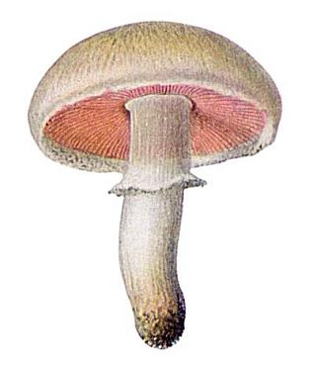
Meadow Mushroom (Agaricus campestris)
The Meadow Mushroom, commonly seen in grocery stores, usually appears after rains in lawns, pastures and open areas in late summer. Don’t harvest wild mushrooms unless you are expert. The Meadow Mushroom can be confused with similar looking poisonous mushrooms!

Slide 11
Good-bye

