Slide 1
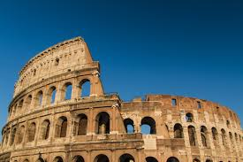
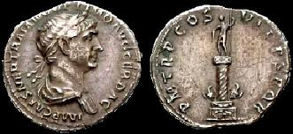
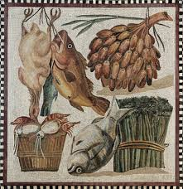
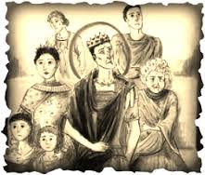
Life in the Roman times
-clothes-

Slide 2
Clothing for mEn
Men used to wear long togas(that is a long material) that people just threw on their bodies. They used to wear tunics (long T-shrts) and sandals too.In the winter time they used to wear trousers.As accessorise men used to wear rings.

Slide 3
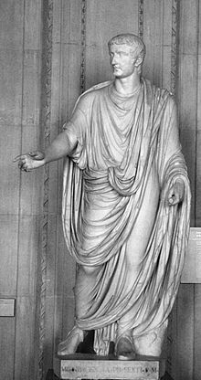
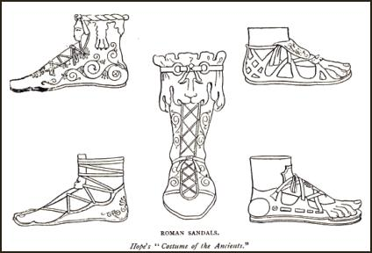
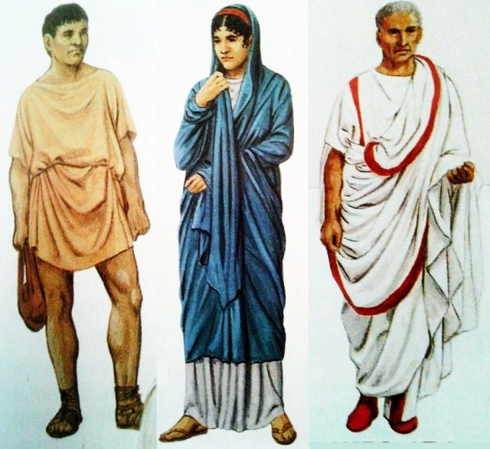
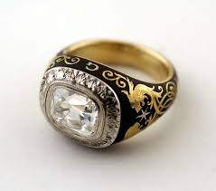
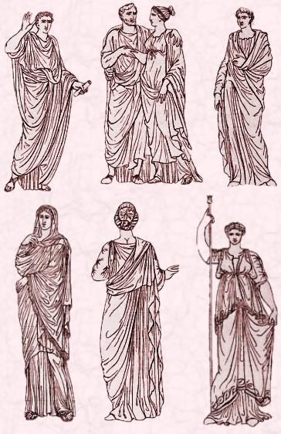
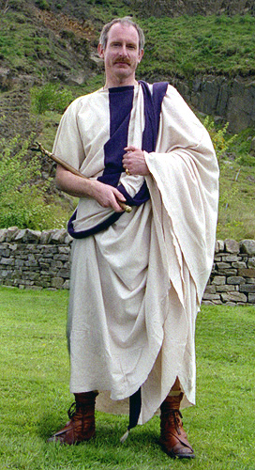
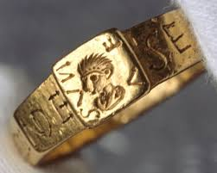
.

Slide 4
women clothes
Women in old Rome used to wear a lot of accessorise. They
used to wear necklaces, pins,earrings, brecelets and friendship rings. They used to wear a lot of pearls too ! Women used to have their hair dyed golden-red. They wore

Slide 5
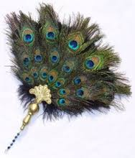
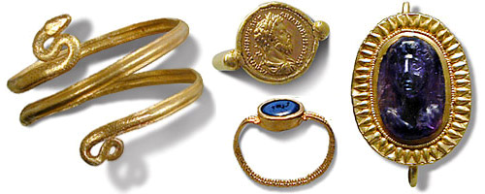
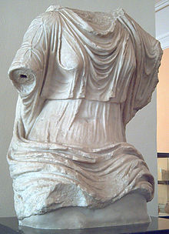
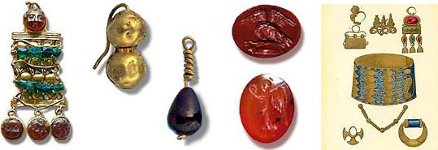
.
false hairpieces (hair extensions) to make hair look thicker or longer. They used to have fans made of peacock feathers or wood.

Slide 6
Kids-boys and girls
Boys in old Rome used to wear white tunics. Rich boys had purple border on it.
Girls in old Rome used to wear simple tunics with a belt. Sometimes they wore bulla.

Slide 7
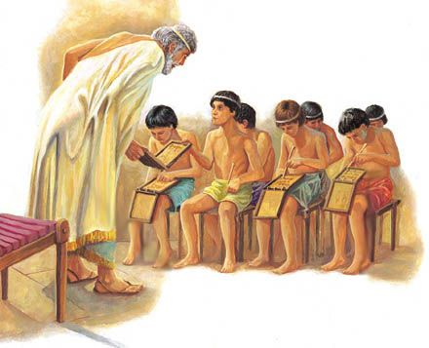
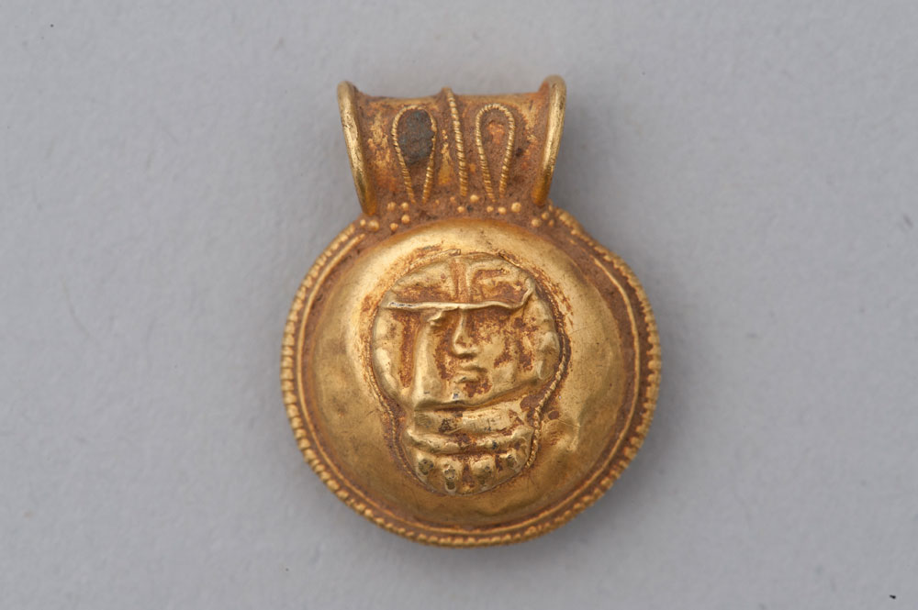
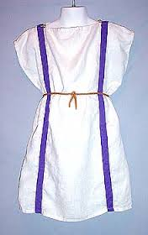
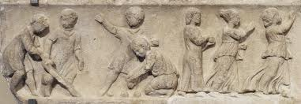
Bulla is an amulet for children, something like a necklace.

Slide 8
Thank you for your attention
Anja Milojevic VII1
Andjela Popovic VII1

