Slide 1
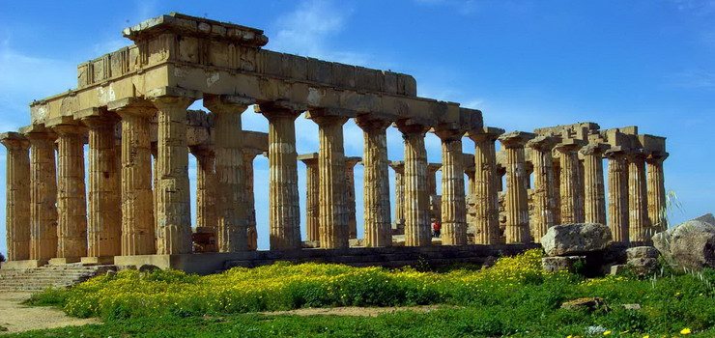
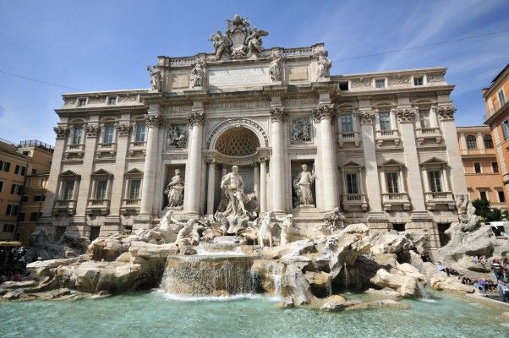
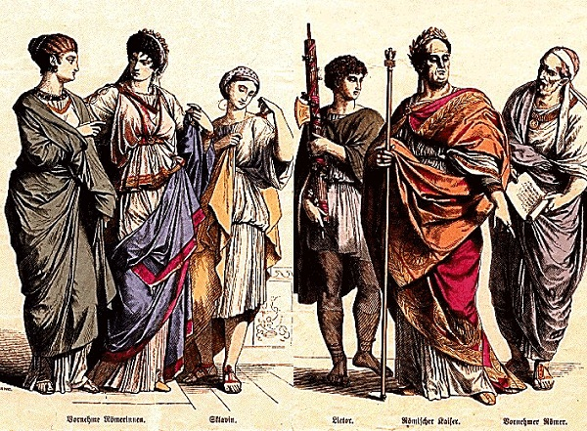
ANCIENT Rome

Slide 2
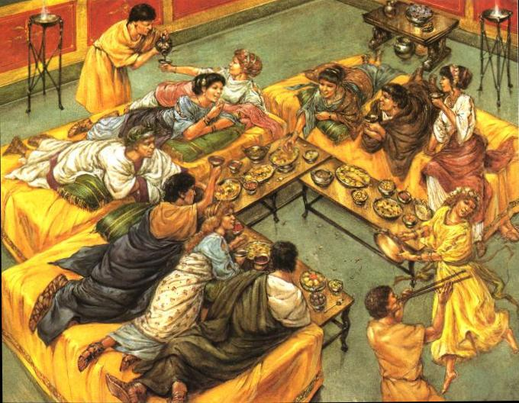
What is ancient Rome ?
How did Romans live?
What did they eat ?
- What is Viminacium ?

Slide 3
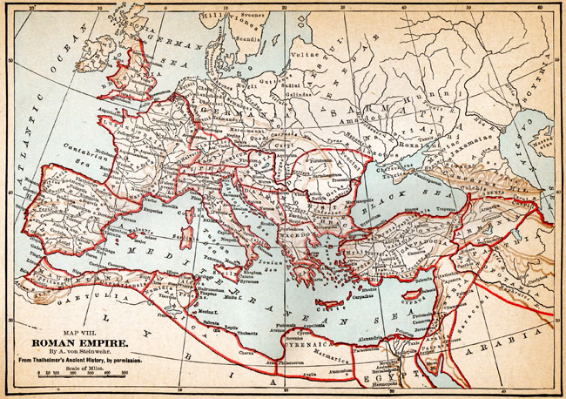
-What is ancient Rome ?
- Ancient Rome (often referred to as the Old Rome) was a civilization that arose from the city-state founded in the Apennines .

Slide 4
- How did Romans live?
The girls were married at an early age
People didn’t have a long lifespan , some died in their thirties, perhaps due to starvation and perhaps because of illness.

Slide 5
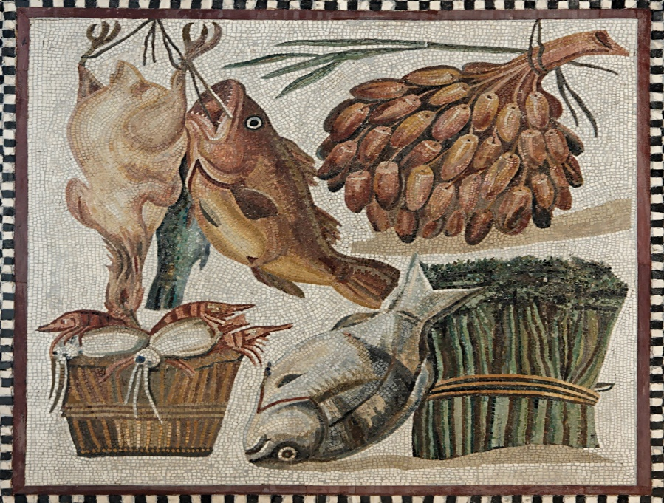
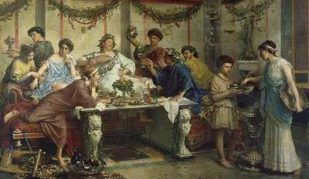
- What did they eat ? ;)
- The Romans lived and ate simply. They ate flour, vegetables, fruits and olive oil.

Slide 6
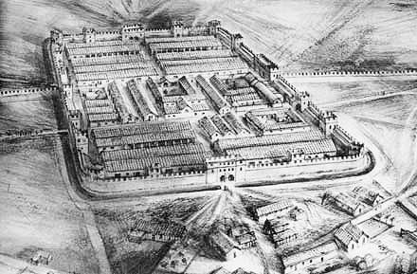
- Viminacium
-Viminacium is an archaeological site . The Roman military camp and the town was built in the I and lasted until the beginning of the seventh century. He was one of the most important legion camps on the Dunav , and for a time the capital of the Roman province of Upper Moesia .

Slide 7
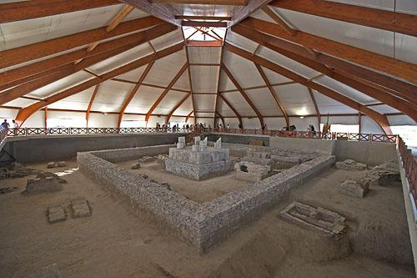
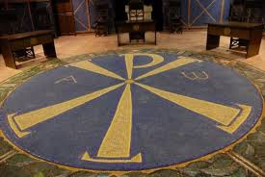
And more photos of Viminacium

Slide 8
Byeeee !!!
Thanks for watching and listening !

