Slide 1
Holidays in Poland
Klaudia Błąkała
Bartosz Imieło
Mateusz Lisieński

Slide 2
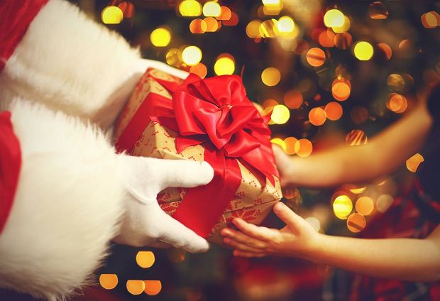
Mikolajki
Saint Nicholas Day, also called the Feast of Saint Nicholas, it is a tradition that is celebrated on 6th December.
It isn’t really a holiday it’s more of an tradition that is most popular in Germany and Poland.
The main goal of this tradition is to give a little presents or at least sweets to children. The tradition is named after Saint Nicholas of Myra who gifted some basic needs and money to poor children in poor areas.

Slide 3
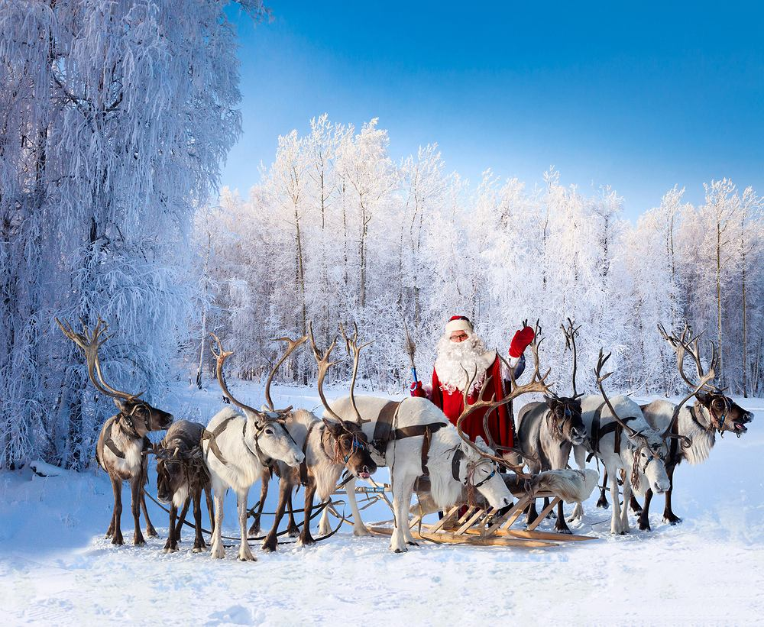
Also this tradition like many other has a nice legend that According to it, young Nicholas, even before being elected bishop, had a greedy and wealthy neighbor who mocked him constantly for not being rich. God punished a neighbor and made him lose his fortune and fall into extreme poverty. When he could no longer support his family, he decided to sell his three daughters because no one wanted to marry them without receiving a dowry. Nicholas, after a long reflection on the texts of the Bible and prayer, decided to save the virtue of girls. Three times, under the cover of night, he threw money for a dowry for each subsequent sister through the window. After the neighbor has already organized two weddings, he decided to find out where the mysterious money was coming from. He stayed awake all night and was surprised to discover that
it was Nicholas, despised by him, that was throwing money through the window for the third time. He thanked him, ashamed, and decided to change his life to comply with the commandments.

Slide 4
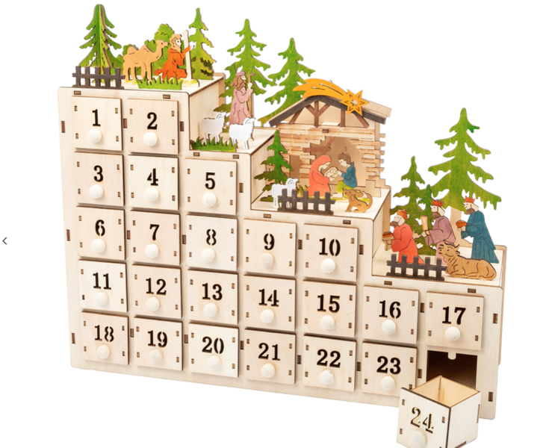
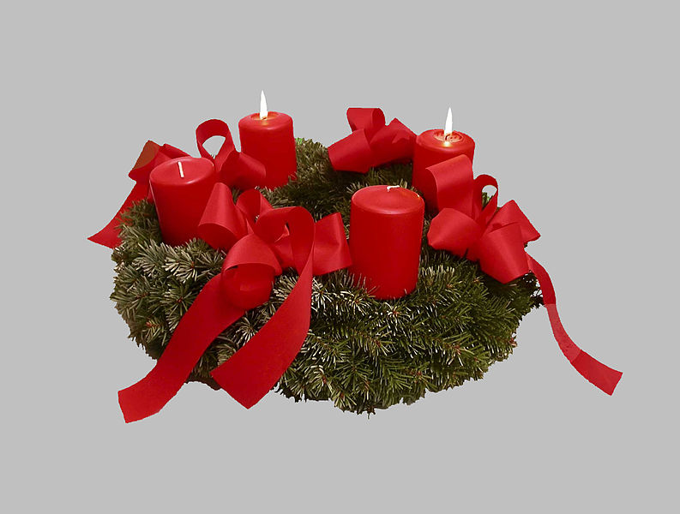
Christmas
Christmas, this is a holiday that commemorates the birth of Jesus Christ. It is celebrated on December 25. Christmas is preceded by a period of three weeks of waiting (four Sundays to be exact), known as Advent.
Many children during Advent receive an Advent calendar, which means that they open one item from that calendar every day until December 24 (ussually sweets).
Advent wreath, four candles symbolize four Sundays
Advent calendar

Slide 5
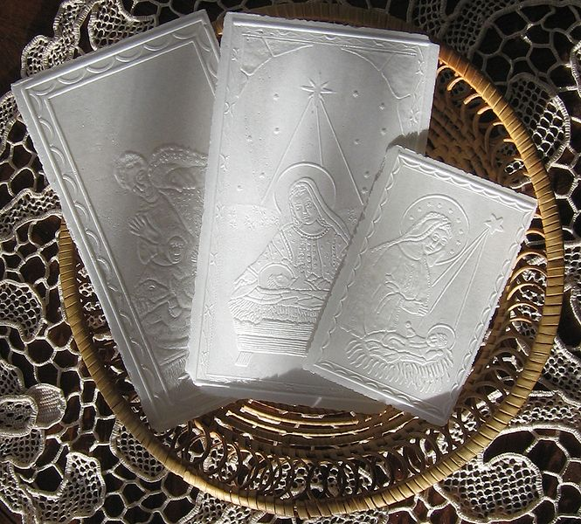
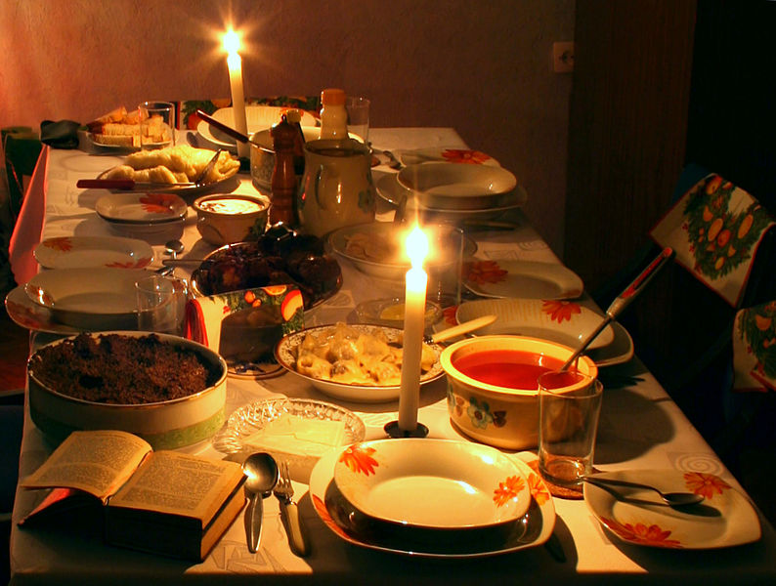
Christmas Eve
In Poland we start on December 24 with Christmas Eve. On this day, all people clean their houses and decorate their Christmas trees. In the evening people (most of them are children) go to the window and are looking for "the first star". It is a symbolic reference to the Star of Bethlehem announcing the birth of Jesus. Supper begins with prayer. Then the participants of the supper break with each other's wafer, while making wishes for each other.
On a table covered with a white Loth The hosts set one place more than the number of people gathered. An additional seat at the Christmas Eve table is intended for an unannounced guest or an absent, close person. No one should be alone on this day.
Wafer

Slide 6
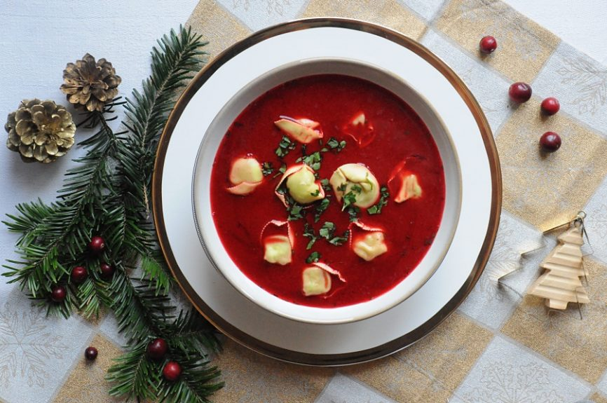
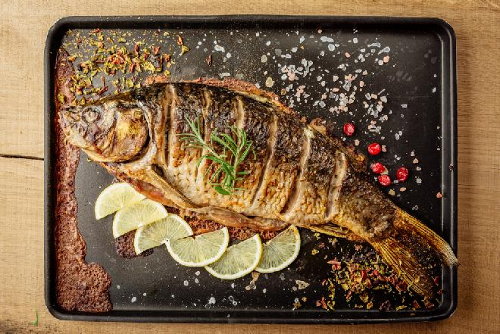
Depending on the region and family traditions, the set of Christmas Eve dishes is different, but it is customary to have twelve dishes on the Christmas Eve table. You should try each one to ensure happiness all year round. The most typical are: borsch with dumplings, mushroom soup, fish, cabbage with mushrooms, dumplings with cabbage, dumplings with sugar, dried fruit compote and almond soup. In Upper Silesia, makówki are also a dish of Christmas Eve. According to Polish custom, Christmas Eve dishes should be fast, meatless and without the use of animal fats.
Carp
Borsch with dumplings

Slide 7
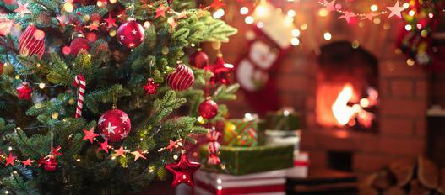
An important element of Christmas Eve, but also throughout Christmas, is singing Christmas carols. There are many of them in the Polish tradition. the most popular of them are „In The Silence of the night", „Silent night" or „Hush Little Jesus”. The Christmas Eve evening ends with the midnight mass in churches. According to tradition, it commemorates the arrival of the shepherds who were the first to pay homage to the newborn Christ.
The day after Christmas Eve (December 25) is called Christmas, and on December 26 it is the second day of Christmas in Poland in memory of Saint Stephen. These are usually days for rest, family meetings and caroling.

Slide 8
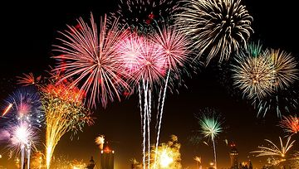
New Years Eve
New years eve the day preceding the New Year - on December 31, the end of the old year and the beginning of the new one are celebrated, which is the time of loud games, toasts and fireworks. New Year - in Poland it is a day off from work. It is generally accepted to celebrate the holiday by opening a bottle of champagne at midnight on December 31 to January 1 of the following year.
New year is also church celebration.
It is time that we spend with our friends and families. One of most popular new years eve traditions is counting from 10 to 0 when new year is coming.We are mostly eating starters and drink party drinks.

Slide 9
Thank you for watching
Now you can enjoy our kahoot
Good Luck!

Slide 10
Sources
Photo of Advent calendar - https://www.epinokio.pl/product-pol-319915-Kalendarz-adwentowy-z-oswietleniem-led-kaskada-small-foot-design-zabawka-drewniana-zabawka-swiateczna-dla-4-latka.html
Photo of Advent wreath - https://pl.wikipedia.org/wiki/Plik:Advent_wreath.jpg
Photo of the table - https://pl.wikipedia.org/wiki/Plik:Wigilia_potrawy_554.jpg
Photo of Wafers - https://pl.wikipedia.org/wiki/Plik:Oplatki.w.koszyczku.jpg
Informations about Christmas - https://pl.wikipedia.org/wiki/Boże_Narodzenie_w_Polsce
Photo of borscht with dumplings - https://zakochanewzupach.pl/barszcz-z-uszkami/
Photo of Carp - https://beszamel.se.pl/dania-wigilijne/karp-wigilijny-smazony-pieczony-gotowany-marynowany-14-najlepszych-przepisow-na-karpia,21359/
Photo of christmas tree - https://fajnyogrod.pl/porady/choinka-swiateczna-_t/
Photo od fireworks - https://www.nocowanie.pl/miejski-sylwester-19-20-w-najwiekszych-polskich-miastach.html
Photo of Santa - https://kobieta.gazeta.pl/kobieta/7,107881,26577849,mikolajki-co-to-za-swieto-czy-wiecie-dlaczego-dajemy-sobie.html
Photo of the present - https://www.edziecko.pl/edziecko/1,80257,19291677,swiety-mikolaj-w-szkole-czyli-jak-wspolczesnie-obchodzimy.html
Infomations about New Years Eve - https://pl.wikipedia.org/wiki/Nowy_Rok
Informations about Mikołajki - https://pl.wikipedia.org/wiki/Mikołajki

