Slide 1
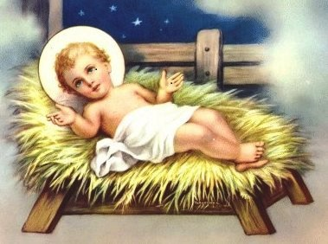
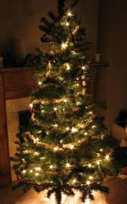
Christmas in Poland

Slide 2
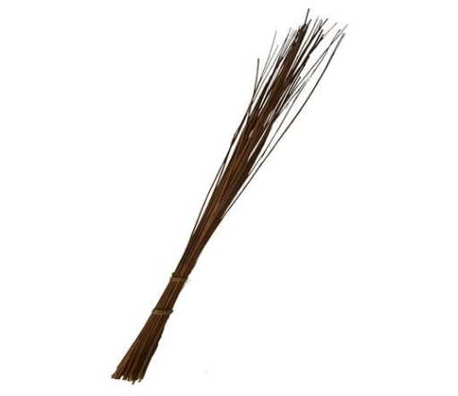
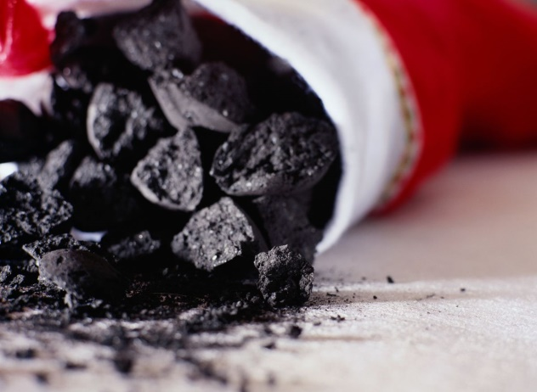
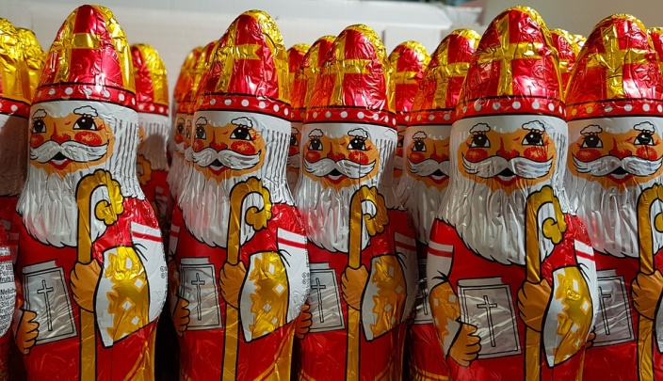
The Day of Saint Nicholas
The day of st Nicholas known as „DZIEŃ SWIĘTEGO MIKOŁAJA’’ celebrated on the 6th of december is the unofficial beginning of the festive season in Poland. Well-behaved children receive small gifts like sweets or toys on the day, whereas naughty children receive a lump of coal or a twig, called "rózga".

Slide 3
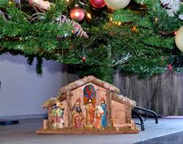
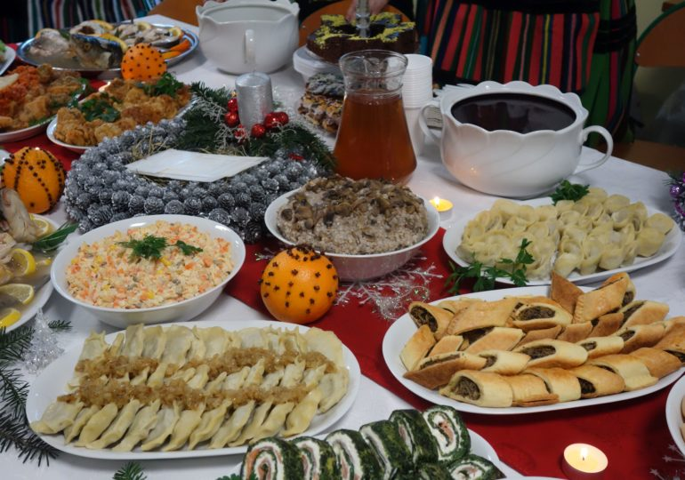
Christmas eve
The christmas eve („wigilia”),celebrated on the 24th of december is one of the most longstanding and widely cherished of Polish rituals. In the majority of homes, both among believers or non-believers, a formal meal is celebrated and served on the table which is covered with a tablecloth.

Slide 4
The following days
The 25th of december/1st day of christmas and the 26th of december-the 2 days after the christmas eve is when we celebrate the Birth of christ.it is a national holiday,off work and school.It is often a time to meet friends and family and have a meal together.

Slide 5
POLISH CHRISTMAS TRADITIONS

Slide 6
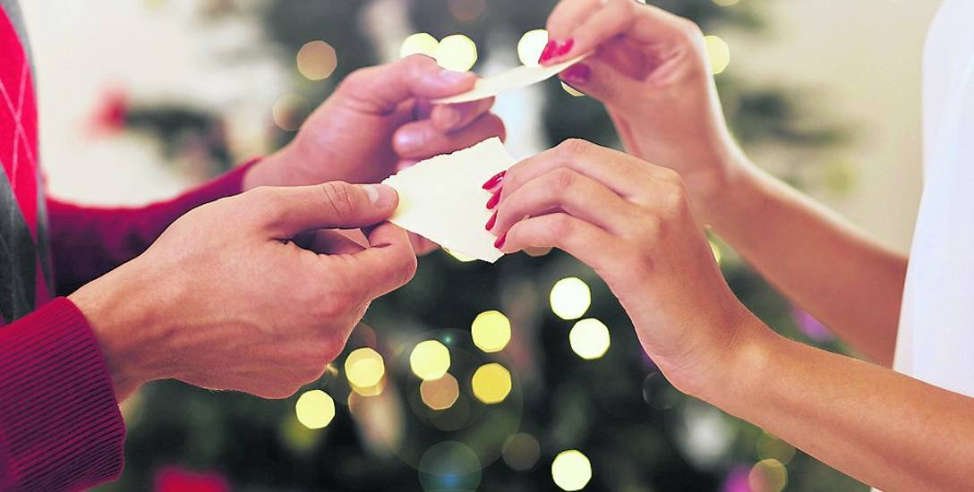
Sharing wafer
Sharing wafer („Opłatek”) is an old polish tradition of breaking the wafer before the christmas supper and expressing one’s good wishes for the following year.The wafer usually has a symbol of jesus or saint on it.

Slide 7
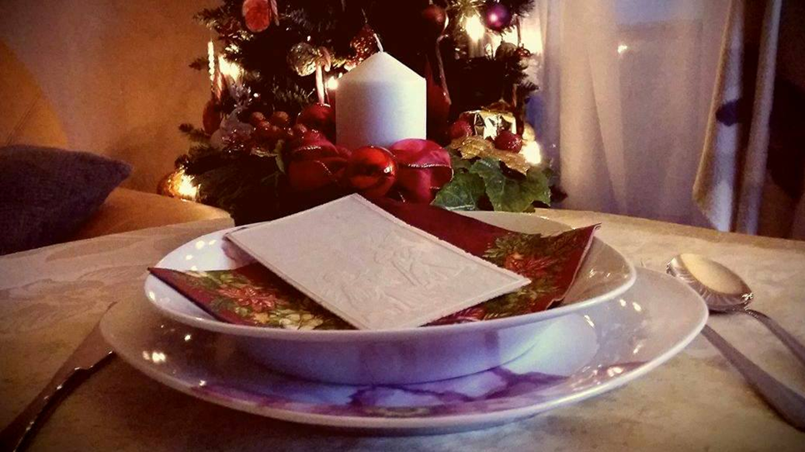
Extra seat
Many Poles leave an empty place at the table in case a person shows up and asks for shelter. While this rarely happens nowadays, the tradition nevertheless requires that lone strangers be taken in and treated as family.

Slide 8
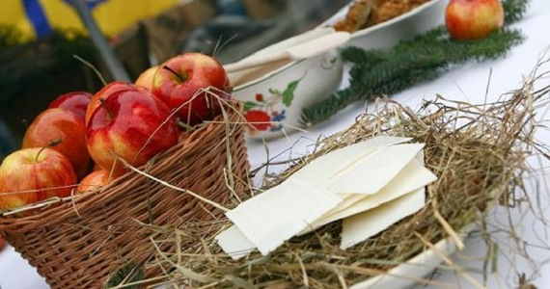
Hay on the table
Many families leave a piece of hay on the table as a symbol of the place jesus was born-a stable

Slide 9
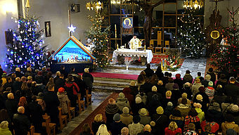
Midnight mass
Midnight mass („pasterka”) is a mass celebrated at midnight following christmas eve to commemorate the prayers of those on their way to bethlehem

Slide 10
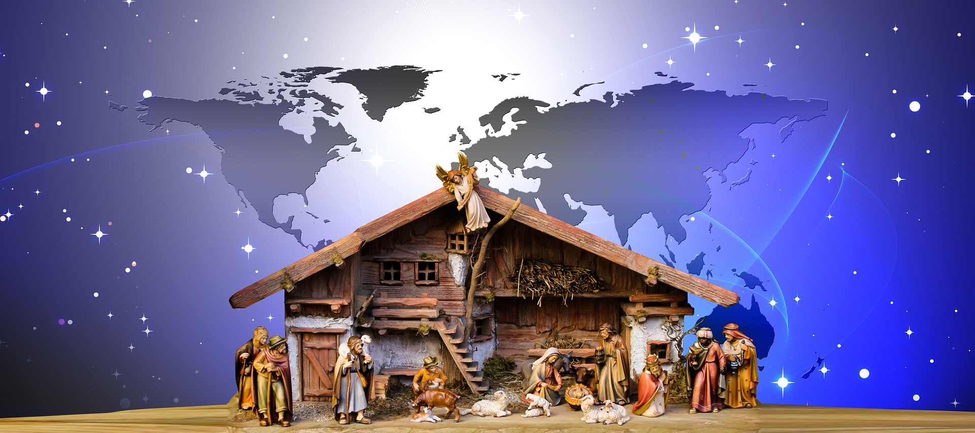
jasełka
Jasełka is a traditional polish play in the memory of the birth of jesus.The performance shows the story of mary,st Joseph,Jesus and the road that the shepherds had to face to get to bethlehem in time.It is played in schools or churches.

Slide 11
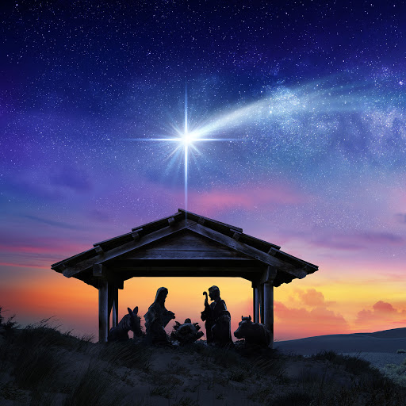
fasting
Christmas Eve is a day of fasting and not eating meat (only fish) followed by a dinner which in most homes starts with the appearance of the first star.Just after that you’re allowed to open your present.

Slide 12
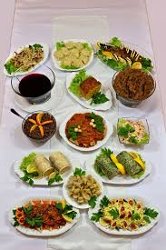
12 dishes
Having 12 dishes on the table is an essential tradition in all polish homes.12 is the numer of the apostoles of jesus.In many homes families believe you have to taste every dish on the table for the supper to end.

Slide 13
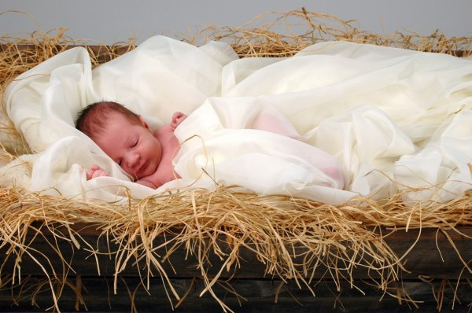
Silesian customs
Silesia is a region of poland situated in the southern-West of the country.Some of the most interesting traditions is putting money under your plade which privides everyone from poverty.
Silesians are also the only poles that believe that baby jesus is the one bringing presents at christmas eve

Slide 14
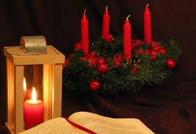
advent
Advent is a 4 week period of preparation before the Navity of Jesus,it is a religious practice

Slide 15
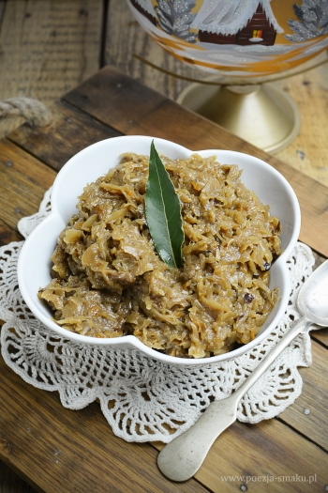
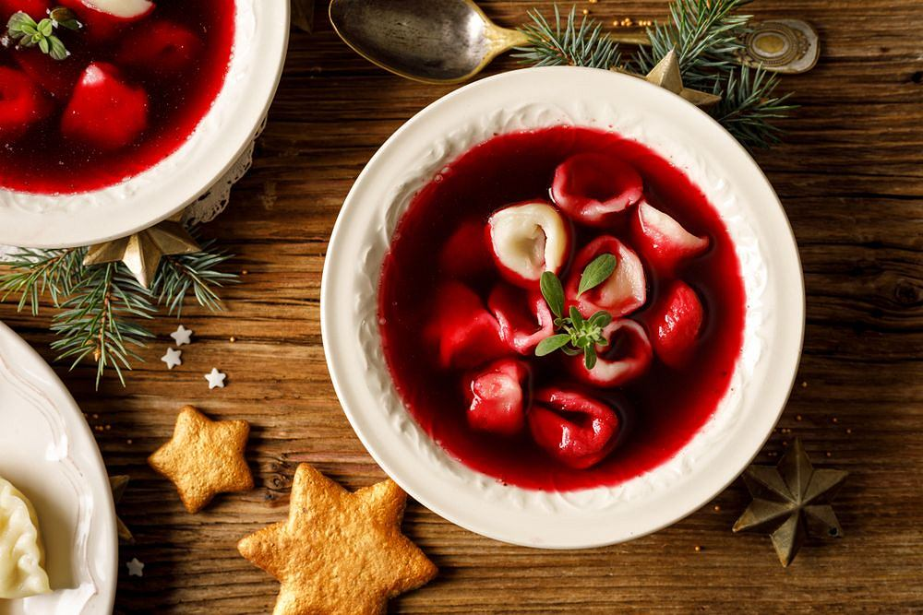
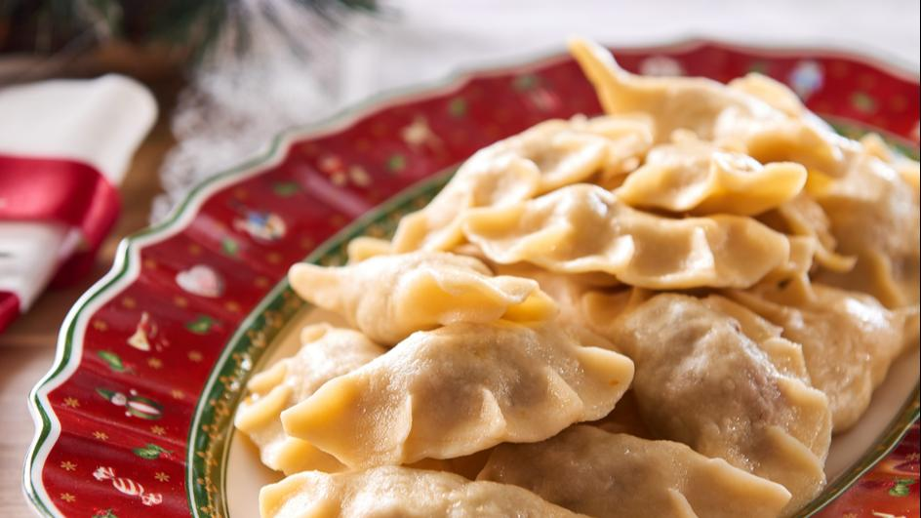
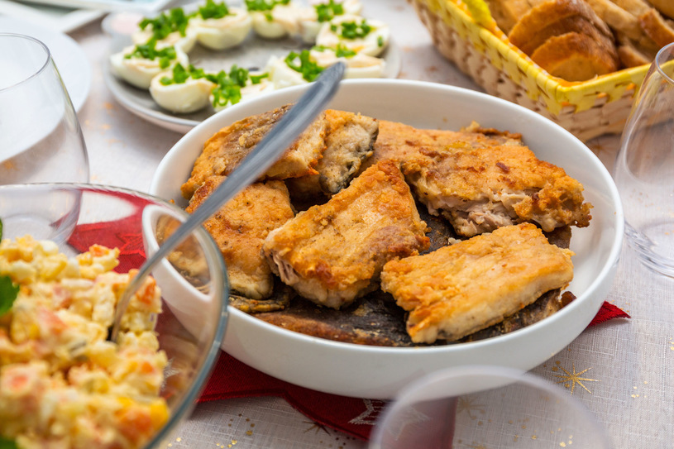
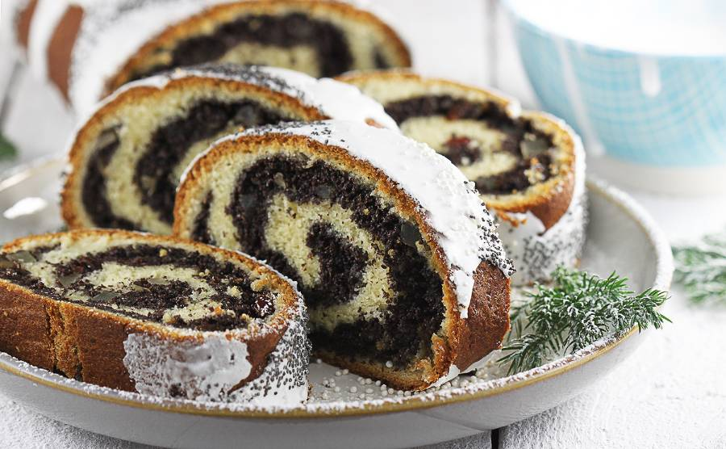
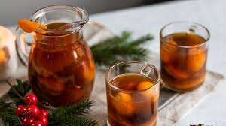
Traditional dishes
Barszcz z uszkami
PIEROGI
CARP
SAUERKRAUT WITH PEAS OR MUSHROOMS
POPPYSEED CAKE-MAKOWIEC
DRIED FRUIT COMPOTE

Slide 16
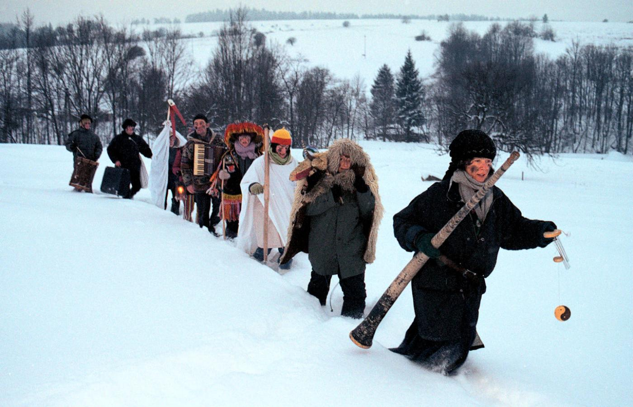
CHRISTMAS CAROLS
Christmas carols are serious and religious in character, yet it is customary to sing them after dinner.There are television channels that stream christmas charol concerts.
Caroling on Christmas Eve - In some parts of Poland, especially in the countryside, there are groups of carolers going house to house, caroling or performing a short nativity play.
https://www.youtube.com/watch?v=SX5xO4BPRIo&list=PLwDZdwbUx2F0XVyrrJ_SVtfYzxaE17hhD&index=3

Slide 17
Thank you for your attention
Author: Aleksy Więdłocha

