Slide 1
Journeys for Peace – dissemination activities and projects at our school

Slide 2
The results of the DNA experiment
The experiment which we did in Italy had been presented during some Biology lessons at our school.
The lessons were coordinated by our Biology teacher Dr. Priczkat.
The students discussed about the most important subjects and also during the extracurricular Erasmus+ - working group meetings.

Slide 3
Our two dissemination activities
„Spiele Café – Come and play for peace!“
This activity took place June 21st at the Diakonie Center Bitterfeld.
We students from our school who are involved in the Erasmus+ - project came to the Diakonie.
We brought games and cake with us.
Together with refugee families and immigrants we played these games, ate the cakes and talked with each other.

Slide 4
The poster advertising for the „Spiele Café – Come and play for peace!“

Slide 5
Cake for peace!

Slide 6
We played some nice games…

Slide 7
…and had lots of fun.

Slide 8
Head coordinators from Heinrich – Heine – Gymasium, Jugendmigrationsdienst Diakonie Bitterfeld and BiWoRegio: Mrs. Neubert, Mrs. Milde, Mrs. Hampel.

Slide 9
We talked about our daily life…

Slide 10
…and learned from each other.

Slide 11
Presentation of the project „Journeys for Peace!“
June 27th in 2018 was our last school day before summer holidays.
Mrs. Neubert, Mrs. Schuchert and a few students involved in the project presented it to all the classes of Heinrich – Heine - Gymnasium.
They told them about the project´s single phases and results including
our questionnaire results
C1 in Wolfen
C2 in Italy and
the activity at Diakonie Bitterfeld.

Slide 12
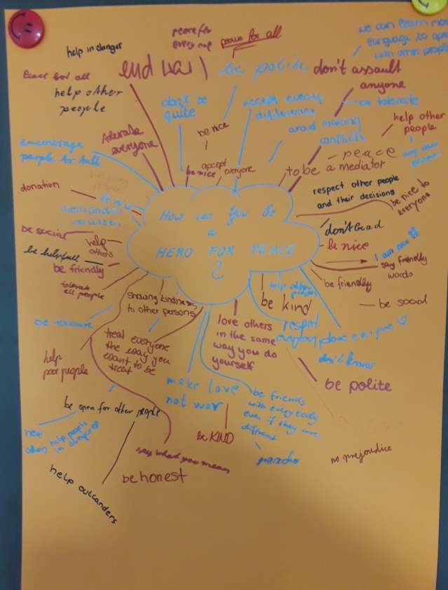
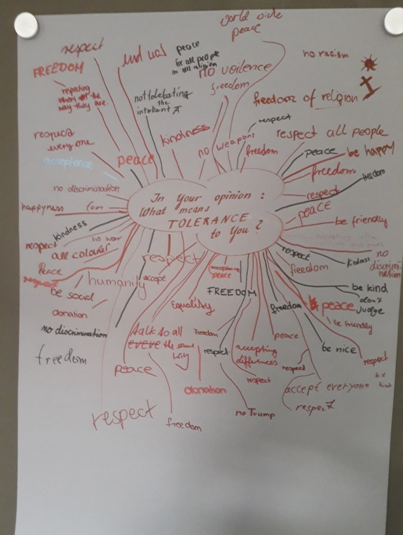
The students listening to the presentation had to reflect on the meaning of tolerance and how they could become a hero for peace.

Slide 13
Work on peace heros
Every member of the Erasmus+ - group had to create a poster and a Power Point Presentation to inform the listeners about a certain global, German or local peace hero.
Afterwards there will be a creative work which we hopefully can present in Spain- but that is a surprise.

Slide 14
Work in progress…

Slide 15
Poster of Aung San Suu Kyi

Slide 16
Poster of Malala Yousafzai

Slide 17
Poster of Mrs. Fischer who is very committed in social projects and work with refugees:

