Slide 1
Warsaw Schools Support System – a new and innovative work model
Paulina Wawer
Justyna Zaremba
Ferrol, October 2017

Slide 2
Warsaw https://www.youtube.com/watch?v=Th6eOcGxc3w

Slide 3
WCIES Warsaw Centre for Socio-Educational Innovation and Training
local government-operated teacher development facility, an institution providing knowledge and education, whose work is perfectly reflected by the motto
“Warsaw – the City of Education”.

Slide 4
Warsaw Schools Support System Aims of programme: enhancement of the quality of work at educational institutions in three areas
Didactic methods
Childcare
Pedagogy

Slide 5
To learn or to be taught?

Slide 6
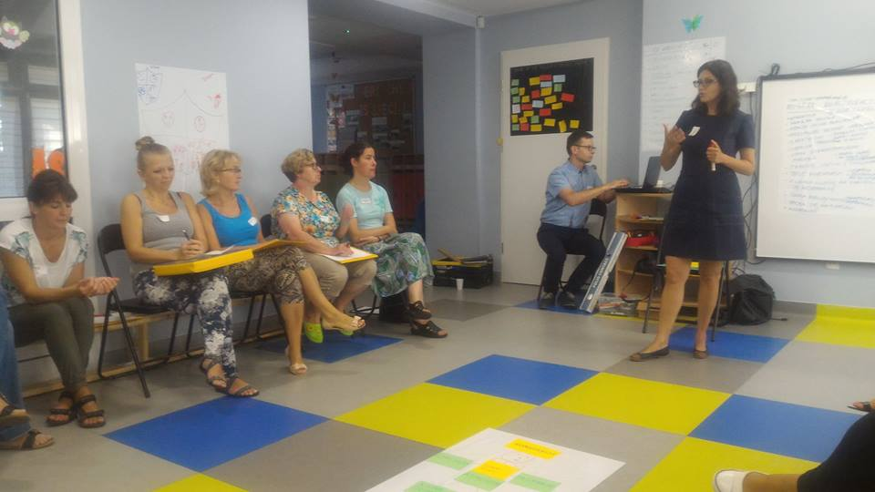
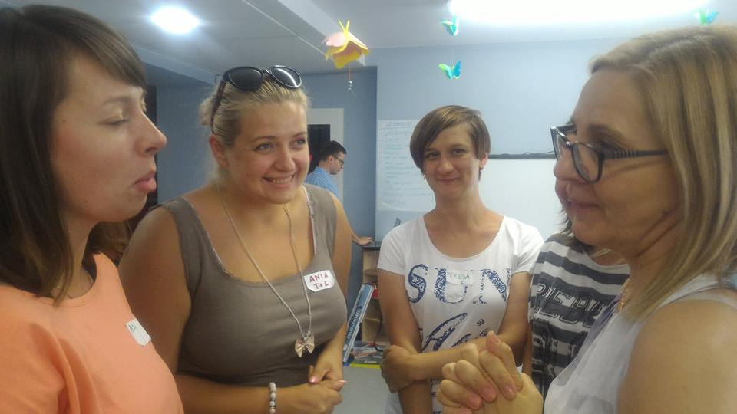
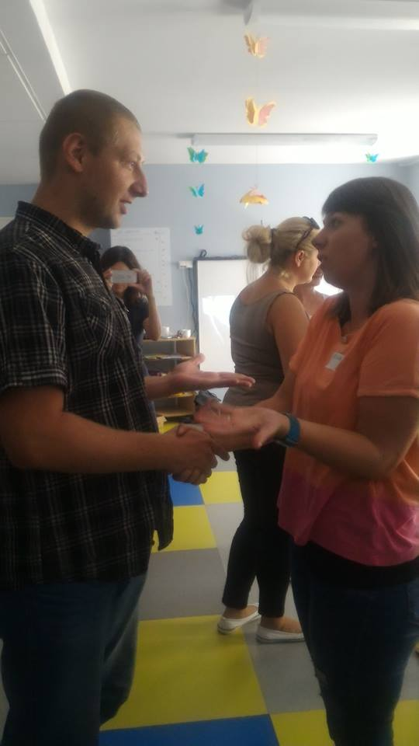
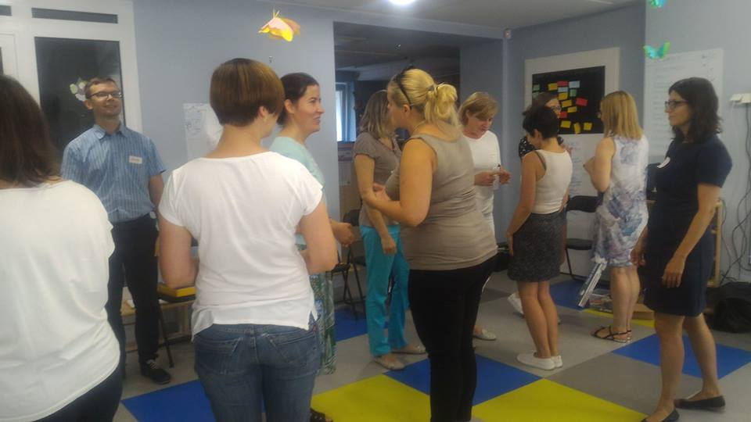
Key word – involvement

Slide 7
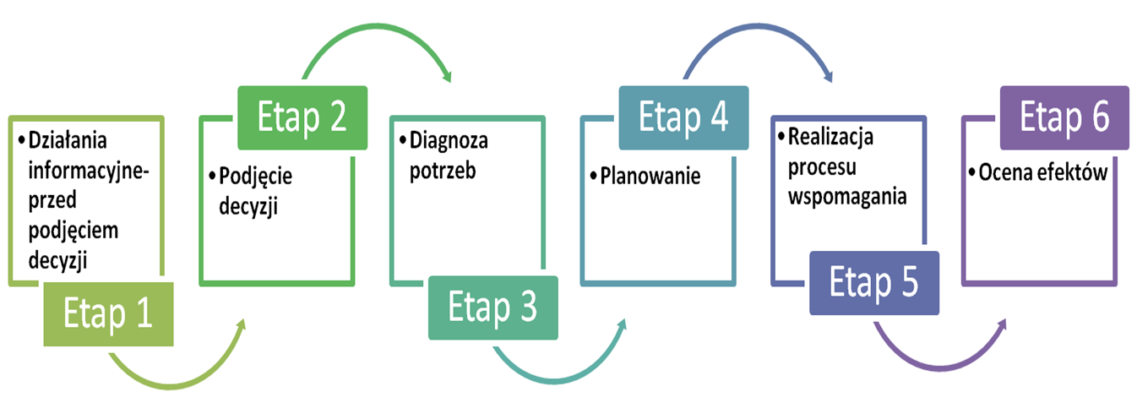
Step 3 Diagnosis of needs
Step 5 Implementation of the support programme
Step 1 Actions undertaken before making a decision
Step 2 Decision moment
Step 4 Action planning
Step 6 Assesments of the results

Slide 8
School year 2016/2017 93 Educational institutions – kindergartens, schools, school complexes, playgrounds 1814 Teachers and headmasters 3190 hours of trainings and counselling at schools 117 experts working with teachers 6 WAW

Slide 9
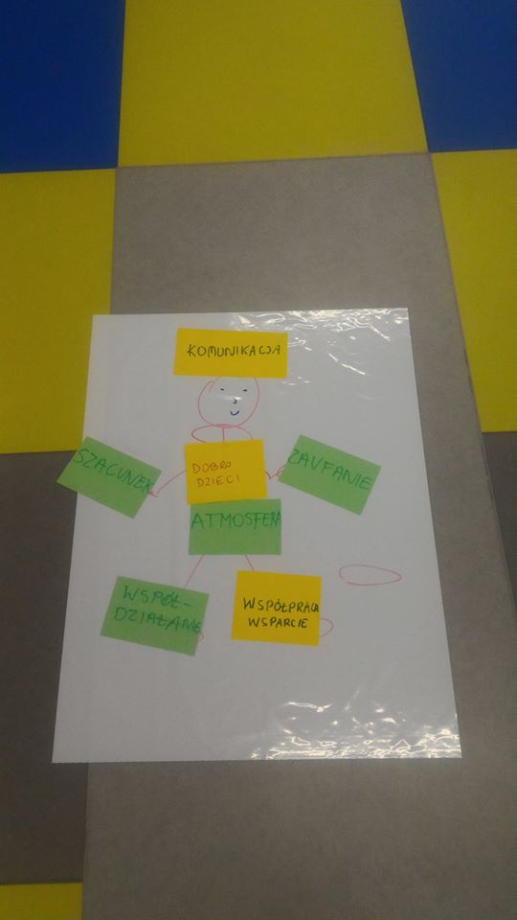
Head – communication
Right hand –
respect
Left hand – Trust
Belly – the welfare of children and atmosphere
Left leg – support
Right leg – cooperation

Slide 10
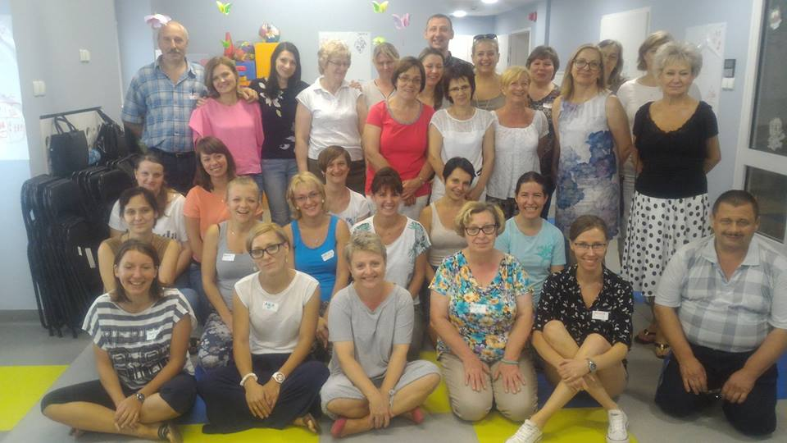
Does not matter who you are and where you are you always have the power to change the system. If you are a teacher, you are that system for your students. A whole community can benefit from a vibrant school, as it becomes a source of hope and creative Energy. Ken Robinson „Creative Schools”.

Slide 11
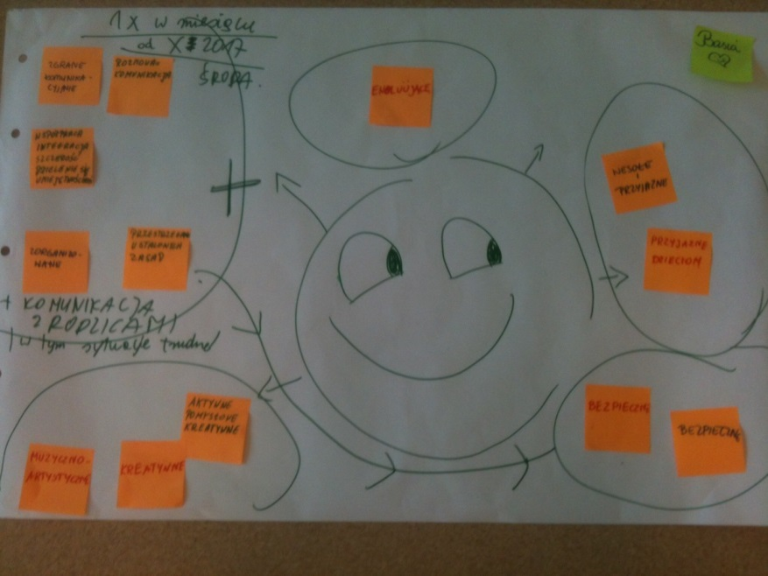
Start a positive change: Think about one thing you would like to change Start act now and change the world for the better

Slide 12
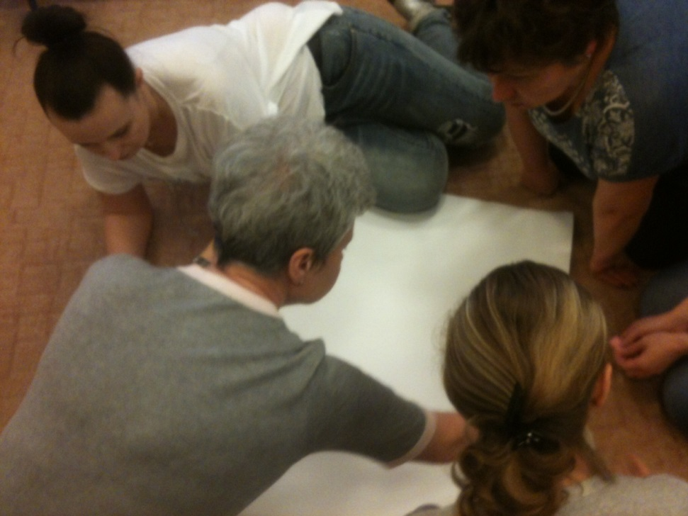
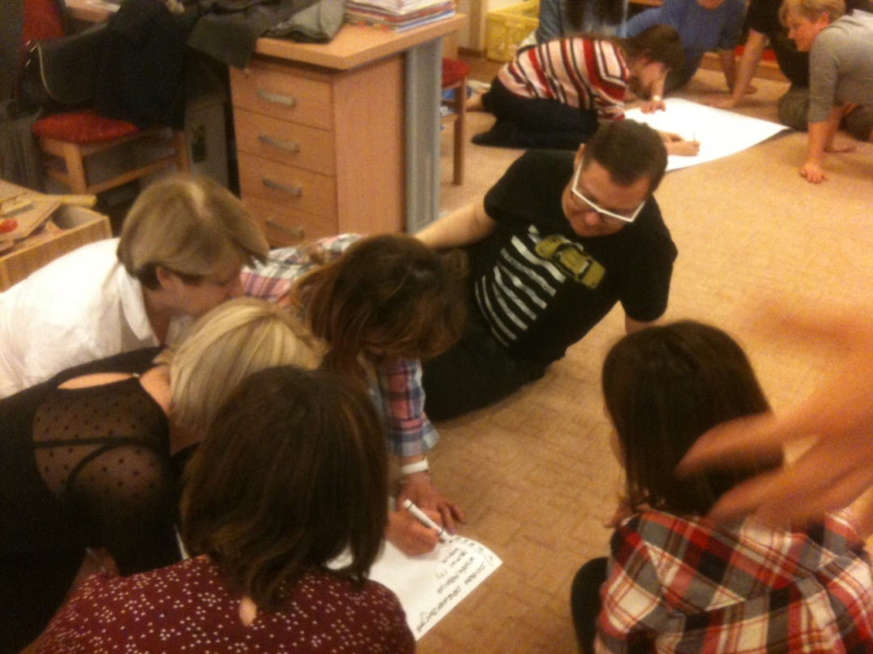

Slide 13
Gracias!

