Slide 1
Present for the future
Members: Leonora, Vanessa, Alex, Jan, Gabrielle(FRAN), Mallory(FRAN), Rizoiu(ROM), Alexandru(ROM), Yigit(TURK), Derya(TURK)

Slide 2
Assignment:
Present the historical development of these nature reserves.
In this context, also consider the specific features in the past, the present and the future.

Slide 3
Biesterberg
Historie:
Until 1993 the area was used as a military training ground for British troops. Today the military training site is a nature reserve.
Today’s nature reserve:
1953-1990: tank driving ground and training area for the British army
had its roots pushed up by the tanks
neither biocides nor fertilizers were used here during the past 60 years
high biodiversity
is highly structured

Slide 4
Results of 2000/2003 investigation:
Home of interesting insects, birds, mammals, amphibians, plants
2009: designation as a nature reserve
Development without destruction:
1994: less open space
2004: more woody plants
2000:
- highly structured
- wood in place of flowers
- sharp borderline
- higher vegetation = homogenious structure
- management : tractor instead of tanks
- different management: once in a year/ two times used

Slide 5
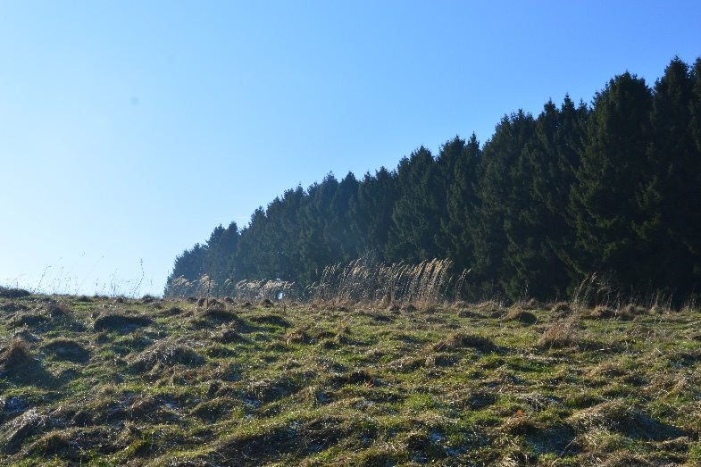

Slide 6
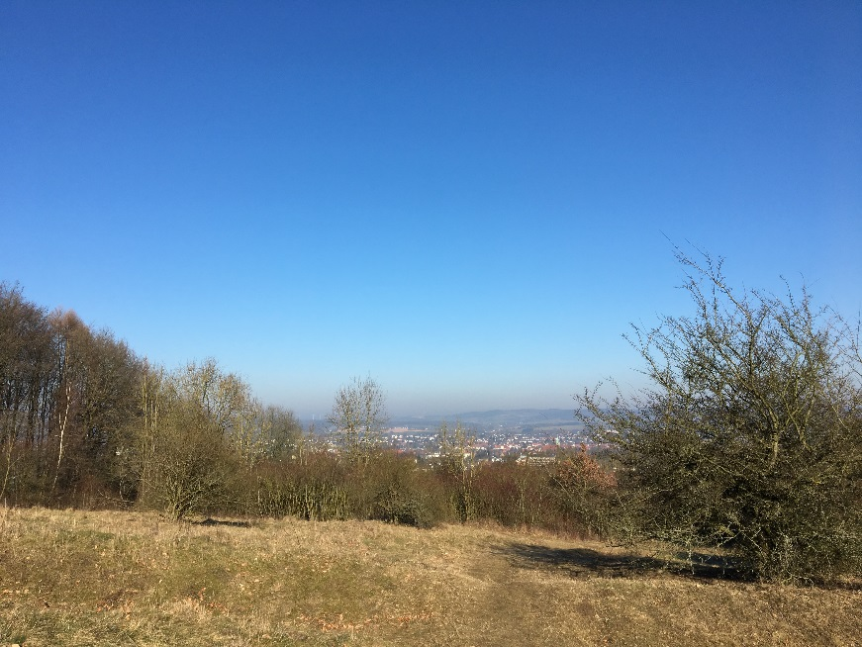

Slide 7
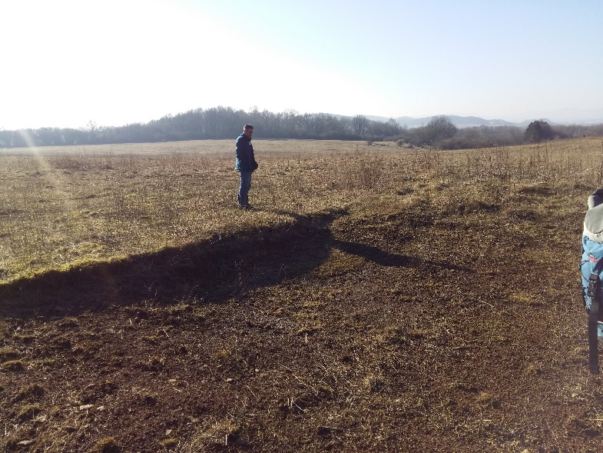

Slide 8
Senne
Heather surfaces are not natural landscapes but rather remains of former farming activities
After the clearing of the original oak-birch forest developed the heath farming industry
More nutrients were taken than introduced
Until about 1950, the old heathland was swept by the farmers in the nature conservation area
Heather surfaces are abandoned fields > rectangular and very flat
Problems: Burying, High Grass, Disturbing plants
Is solved by sheep weaving, sometimes machine positioning

Slide 9
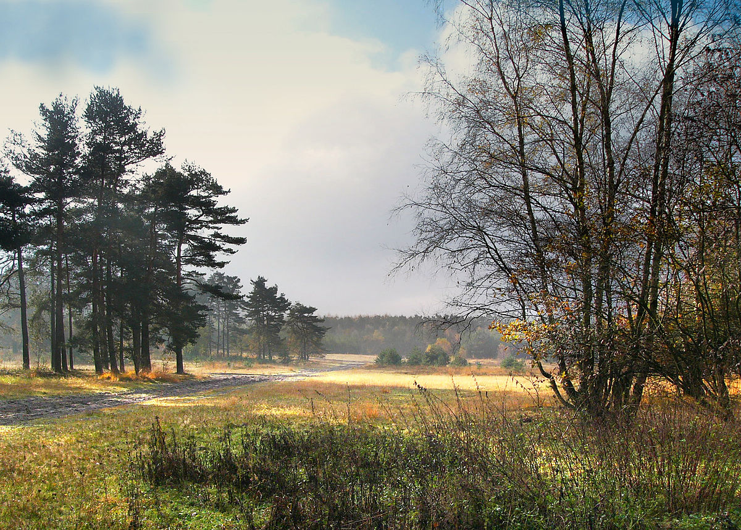

Slide 10
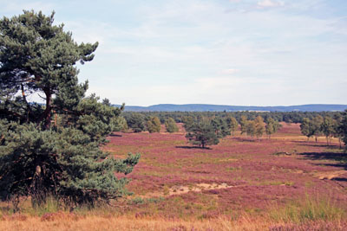

Slide 11
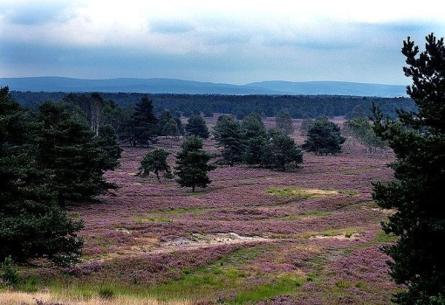

Slide 12
Bega
Nearby is the castle of Brake, built in the style of the Weser renaissance and the local mill museum
Years ago there was a swimming pool
In 1969 they built some train rails which were closed and rebuilt in 1980 in another place
Only the nobles had the right to own a plantation

Slide 13
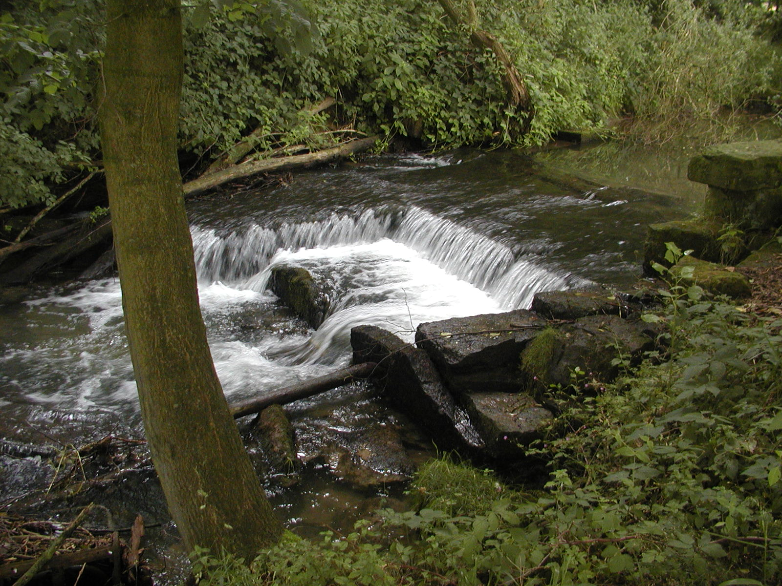

Slide 14
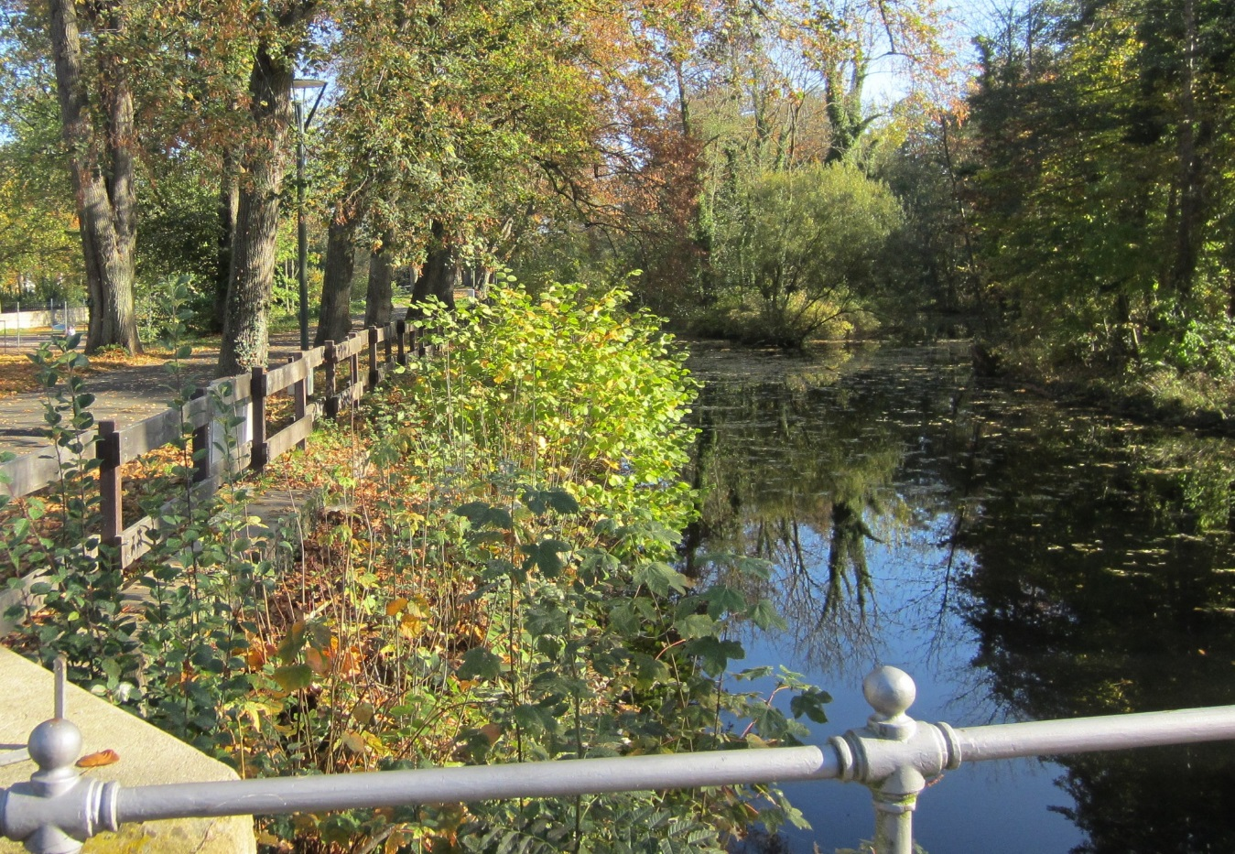

Slide 15
