Slide 1
Logo Competition
Present for the Future

Slide 2
Introduction
We needed an amazing logo for our project which would represent us
To choose our logo for the project “Present for the Future” we had to do a competition.
Further we would like to give you a little overview of this competition.

Slide 3
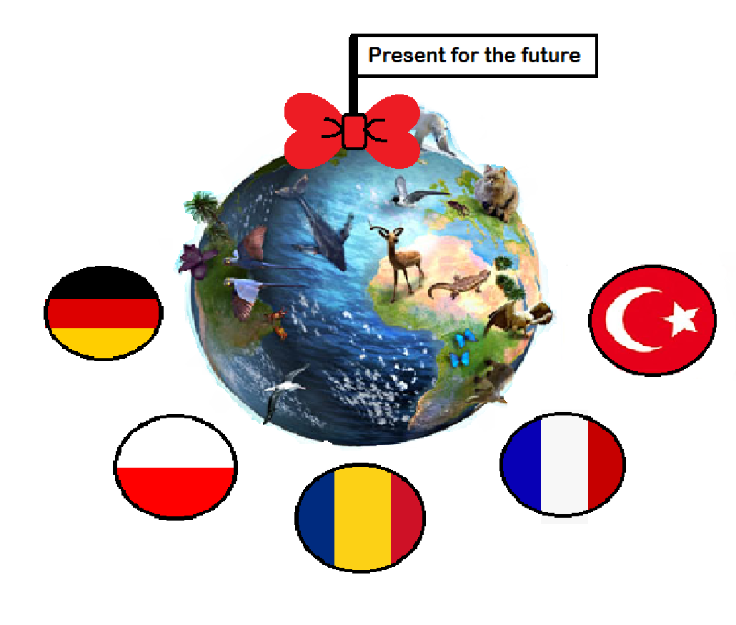
First Steps in our Class
First of all each country created a few logos on their own
We had to be very creative and use our imagination to create an impressive logo
Then we started a little competition in class where we picked our favorite logo, afterwards we introduced this one to the international group and choose again

Slide 4
International competition
One of our first steps when the international members were in Germany was, to show our best logos to the others
After we saw all of them we hold a competition to choose our favourite logo
The best logo of our project was from Turkey ,although all logos were pretty impressive
The winning logo is now the logo which we use for our project

Slide 5
The winning logo

