Slide 1
typical animal species and plant species
Biesterberg, Senne, Bega

Slide 2
Assignment
Name and describe typical animal species as well as plant species that have adapted to the specific features and conditions in the nature reserve
Also mention those species of animals and plants that are particularly threatened when it comes to changes of abiotic and biotic factors.

Slide 3
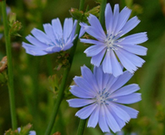
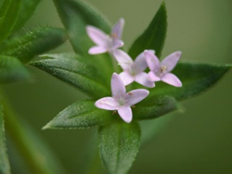
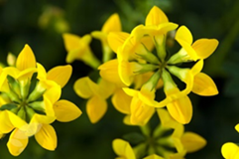
Biesterberg - plants
Common chicory (Cichoriumintybus) Sherardia (Sherardiaarvensis)
Birdsfoot trefoil (Lotus corniculatus)

Slide 4
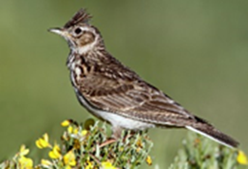
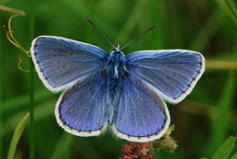
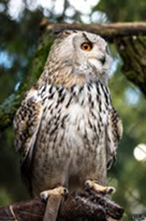
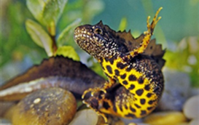
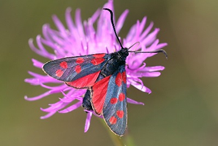
Biesterberg - animals
Red-backed shrike Skylark (AlaudaArvensis) Restharrow chalk-blue (LanniusCollurio) (Polyommatuslcarus)
Owl (BubuBubu) Great crested newt Six-spot burnet (Trituruscristatus) (ZygaenaFilipendulae)

Slide 5
Biesterberg
Animals that live in Biesterberg like slightly open, sunny areas
Due to this, these animals would disappear if the forest overgrew
Tanks have stopped driving there and the forest will overgrow if we do not do anything about it
Mostly consists of nutrient-poor, barren grassland

Slide 6
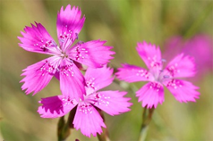
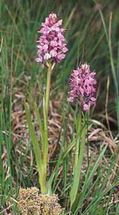
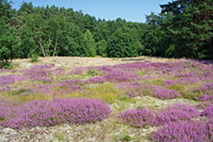
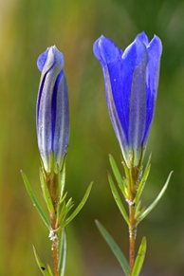
Senne - plants
Maiden Pink Sphagnum Marsh Orchid Flowering Heather
(Dianthusdeltoides) (Dactylorhizasphagnicola) (Calluna vulgaris)
Marsh Gentian
(Gentiana pneumonanthe)

Slide 7
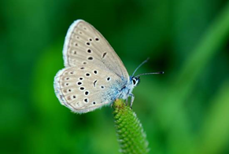
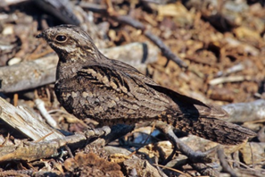
Senne - animals
Alcon Blue Butterfly European Nightjar
(Phengaris alcon) (Caprimulgus europaeus)

Slide 8
Senne
Approx 200,000 years ago the glacier edge in the Teutoburger wood formed a an incredible scenery within Central Europe. At the core of this mosaic of rare habitats you find the Senne -12,000 acres which are currently used as military training ground
More than 5,000 plants and animal species are to be found here – more than 500 of which are claimed to be endangered
Special features of this scenery:
- Inland dunes
- Humid and dry moor surfaces
- The purest of water

Slide 9
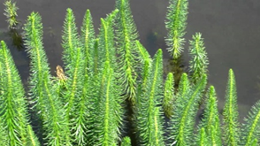
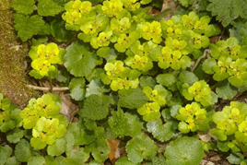
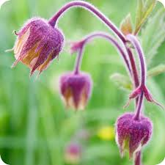
Bega - plants
Mare’s-tail Alternate-leaved golden-saxifrage Water avens
(Hippuris vulgaris) (chrysosplenium alternifolium) (Geum rivale)

Slide 10
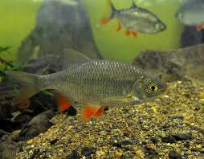
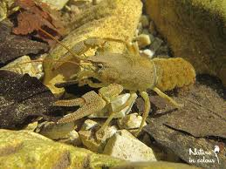
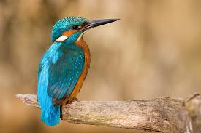
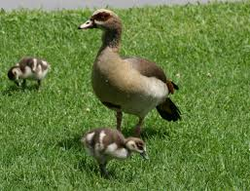
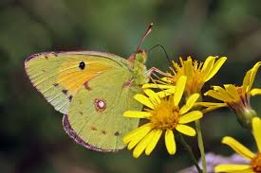
Bega - animals
Common rudd Stone crayfish Common kingfisher
(Scardinius erythrophthalmus) (austropotamobius torrentium) (alcedo atthis)
Egyptian goose Colias croceus
(Alopochen aegyptiacus) (Colias croceus)

Slide 11
Bega
In the upper part the Bega runs very slowly because of its windy course
It has pretty much kept its natural condition
Due to this the Bega is home to endangered species as well as rare plants
As a consequence the Begatal became a designated nature reserve in1996

Slide 12
Thanks for listening

