Slide 1
Dear Visitor! Visiting this region of the Krakow-Częstochowa Upland remember that its origin dates back to 150 million years back - the days of the Jurassic Sea. Please, respect it! The Towarne (or Towarnie) Mountains They are an ecological ground. Their highest peak is Lisica (349 m.n.p.m.), and their beauty is formed by groups of limestone rocks with fanciful shapes, covering caves with rich dripstone formations (Niedźwiedzia, Dzwonnica, Cabanowa Caves), often inhabited by bats. You will find here rare plants (galium cracoviense, southern bludgeon) This is an extraordinary place that used to be covered in the beech forest. Man changed it into treeless hills, littering them and destroying with quad rides. Let's protect the place! Be delighted by its uniqueness and let them survive so that future generations can admire its beauty. Do not litter! Do not devastate the rocks and caves! Do not destroy the plants! Do not frighten the animals! Be eco! Admire!

Slide 2
Implementation of the project "Present for the future - protection of the natural environment in tourist areas" within the ERASMUS + program (2016-2018) Five schools: Lycee Saint Caprais in Agen, Hanse-Berufskolleg in Lemgo, Colegiul Energetic in Ramnicu Valcea, and Juliusz S łowacki Secondary School in Częstochowa and Atilim Anadolu Lisesi in Izmit cooperated in the ERASMUS + project "The present for the future - protection of the natural environment in tourist areas". While working on the project, we got to know unique places in partners' countries, we look for ways to protect them and convince people to respect them. Disclaimer: This project has been funded with the support of the European Comission. This publication reflects the views of the author only and the European Commission and the National Agency of Erasmus+ cannot be held responsible for its content.

Slide 3
„The Towarne Mountains/Hills” (ecological ground)

Slide 4
The Towarne Mountains
The Towarne Mountains are a two pitched hill with the highest point - Fox of 349 m , near The Eagles' Nests Trail and the village Kusięta, near Olsztyn on the Cracow-Czestochowa Jura. The place is well-known for its caves and lime rocks, very popular with speleologists and climbers.

Slide 5
The Towarne Mountains have had the status of so called ecological ground since 2003
(The Ordinance of the Silesian Province Governor, 2003), with an area of 10,38 ha

Slide 6
The caves
The caves consist of three separate corridors of Towarna Cave, Bear Cave and Belfry Cave. The entrance to the Towarna Cave is spacious and nicely smoothed by water. The ceiling of the Bear Cave is covered in an interesting and unique dripstone called the lime milk.

Slide 7
The Towarna and Belfry Caves

Slide 12
Cabanowa Cave
The cave was created in Jurassic limestones. It has a rich but largely destroyed dripstone (glaze, stalagmites and stalactites). Bats like hibernating here, so called - large nocek ( Myotis myotis ). It was also visited by foxes (hence the other name of the cave – the Fox Cave). In the '90s troglobiont beetles ( Speonomus hydrophilus ) came to live in the cave.

Slide 13
The interior of the Cabanowa Cave

Slide 17
Myotis myotis
Big Noot (Myotis myotis) is the largest of our Polish bats. Its body is covered with grey-brown fur on the back and bright on the belly. It has big ears and characteristic reddish, cheeks without hair.

Slide 18
Myotis nattereri
Medium-sized species. Fur on the back brown, while on the belly white. The ear is bright and long, with half the length evenly narrow, the upper part rounded, rolled inwards. Wings quite wide.

Slide 19
Myotis brandti
The species of a small size. Brown hair on the back with lighter (at adult specimens - gold) ends, on the belly brighter. The snout, the ears and membranes are dark brown or blackish.

Slide 20
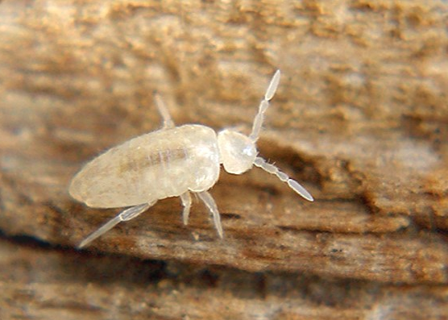
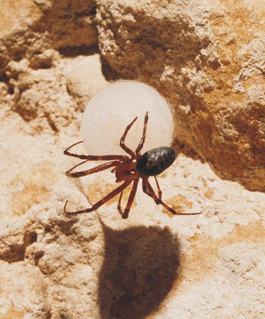
There are two indigenous species of troglobionts in the caves of the Towarnie Mountains
Arrhopoalites pygmaeus
Porrhoma moravicum

Slide 21
The Belfry Cave is the site of a successful introduction of troglobionic beetles from the Catopidae family. In 1982 A. W. Skalski, a well-known explorer of the underground fauna, brought 100 individuals of Speonomus hydrophilus, the endemic species of the l'Arize massif in the French Pyrenees, taken in the Bastardech cave, and experimentally placed them in a cave.

Slide 22
Nowhere else in Poland can you encounter such a variation in such a small area. There are over 800 species of vascular plants in the area of Olsztyn. The rich variety of species is also represented by lower plants: about 400 species of visible mushrooms visible , more than 200 species of moss. Examples include: Saxifraga paniculata and Galium cracoviense - an inconspicuous plant that grows only on the castle hill in Olsztyn, in the Towarnie Mountains and anywhere else in the world.

Slide 23
Saxifraga paniculata

Slide 24
Galium cracoviense

Slide 25
Galium cracoviense

Slide 26
The large areas of the Towarnie Mountains is occupied the so-called „ Yalovian” - groups of juniper scrub, formed on limestone grasslands. They raise the values of the landscape and contribute to the creation of microclimate with medicinal properties.

Slide 28
On the hill called : Big Towarnia there is hazelnut brushwood, with an exceptionally rare bush - kłokoczka południowa - southern bladdernut ( Staphylea pinnata )

Slide 29
Staphylea pinnata

Slide 30
pr

